Slide 1
Chapter 5.
Machine Learning 1 - Supervised Learning
AI Course

Slide 2
Chapter Description
Chapter objectives
Be able to introduce machine learning-based data analysis according to the business objective, strategy, and policy and manage the overall process.
Be able to select and apply a machine learning algorithm that is the most suitable to the given problem and perform hyperparameter tuning.
Be able to design, maintain, and optimize a machine learning workflow for AI modeling using structured and unstructured data.
Chapter contents
Unit 1. Machine Learning Based Data Analysis
Unit 2. Application of Supervised Learning Model for Numerical Prediction
Unit 3. Application of Supervised Learning Model for Classification
Unit 4. Decision Tree
Unit 5. Naïve Bayes Algorithm
Unit 6. KNN Algorithm
Unit 7. SVM Algorithm
Unit 8. Ensemble Algorithm

Slide 3
Unit 1.
Machine Learning Based Data Analysis
1.1. What is Machine Learning?
1.2. Python scikit-learn Library for Machine Learning
1.3. Preparation and Division of Dataset
1.4. Data Pre-processing for Making a Good Training Dataset
1.5. Practicing to Find an Optimal Method to Solve Problems with scikit-learn

Slide 4

1.1. What is Machine Learning?
UNIT 01
What is Machine Learning?
What is machine learning?
A statistical model that learns from data.
A rather simple model can make complex predictions.
Notes:
Traditionally decision making relied on “hard wired” combination of control structures.
Also, traditionally prediction relied on “hard wired” functions.
Machine learning is different in the sense that no “hard wiring” is necessary.
Machine learning relies on rather simple models (or algorithms) that learn from data to do the decision making and prediction.
Hard-wiring is to create a permanent function in the computer through the permanently connected circuit so that it won’t be changed by software.

Slide 5
1.1. What is Machine Learning?
UNIT 01
Samuel’s definition in the early phase of artificial intelligence
“Programming Computers to learn from experience should eventually eliminate the need for much of this detailed programming effort.” – Samuel, 1959
Modern definition
“A computer program is said to learn from experience E with respect to some class of tasks T and performance measure P, if its performance at tasks in T, as measured by P, improves with experience E.” – Mitchell, 1997 (p.2)
“Programming computers to optimize a performance criterion using example data or past experience.” – Alpaydin, 2010
“Computational methods using experience to improve performance or to make accurate predictions.” – Mohri, 2012
Notes:
Machine learning was invented as a subset of artificial intelligence related to the self-learning algorithm which makes prediction by extracting knowledge from data.
So, it is science for computer programming so that the computer can learn from data.
The common terms found in the definitions are experience, performance improvement, and computer. Thus, machine learning refers to a computer programming task to improve the performance so that the problems can be solved by using data (experience) that occur from a certain application area.

Slide 6






1.1. What is Machine Learning?
UNIT 01
Mathematical definition
Suppose that the x-axis is invested advertising expenses while the y-axis is sales.
$y$ (Target)
Question about prediction – What are the sales when random advertising expenses are given?
Linear regression
w and b as parameters
‘w’ is commonly used as an abbreviation of ‘weigh.’
$$f_{2}$$
$$f_{3}$$
$$f_{1}$$
$$y=\underline{w}x+\underline{b}$$
$x$ (Feature)
2
4
6
8
10
Since the optimal value is unknown in the beginning, start with an arbitrary value and then reach the optimal value by gradually enhancing the performance.
From the graph, it starts from f1 to continue as f1 → f2 → f3.
The optimal value is f3 where w=0.5 and b=2.0.
Notes:
There are classification and regression problems.
While the target value of a regression problem is a real number, it is a categorical value in a classification problem. (The figure above is a regression problem.)
The purpose of machine learning is to find the optimal parameter to make an accurate prediction.

Slide 7
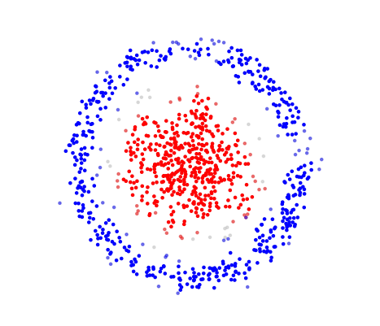
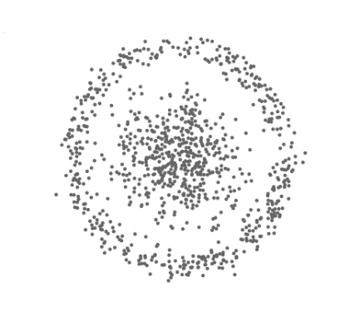
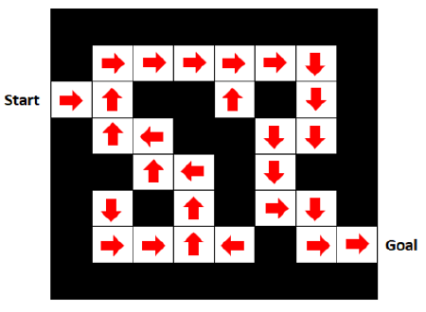
1.1. What is Machine Learning?
UNIT 01
Types of machine learning according to methods of supervision
Machine Learning
Supervised
Unsupervised
Reinforcement
Target pattern is given.
Target pattern must be found out.
Policy optimization
Notes:
There are three main types of machine learning.
When the response variable $Y$ and the target “pattern” is given, we can apply supervised learning.
When the response variable $Y$ does not exist, we should apply unsupervised learning to find out the hidden pattern.
Although very relevant, reinforcement learning will not be covered in this course.
There can be many different criteria to classify machine-learning based data analysis method depending on different perspectives, but in general, it is classified into supervised learning and unsupervised learning depending on the presence of objective variables (or response variables, output target value), and it is also further classified into reinforced learning and semi-supervised learning, etc.

Slide 8
1.1. What is Machine Learning?
UNIT 01
Machine learning workflow
Machine Learning
Feature engineering
Understanding the business and
problem definition
Pre-processing
and searching of data
Problem Definition
Data Preparation
Train
Modeling and optimization
Validate
Model training for data
Performance metrics
Test
Raw Data
Model performance evaluation
Data collection
Enhanced model performance and
application to real life
Notes:
Here, the machine learning workflow is illustrated.

Slide 9
1.1. What is Machine Learning?
UNIT 01
Machine learning types:
Type | Algorithm/Method
Unsupervised learning | Clustering
 | MDS, t-SNE
 | PCA, NMF
 | Association analysis
Supervised learning | Linear regression
 | Logistic regression
 | Tree, Random Forest, Ada Boost, XGBoost
 | Naïve Bayes
 | KNN
 | Support vector machine (SVM)
 | Neural Network
Notes:
In this table, we summarize the machine learning algorithms; some of them are supervised and some of them are unsupervised.

Slide 10
1.1. What is Machine Learning?
UNIT 01
Parameters vs. Hyperparameters
Parameters
Learned from data by training and not manually set by the practitioner.
Contain the data pattern.
Ex
Coefficients of linear regression
Ex
Weights of neural network
Hyperparameters
Can be set manually by the practitioner.
Can be tuned to optimize the machine learning performance.
Ex
$k$ in KNN algorithm
Ex
Learning rate in neural network
Ex
Maximum depth in Tree algorithm
Notes:
Here we make a clear distinction between “parameters” and “hyperparameters.”
Parameters are “learned” values from the data.
In contrast, hyperparameters are conditions set by the practitioner to optimize the performance.

Slide 11
Unit 1.
Machine Learning Based Data Analysis
1.1. What is Machine Learning?
1.2. Python scikit-learn Library for Machine Learning
1.3. Preparation and Division of Dataset
1.4. Data Pre-processing for Making a Good Training Dataset
1.5. Practicing to Find an Optimal Method to Solve Problems with scikit-learn

Slide 12
1.2. Python scikit-learn Library for Machine Learning
UNIT 01
Features of the scikit-learn library
Features
Integrated library interface by applying the façade design pattern
Installed with various kinds of machine learning algorithms, model selection, and data pre-processing functions
Simple and efficient tool to analyze predicted data
Based on NumPy, SciPy and matplotlib
Easily accessible and can be reused in many different situations
Highly compatible with different libraries
Does not support GPU
Can be used as an open source and for commercial purposes
Notes:
Façade pattern is one of the software engineering design patterns, which is commonly used in object-oriented programming. Façade means the front side of a building, and it is an object that provides a simplified interface regarding a larger different code in the software such as class library, etc.

Slide 13
1.2. Python scikit-learn Library for Machine Learning
UNIT 01
Mechanism of scikit-learn
scikit-learn is characterized by its intuitive and easy interface, complete with high-level API.
Instance
Fit
Predict /
transform
Notes:
scikit-learn is easy to use once you become familiar with four major concepts including estimator, fit, predict, and transform.

Slide 14
1.2. Python scikit-learn Library for Machine Learning
UNIT 01
scikit-learn Library
About the scikit-learn library
It is a representative Python machine learning library.
To import a machine learning algorithm as a class:
from sklearn.<family> import <machine learning algorithm>
Hyperparameters are specified when the machine learning object is instantiated:
Ex
from sklearn.linear_model import LinearRegression
Ex
myModel = KNeighborsClassifier(n_neighbors=10) # KNN with k = 10
Notes:
This is a brief introduction to the scikit-learn library.
scikit-learn is simple and easy to use.
scikit-learn is based on NumPy, SciPy and Matplotlib libraries that we have already covered.

Slide 15
1.2. Python scikit-learn Library for Machine Learning
UNIT 01
About the scikit-learn library
To train a supervised learning model: myModel.fit(X_train, Y_train)
To train a unsupervised learning model: myModel.fit(X_train)
To predict using an already trained model: myModel.predict(X_test)
To import a preprocessor as class: from sklearn.preprocessing import <a preprocessor>
To split the dataset into a training set and a testing set:
X_train, X_test, Y_train, Y_test = train_test_split(X, Y, test_size=0.3, random_state=123)
To calculate a performance metric (accuracy): metrics.accuracy_score(Y_test, Y_pred)
To cross validate and do hyperparameter tuning at the same time:
myGridCV = GridSearchCV(estimator, parameter_grid, cv=k)
myGridCV.fit(X_train, Y_train)
Notes:
With scikit-learn, we can easily train a model and make predictions.
Also, with scikit-learn calculating performance metrics, hyperparameter tuning, etc. are a breeze.

Slide 16
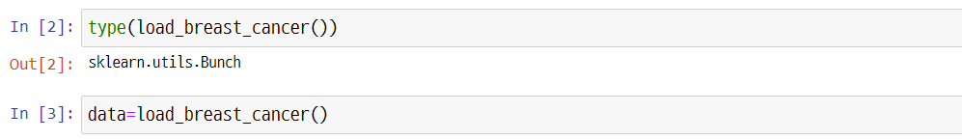
1.2. Python scikit-learn Library for Machine Learning
UNIT 01
Practicing scikit-learn
The sklearn.datasets module includes utilities to load datasets, including methods to load and fetch popular reference datasets. It also features some artificial data generators.
Import data with the load_breast_cancer().
Container object exposing keys as attributes. Bunch objects are sometimes used as an output for functions and methods. They extend dictionaries by enabling values to be accessed by key, bunch[“value_key”], or by an attribute, bunch.value_key.

Slide 17
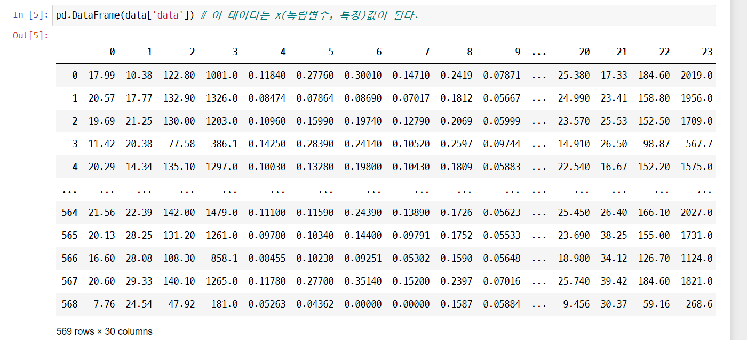

1.2. Python scikit-learn Library for Machine Learning
UNIT 01
Practicing scikit-learn
Line 5
This data becomes x (independent variable, data).

Slide 18
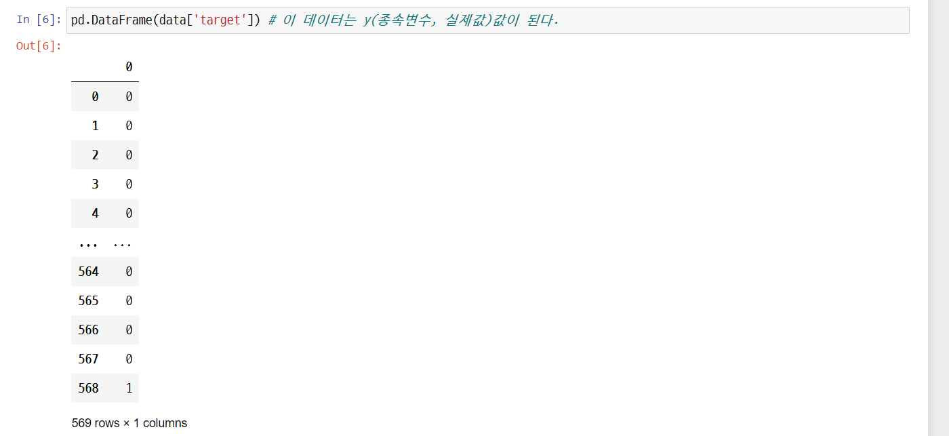
1.2. Python scikit-learn Library for Machine Learning
UNIT 01
Practicing scikit-learn
Line 6
This data becomes y (dependent variable, actual value).

Slide 19
1.2. Python scikit-learn Library for Machine Learning
UNIT 01
Practicing scikit-learn
1
2
Line 1
Provides details about the data.
The help shows that the default value of test_size is 0.25.

Slide 20
1.2. Python scikit-learn Library for Machine Learning
UNIT 01
Practicing scikit-learn
Line 7
From the total of 569 observed values, divide the data for training and evaluation into 7:3 or 8:2. 7.5:2.5 is the default value.

Slide 21
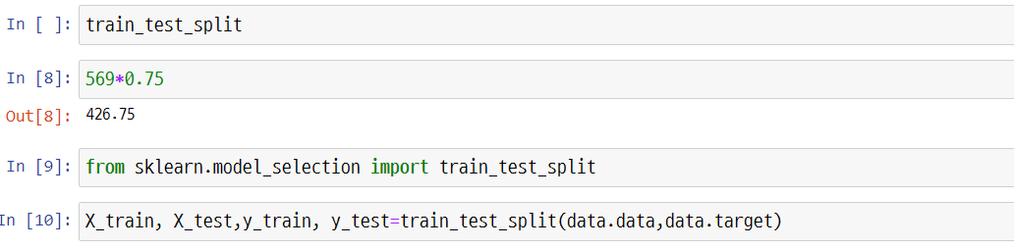
1.2. Python scikit-learn Library for Machine Learning
UNIT 01
Practicing scikit-learn
Use train_test_split() to split the data for making and evaluating the model.

Slide 22
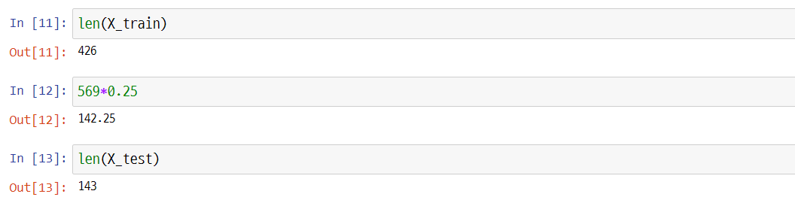
1.2. Python scikit-learn Library for Machine Learning
UNIT 01
Practicing scikit-learn
Line 11
426 observed values (75%) out of total 569 observations are found.
Line 13
143 observed values (25%) out of total 569 observations are found.

Slide 23
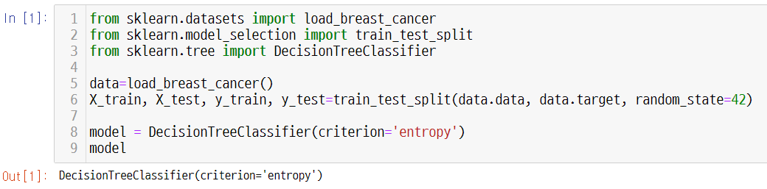
1.2. Python scikit-learn Library for Machine Learning
UNIT 01
Practicing scikit-learn
For instancing, use the model’s hyperparameter as an argument. Hyperparameter is an option that requires a human setting and greatly affects the model performance.
Line 1-5
Loading the test dataset
Line 1-8
Instancing the estimator and hyperparameter setting
Model initialization by using the entropy for branching
Notes:
Instancing is a process of selecting hyperparameters. Default values are applied to unset hyperparameters. Call the estimator to show parameter status.

Slide 24
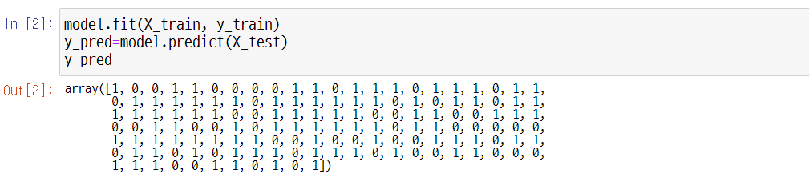
1.2. Python scikit-learn Library for Machine Learning
UNIT 01
fit
Use the fit method with an instance estimator for training. Send the training data and label data together as an argument to the supervised learning algorithm.
predict
The instance estimator that has completed training with fitting can be applied with the predict method. ‘Predict’ converts the estimated results of the model regarding the entered data.
Line 2
It is an estimated value, so the actual value for X_test may vary. Measure the accuracy by comparing the two values.

Slide 25
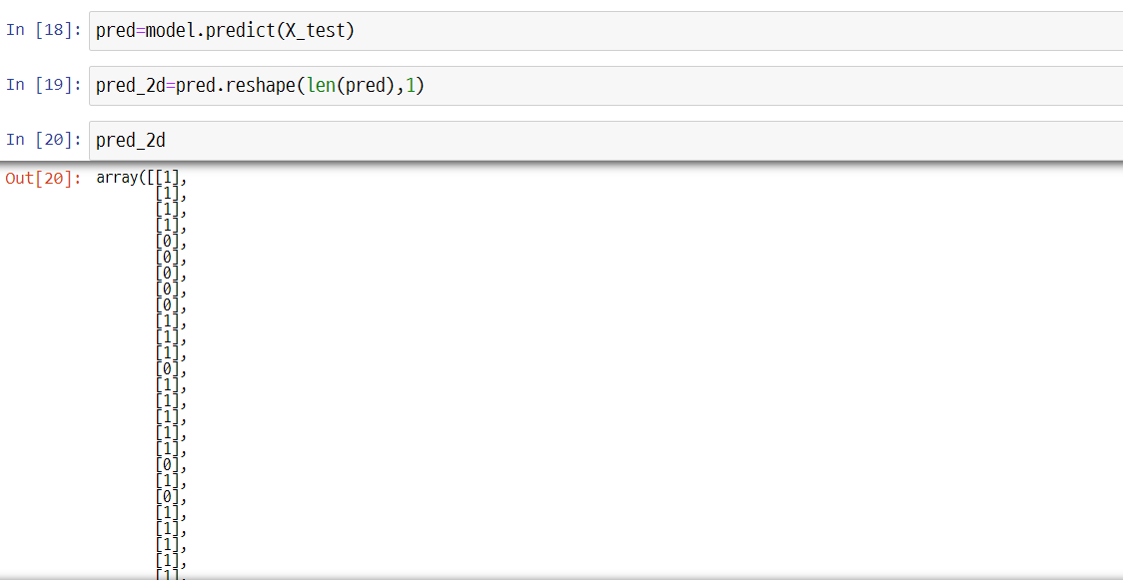
1.2. Python scikit-learn Library for Machine Learning
UNIT 01
Practicing scikit-learn

Slide 26
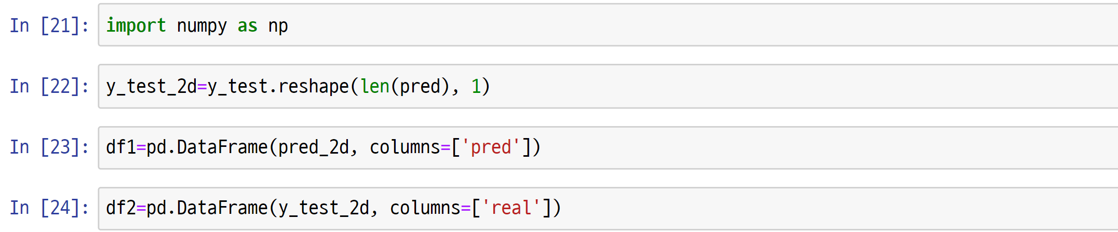
1.2. Python scikit-learn Library for Machine Learning
UNIT 01
Practicing scikit-learn

Slide 27
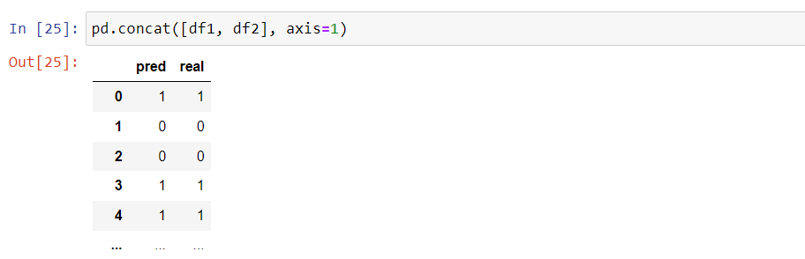
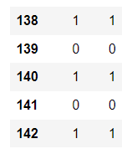
1.2. Python scikit-learn Library for Machine Learning
UNIT 01
Practicing scikit-learn
Line 25
Data frame shows a result where predicted value and actual value differ.

Slide 28
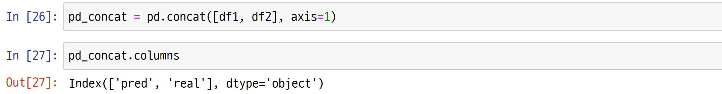
1.2. Python scikit-learn Library for Machine Learning
UNIT 01
Practicing scikit-learn

Slide 29
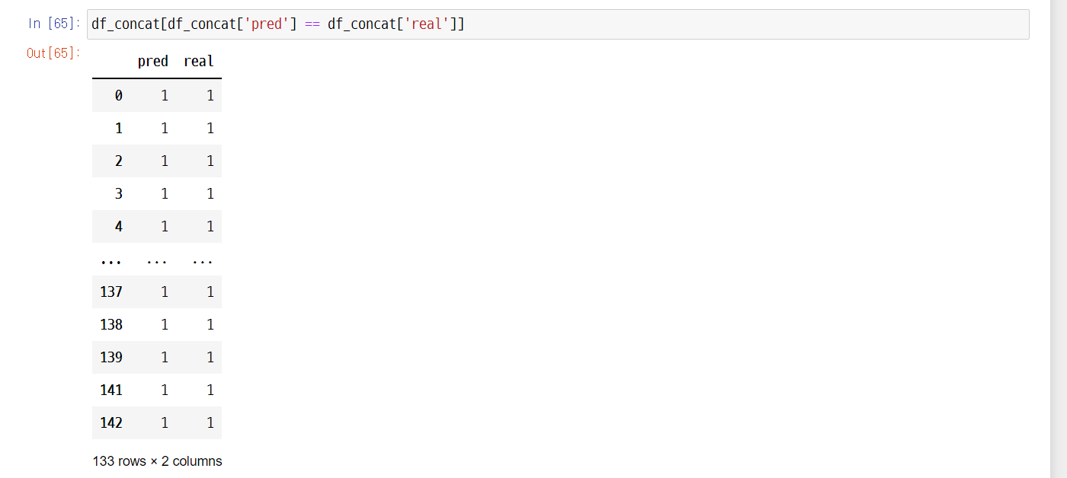
1.2. Python scikit-learn Library for Machine Learning
UNIT 01
Practicing scikit-learn

Slide 30
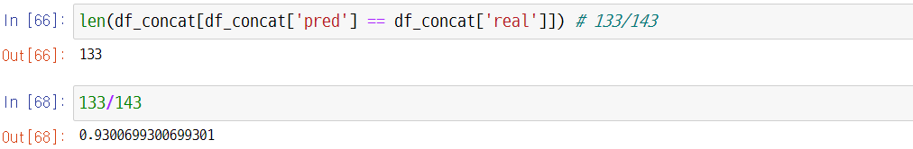
1.2. Python scikit-learn Library for Machine Learning
UNIT 01
Practicing scikit-learn
Line 66
133/143

Slide 31

1.2. Python scikit-learn Library for Machine Learning
UNIT 01
Practicing scikit-learn
It showed 93% accuracy, which is quite a rare result. In fact, a process of increasing data accuracy is required during data pre-processing, and standardization is one of the options. The following is a brief summary of standardization.
Standardization can be done by calculating standard normal distribution. Another term for standardization is z-transformation, and the standardized value is also referred to as z-score. 94% accuracy would be obtained from KNN wine classification through standardization.
Standardization is widely used in data pre-processing in general other than KNN, and the following is the equation.
$x=\frac{x−m}{σ}$ ($m:average$, $σ:$ standard deviation)
The standardization is available as StandardScaler class in the scikit-learn.

Slide 32
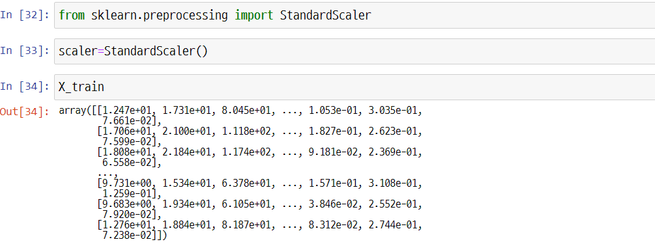
1.2. Python scikit-learn Library for Machine Learning
UNIT 01
Practicing scikit-learn

Slide 33
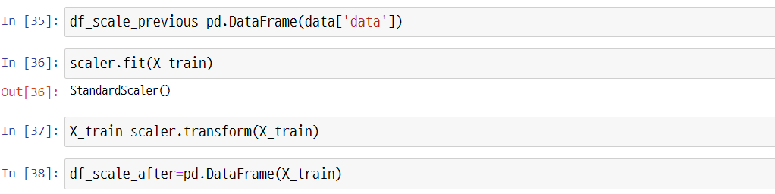
1.2. Python scikit-learn Library for Machine Learning
UNIT 01
Practicing scikit-learn
Line 35
Data frame before standardization

Slide 34
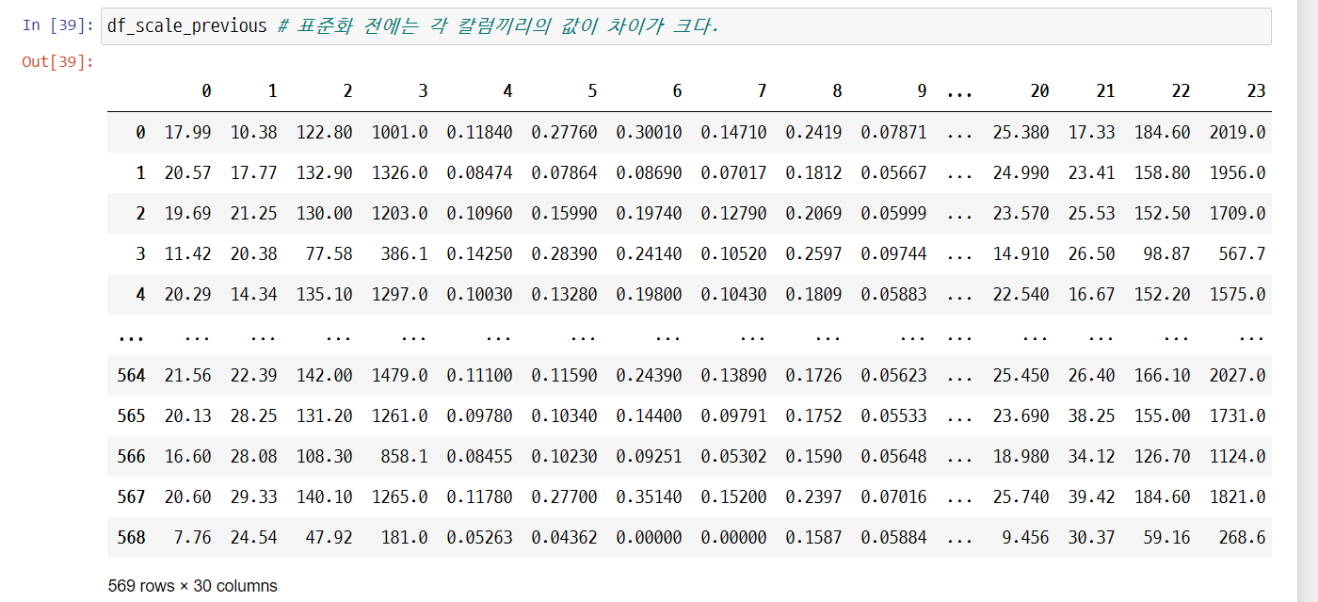
1.2. Python scikit-learn Library for Machine Learning
UNIT 01
Practicing scikit-learn
Line 39
The differences among column values are huge before standardization.

Slide 35
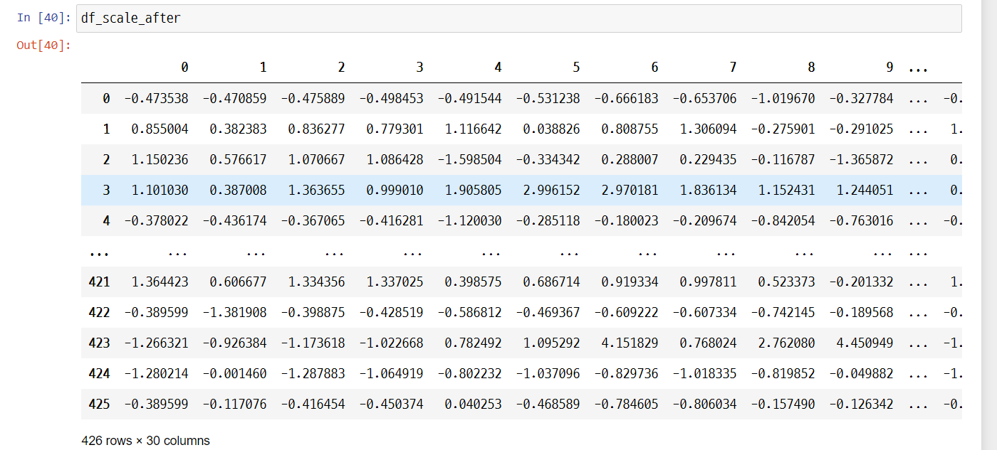
1.2. Python scikit-learn Library for Machine Learning
UNIT 01
Practicing scikit-learn
Line 40
After standardization, the column values do not significantly deviate from 0.
Better performance would be possible compared to the performance before standardization.

Slide 36

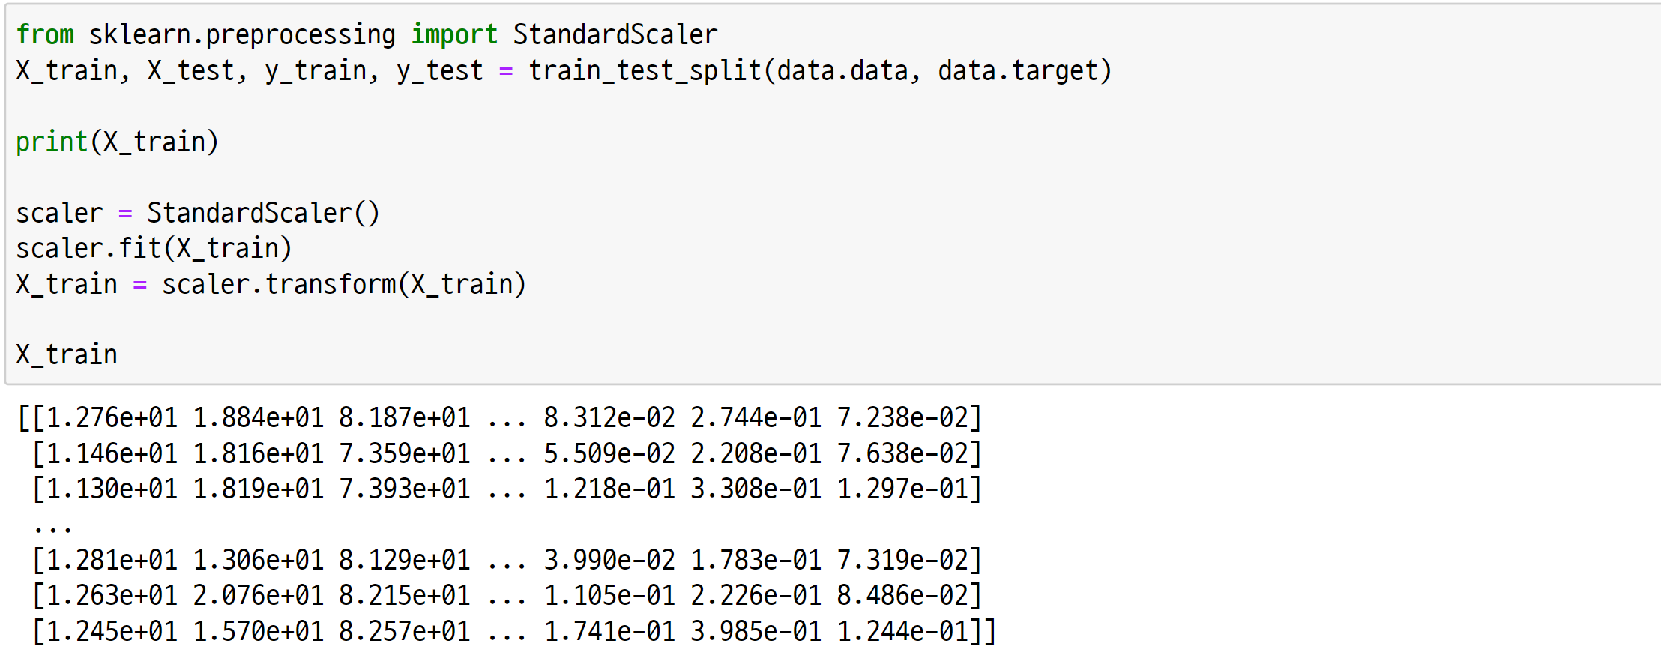
1.2. Python scikit-learn Library for Machine Learning
UNIT 01
transform
Feature processing is done with ‘transform’ to return the result.
3
Line 3-3
Output before pre-processing
Notes:
Because all of the functions including algorithms in scikit-learn are standardized as instance -> fit -> predict or transform, it is extremely easy to use.

Slide 37
1.2. Python scikit-learn Library for Machine Learning
UNIT 01
transform
Feature processing is done with ‘transform’ to return the result.
3
Line 3-7
Pre-processing – Apply scaling

Slide 38
1.2. Python scikit-learn Library for Machine Learning
UNIT 01
transform
Feature processing is done with ‘transform’ to return the result.
3
Line 3-9
Result check after pre-processing

Slide 39
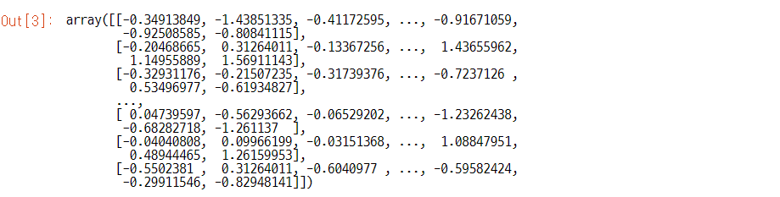
1.2. Python scikit-learn Library for Machine Learning
UNIT 01
transform
Feature processing is done with ‘transform’ to return the result.

Slide 40
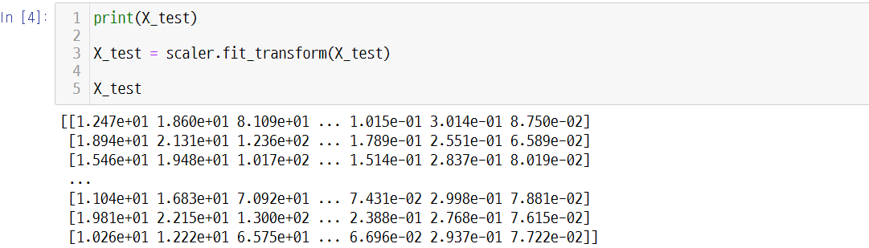
1.2. Python scikit-learn Library for Machine Learning
UNIT 01
fit_transform
Fit and Transform is combined as fit_transform.
Line 4-1 & 4-5
Before & After
Line 4-3
Combination of fit and transform

Slide 41
1.2. Python scikit-learn Library for Machine Learning
UNIT 01
Major scikit modules
Classification | Module | Embedded Functions
Data example | sklearn.datasets | Dataset for practicing
Feature processing | sklearn.preprocessing | Pre-processing techniques (One-hot encoding, normalization, scaling, etc.)
 | sklearn.feature_selection | Technique to search and select a feature that provides a significant impact to the model
 | sklearn.feature_extraction | Feature extraction from source data The supporting API for feature extraction regarding image is present in the submodule image, while the supporting API for text data feature extraction is present in the submodule test.
Dimension reduction | sklearn.decomposition | Algorithms related to dimension reduction (PCA, NMF, Truncated SVD, etc.)
Validation, hyperparameter tuning, data separation | sklearn.model_selection | Validation, hyperparameter tuning, data separation, etc. (corss_validate, GridSearchCV, train_test_split, learning_curve, etc.)
Model evaluation | sklearn.metrics | Techniques to measure and evaluate model performance (accuracy, precision, recall, ROC curve, etc.)

Slide 42
1.2. Python scikit-learn Library for Machine Learning
UNIT 01
Major scikit modules
Classification | Module | Embedded Functions
Machine learning algorithm | sklearn.ensemble | Ensemble algorithms (Random forest, AdaBoost, bagging, etc.)
 | sklearn.linear_model | Linear algorithms (Linear regression, logistic regression, SGD, etc.)
 | sklearn.naïve_bayes | Naive Bayes algorithms (Bernoulli NB, Gaussian NB, multinomial distribution NB, etc.)
 | sklearn.neighbors | Nearest neighbor algorithms (K-NN, etc.)
 | sklearn.svm | Support Vector Machine algorithms
 | sklearn.tree | Decision tree algorithms
 | sklearn.cluster | Unsupervised learning (clustering) algorithms (Kmeans, DBSCAN, etc.)
Utility | sklearn.pipeline | Serial conversion of feature processing and machine learning algorithms, etc.

Slide 43
Unit 1.
Machine Learning Based Data Analysis
1.1. What is Machine Learning?
1.2. Python scikit-learn Library for Machine Learning
1.3. Preparation and Division of Dataset
1.4. Data Pre-processing for Making a Good Training Dataset
1.5. Practicing to Find an Optimal Method to Solve Problems with scikit-learn

Slide 44
1.3. Preparation and Division of Dataset
UNIT 01
Preparation and Division of Dataset
Chapter objectives
Be able to understand the meaning and ripple effect of overfitting and generalization and design dataset division to solve issues.
Be able to properly divide the training and test datasets for machine learning technique application according to the analysis purpose and dataset features.
Be able to divide the training and validation datasets and decide the appropriate k-value for cross-validation by deciding the necessity of cross-validation according to the issue and applied technique. Be able to divide the datasets and perform sampling by considering the prediction results based on data features and classified variable distribution.
Be able to analyze differences among various sampling methods for dataset division and apply appropriate sampling methods.
Notes:
In general, k=10.

Slide 45
1.3. Preparation and Division of Dataset
UNIT 01
Necessity of dataset division
When analyzing machine learning-based data, especially when applying a supervised learning-based model, do not analyze the overall dataset but analyze by dividing the training and evaluation (test) datasets.
Overall dataset
Training dataset
(Perform K-fold cross validation if necessary)
Model
Division of
dataset
Final model
Test dataset
Performance evaluation
Machine learning modeling process through division of training and test datasets

Slide 46



1.3. Preparation and Division of Dataset
UNIT 01
Overfitting and generalization of modeling
Strictly speaking, the data included in the provided training dataset can be considered as the values obtained by chance. Hence, a new dataset obtained to predict the values of new objective variables (or response variables) is not the same as the existing training dataset.
The chance that the patterns from the training data and new data to perfectly accord is extremely low. Thus, when learning the machine learning-based model, overfitting occurs in highlighting the training dataset pattern when reflecting too much of the training dataset. At the same time, generalization for accurate prediction of new data is underperformed.
To prevent such issues, the datasets are generally divided into training and test datasets. Measure how the machine learning model learned with the training dataset accurately predicts the test dataset’s objective variables (or response variables). The resulting standard will become the model performance evaluation standard.
1st
2nd
3rd
4th
12th
$$y$$
$$y$$
$$y$$
$$y$$
$$y$$
$$x$$
$$x$$
$$x$$
$$x$$
$$x$$
Overfitting and underfitting

Slide 47


1.3. Preparation and Division of Dataset
UNIT 01
Overfitting and generalization of modeling
1st
2nd
3rd
4th
12th
$$y$$
$$y$$
$$y$$
$$y$$
$$y$$
$$x$$
$$x$$
$$x$$
$$x$$
$$x$$
Overfitting and underfitting
Even if machine learning finds the optimal solution in data distribution, a wide margin of error occurs since the model has a small capacity. Such a phenomenon is referred to as underfitting; the linear equation model on the leftmost figure above is an example.
An easy alternative is to use higher-degree polynomials, which are non-linear equations.
The rightmost figure provided above is applied with the 12th-order polynomial.
The model capacity got larger, and there are 13 parameters for estimation.
$$y=w_{12}x^{12}+w_{11}x^{11}+w_{10}x^{10}⋯w_{1}x^{1}+w_{0}$$

Slide 48
1.3. Preparation and Division of Dataset
UNIT 01
Method and Process of Dataset Division
Cross-Validation:
The data should be split into a training set and a testing set.
In principle, the testing set should be used only once! It should not be reused!
If the training set is also used for evaluation, the errors can be unrealistically small.
We would like to evaluate realistic errors while training by splitting the training data into two.
Training Data
Testing Data
Train
Cross Validate
Evaluate
Cross-Validation and Hyperparameter Optimization:
As we can repeatedly evaluate errors while training, it is also possible to tune the hyperparameters.
Notes:
Here, the concept of “cross-validation” is explained.
We cannot emphasize enough that the final evaluation (testing) should be done only once.
Usually, hyperparameters are tuned during the cross-validation phase.

Slide 49
1.3. Preparation and Division of Dataset
UNIT 01
Cross-Validation:
1) Split the data into a training set and a testing set.
2) Further subdivide the training set into a smaller training and a validation set.
3) Train the model with the smaller training set.
4) Evaluate the errors with the validation set.
5) Repeat from step 2) a few times.
Notes:
Here, the step by step procedure for cross-validation is explained.

Slide 50
1.3. Preparation and Division of Dataset
UNIT 01
Cross-Validation method: k-Fold
Validation
Training
Subdivide the training dataset into 𝑘 equal parts. Then, apply sequentially.
Notes:
The most widely used cross-validation method is the so-called “k-fold.”
The training dataset is partitioned into $k$ equal parts.
Then, we can sequentially take one part as the validation set and the rest as the training set.

Slide 51
1.3. Preparation and Division of Dataset
UNIT 01
Cross-Validation method: Leave One Out (LOO)
Validation
Training
Leave only one observation for validation. Apply sequentially. More time consuming.
Notes:
Here, the “Leave One Out” cross-validation method is explained.
Only one observation is left out for validation.

Slide 52
1.3. Preparation and Division of Dataset
UNIT 01
Cross-Validation method: k-cross folding
k-cross folding
n=k
n=10 most of the time
epoch
Repeated measurement
round 1
round 2
round 3
round 4
round 5
round 6
round 7
round 8
round 9
round 10
validation set
validation set
validation set
validation set
training set
training set
training set
training set
validation set
training set
training set
training set
training set
validation set
training set
validation set
training set
validation set
validation set
validation set
Accuracy
93%
90%
91%
95%
Final average accuracy (Round1, Round2, …, Round10)
Notes:
Here, the concept of “cross-validation” is explained.
We cannot emphasize enough that the final evaluation (testing) should be done only once.
Usually, hyperparameters are tuned during the cross-validation phase.

Slide 53
Unit 1.
Machine Learning Based Data Analysis
1.1. What is Machine Learning?
1.2. Python scikit-learn Library for Machine Learning
1.3. Preparation and Division of Dataset
1.4. Data Pre-processing for Making a Good Training Dataset
1.5. Practicing to Find an Optimal Method to Solve Problems with scikit-learn

Slide 54
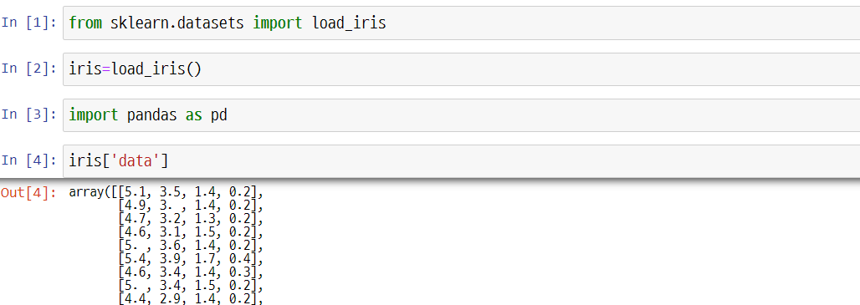
1.4. Data Pre-processing for Making a Good Training Dataset
UNIT 01
Missing Value Processing
Data cleansing for machine learning-based data analysis uses missing value and noise processing to eliminate discrepancies in collected data.
Missing value processing is done as follows.
First, import the iris data for quick examination.

Slide 55
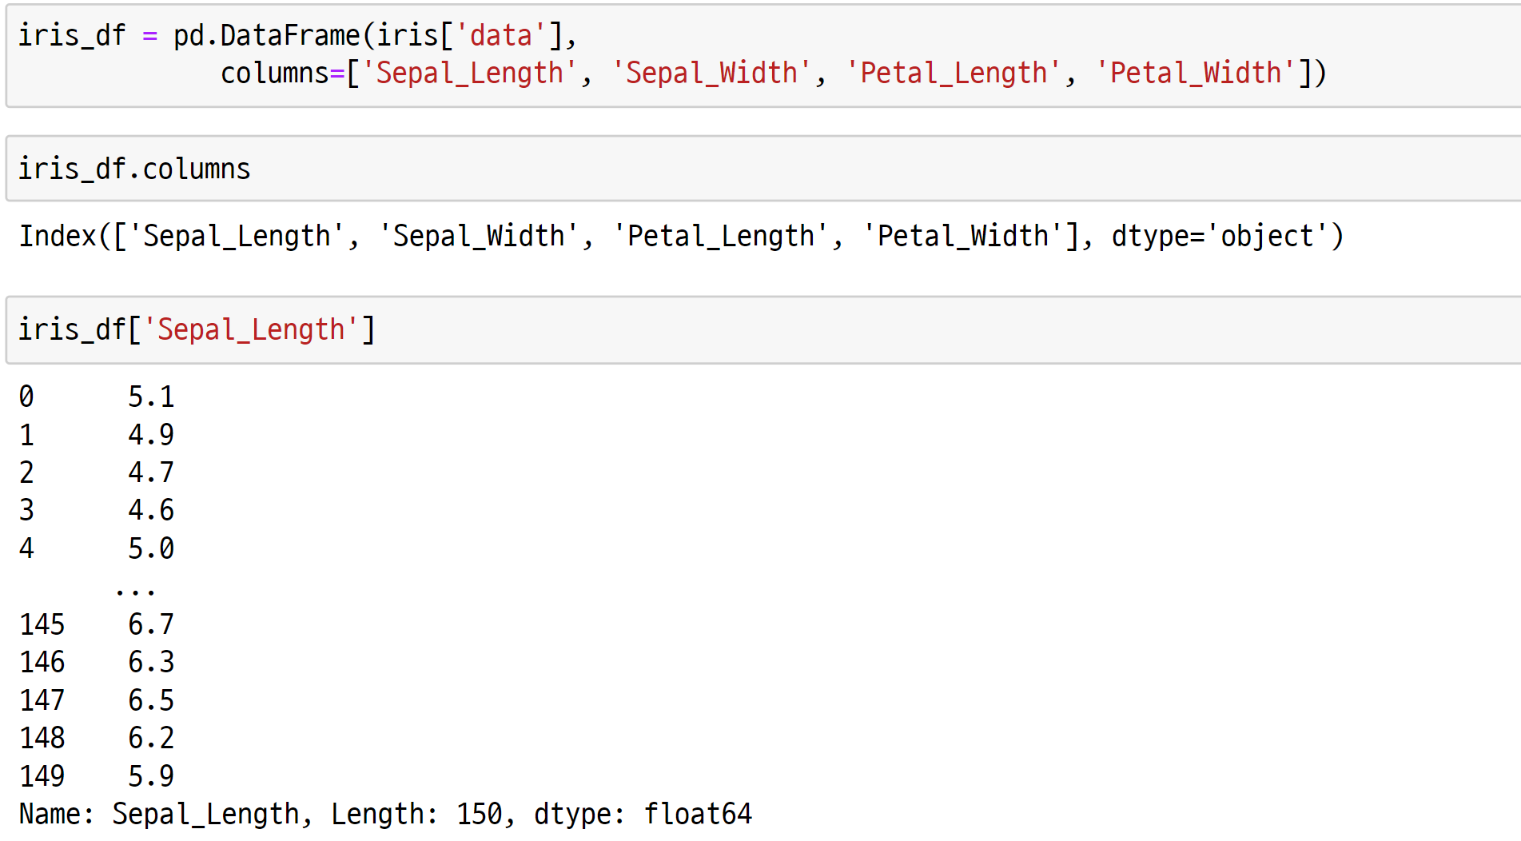
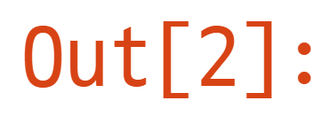
1.4. Data Pre-processing for Making a Good Training Dataset
UNIT 01
Missing value processing
7
8
8
9
9

Slide 56
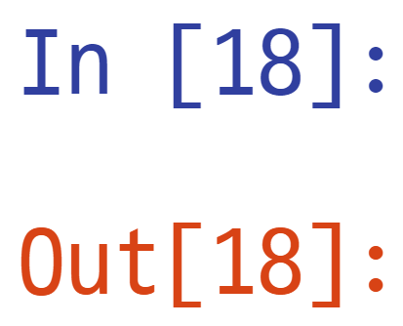
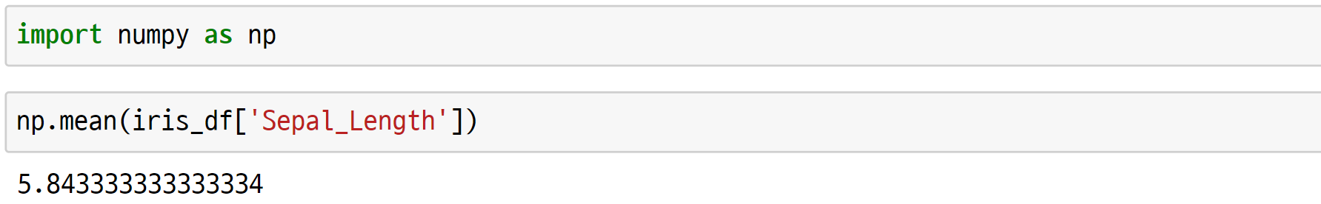
1.4. Data Pre-processing for Making a Good Training Dataset
UNIT 01
Missing value processing
10
11
11

Slide 57
1.4. Data Pre-processing for Making a Good Training Dataset
UNIT 01
Missing value processing
1) Ignore the record (row)
In data classification, ignore the record if the class label is not distinguished.
Ex
In the case of the iris data, ignore the fourth row as shown on the table below.
 | x1 | x2 | x3 | x4 | y
 | Sepal.Length | Sepal.Width | Petal.Length | Petal.Width | Species
1 | 5.1 | 3.5 | 1.4 | 0.2 | setosa
2 | 4.9 | 3 | 1.4 | 0.2 | setosa
3 | 4.7 | 3.2 | 1.3 | 0.2 | setosa
4 | 4.6 | 3.1 | 1.5 | 0.2
5 | 5 | 3.6 | 1.4 | 0.2 | setosa
6 | 5.4 | 3.9 | 1.7 | 0.4 | setosa
‘Ignore the record’ is extremely inefficient if missing values frequently occur.

Slide 58
1.4. Data Pre-processing for Making a Good Training Dataset
UNIT 01
Missing value processing
2) Insert the missing value
Enter a certain value like ‘unknown’ for missing value. Or enter the average value of data, such as the overall average value, median value, or class that belongs to the same record.
 | x1 | x2 | x3 | x4 | y
 | Sepal.Length | Sepal.Width | Petal.Length | Petal.Width | Species
1 | 5.1 | 3.5 | 1.4 | 0.2 | setosa
2 | 4.9 | 3 | 1.4 | 0.2 | setosa
3 | 4.7 | 3.2 | 1.3 | 0.2 | setosa
4 | 4.6 | 3.1 | 1.5 | 0.2 | unknown
5 | 5 | 3.6 | 1.4 | 0.2 | setosa
6 | 5.4 | 3.9 | 1.7 | 0.4 | setosa

Slide 59
1.4. Data Pre-processing for Making a Good Training Dataset
UNIT 01
Missing value processing
2) Insert the missing value
The average value of Sepal.Length for iris is 5.843 as provided earlier, so insert 5.843.
 | x1 | x2 | x3 | x4 | y
 | Sepal.Length | Sepal.Width | Petal.Length | Petal.Width | Species
1 | 5.1 | 3.5 | 1.4 | 0.2 | setosa
2 | 4.9 | 3 | 1.4 | 0.2 | setosa
3 | 4.7 | 3.2 | 1.3 | 0.2 | setosa
4 |  | 3.1 | 1.5 | 0.2 | setosa
5 | 5 | 3.6 | 1.4 | 0.2 | setosa
6 | 5.4 | 3.9 | 1.7 | 0.4 | setosa
 | x1 | x2 | x3 | x4 | y
 | Sepal.Length | Sepal.Width | Petal.Length | Petal.Width | Species
1 | 5.1 | 3.5 | 1.4 | 0.2 | setosa
2 | 4.9 | 3 | 1.4 | 0.2 | setosa
3 | 4.7 | 3.2 | 1.3 | 0.2 | setosa
4 | 5.843 | 3.1 | 1.5 | 0.2 | setosa
5 | 5 | 3.6 | 1.4 | 0.2 | setosa
6 | 5.4 | 3.9 | 1.7 | 0.4 | setosa

Slide 60
1.4. Data Pre-processing for Making a Good Training Dataset
UNIT 01
Missing value processing
3) Manual entry
A person in charge (or an expert) should check the data and modify it into an appropriate value.
It requires a lot of time but provides high reliability.

Slide 61
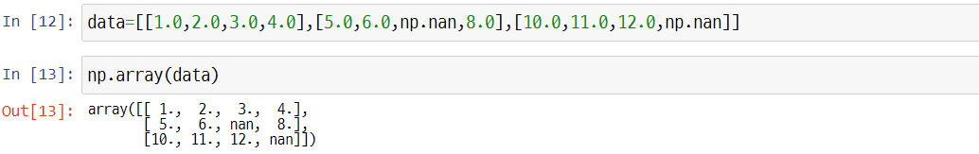
1.4. Data Pre-processing for Making a Good Training Dataset
UNIT 01
Missing value processing
Identify the missing value from the table type of data below and make appropriate processing.
In python, the missing value is specified as np.nan or null value.
’nan’ is an abbreviation of Not a Number.

Slide 62
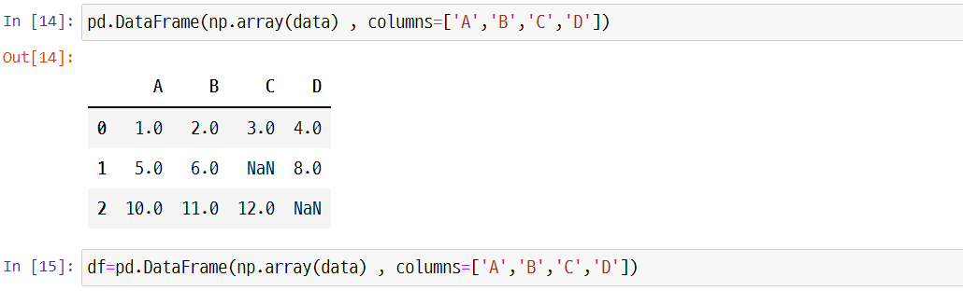
1.4. Data Pre-processing for Making a Good Training Dataset
UNIT 01
Missing value processing
The omitted value is changed to NaN. In this case, it is not problematic due to the low number of data, but it is extremely inconvenient to manually find missing values from a huge data frame.

Slide 63
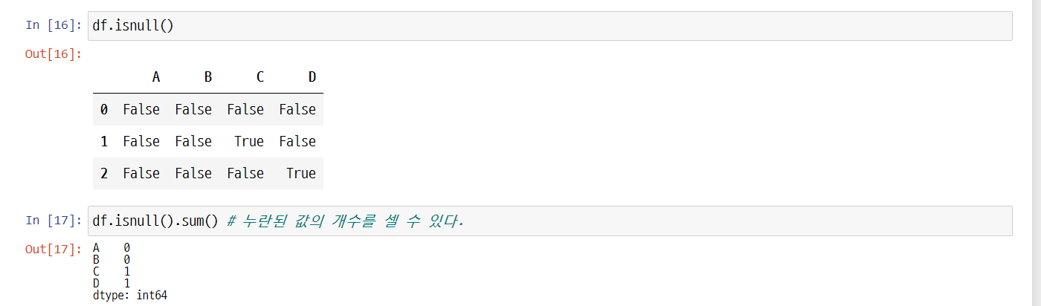
1.4. Data Pre-processing for Making a Good Training Dataset
UNIT 01
Missing value processing
isnull() returns the data frame with a Boolean, which shows if the cell has a numerical value (False) or is omitted with a numerical value (True). Then, sum() is used to obtain the number of omissions.
It is mandatory to check the number of missing values when importing data.
Line 17
The number of missing values can be counted.

Slide 64
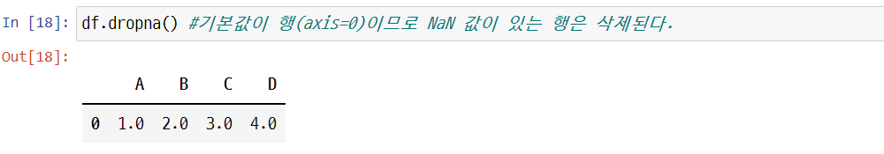
1.4. Data Pre-processing for Making a Good Training Dataset
UNIT 01
Removing the training sample or feature with missing value
Use dropna() to completely delete a certain training sample (row) or feature (column).
help(df.dropna) shows axis=0 is default.
Line 18
axis=0 is default, so the row with the NaN value is deleted.

Slide 65
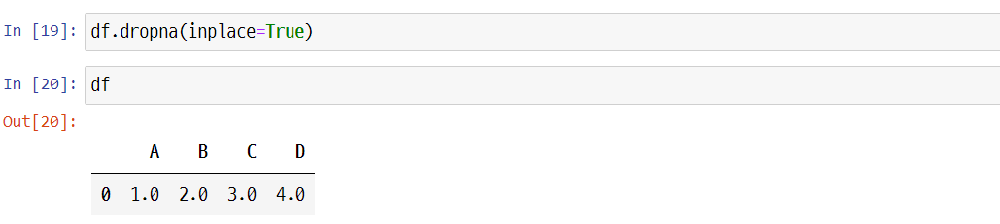
1.4. Data Pre-processing for Making a Good Training Dataset
UNIT 01
Removing the training sample or feature with missing value
When trying to reflect the deleted result immediately to the object, do not omit inplace=True option.

Slide 66
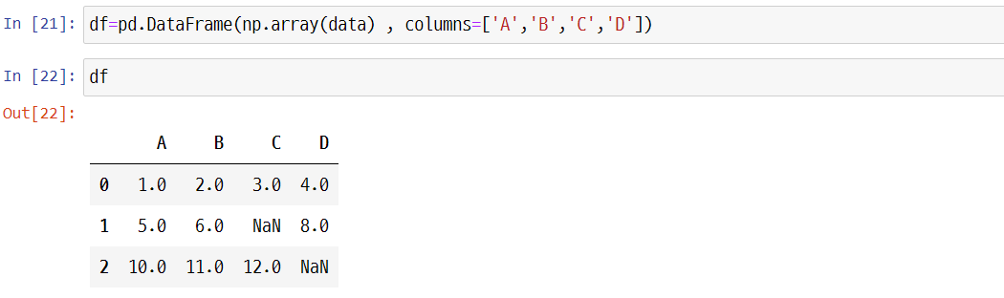
1.4. Data Pre-processing for Making a Good Training Dataset
UNIT 01
Removing the training sample or feature with missing value
Delete the row with missing value.

Slide 67
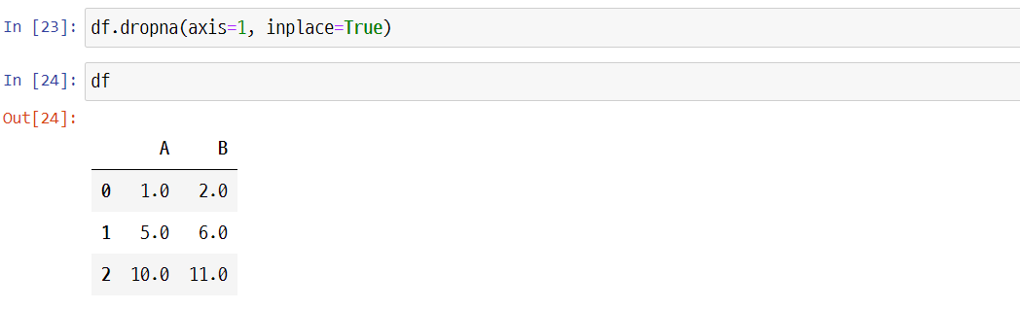
1.4. Data Pre-processing for Making a Good Training Dataset
UNIT 01
Removing the training sample or feature with missing value

Slide 68
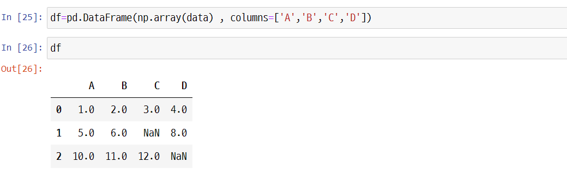
1.4. Data Pre-processing for Making a Good Training Dataset
UNIT 01
Removing the training sample or feature with missing value
If all rows have NaN, use how='all’ to delete.

Slide 69
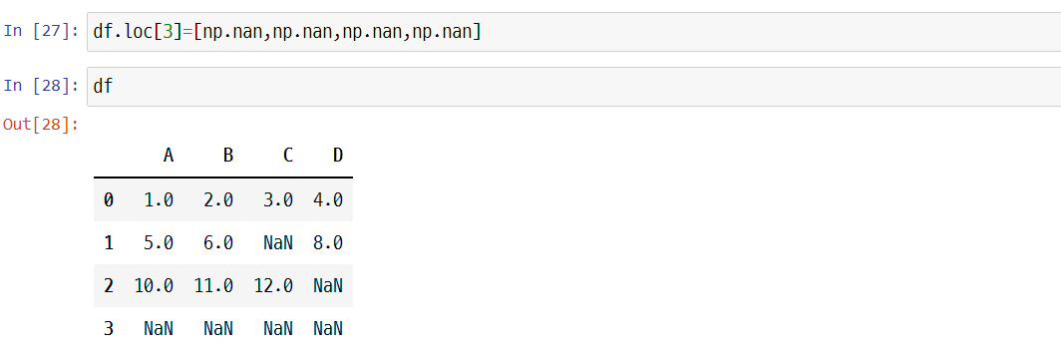
1.4. Data Pre-processing for Making a Good Training Dataset
UNIT 01
Removing the training sample or feature with missing value

Slide 70
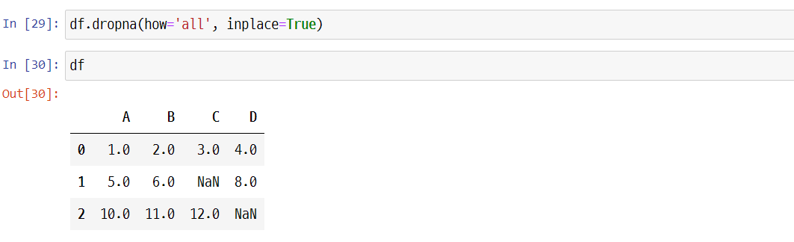
1.4. Data Pre-processing for Making a Good Training Dataset
UNIT 01
Removing the training sample or feature with missing value

Slide 71
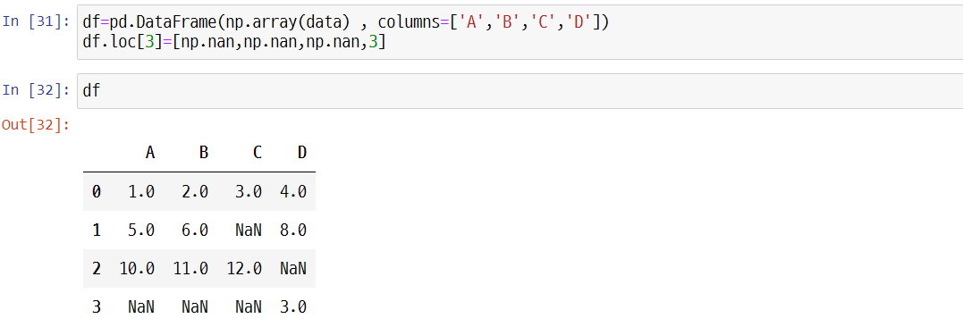
1.4. Data Pre-processing for Making a Good Training Dataset
UNIT 01
Removing the training sample or feature with missing value
When deleting 3 or more NaN values, use thresh.

Slide 72
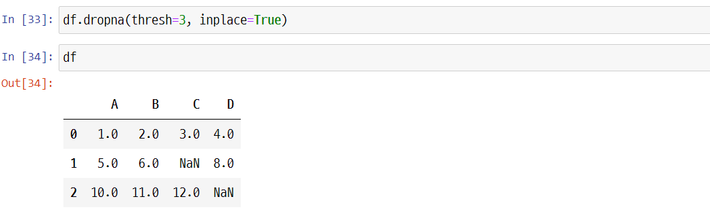
1.4. Data Pre-processing for Making a Good Training Dataset
UNIT 01
Removing the training sample or feature with missing value

Slide 73
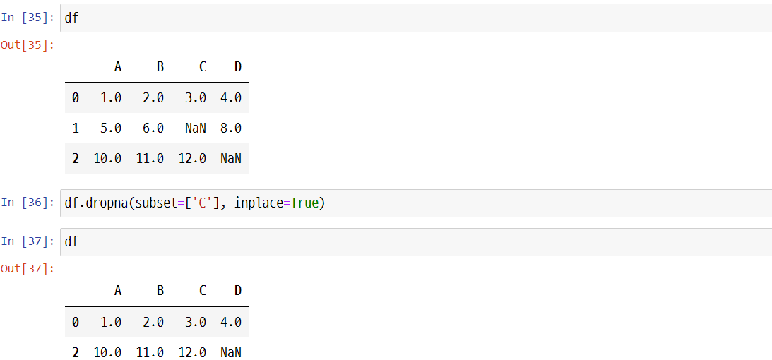
1.4. Data Pre-processing for Making a Good Training Dataset
UNIT 01
Removing the training sample or feature with missing value
When deleting a row with NaN on a certain column, use subject.

Slide 74
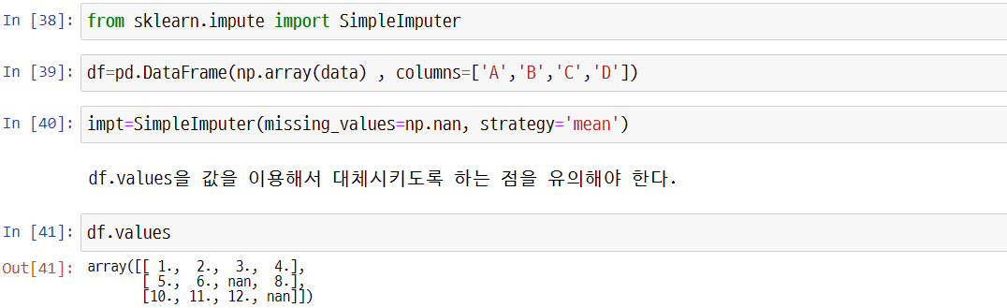
1.4. Data Pre-processing for Making a Good Training Dataset
UNIT 01
Imputation
It is sometimes hard to delete a training sample or a certain column because it loses too much useful data. If so, estimate missing values from other training samples in the dataset by kriging. The most commonly used method is to impute with average value, which is to change the missing value into the overall average of a certain column. In scikit-learn, use SimpleImputer class.
Impute with using df.values.

Slide 75
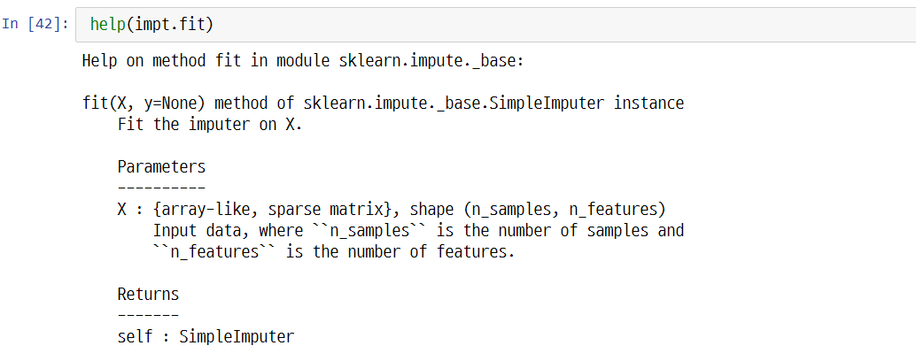
1.4. Data Pre-processing for Making a Good Training Dataset
UNIT 01
Imputation

Slide 76
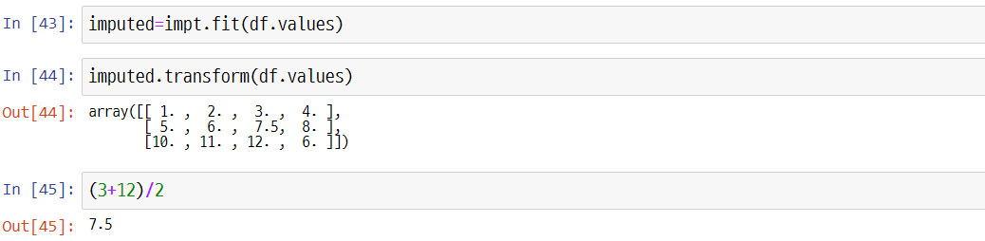
1.4. Data Pre-processing for Making a Good Training Dataset
UNIT 01
Imputation
Line 45
Check it is the average of the column.
For strategy parameters, median and most_frequent can also be set.

Slide 77
1.4. Data Pre-processing for Making a Good Training Dataset
UNIT 01
Review on the scikit-learn estimator API
Impute the missing value of the dataset by using the SimpleImputer class of scikit-learn from the previous clause.
The SimpleImputer class is a transformer class of scikit-learn that is used for data conversion.
The two main methods for the estimator include fit and transform.
Use the fit method to learn the model parameter in the training data.
Use the transform method to convert the data into the learned parameter.
The data array for conversion should be the same as the number of data features used in the model learning.

Slide 78
1.4. Data Pre-processing for Making a Good Training Dataset
UNIT 01
Categorical data processing
Data is generally classified into categorical and continuous scales depending on their features.
In liberal arts and social science, questionnaires are mainly used to collect data.
Categorical scale
It is a scale that can distinguish data into different categories and is classified into the nominal and ordinal scales.
Continuous scale
It is a scale that divides linked data into the purpose of the survey. It is classified into interval and ratio scales.
Actual datasets would include more than one categorical feature. As explained earlier, categorical data would classify sequential and non-sequential features. Ordinal scale can be referred to as sequential categorical scale that can array features with sequences.

Slide 79
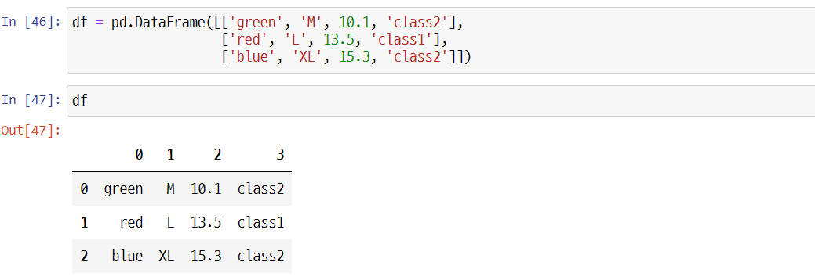
1.4. Data Pre-processing for Making a Good Training Dataset
UNIT 01
Categorical data processing
The data on the table has features that have orders and do not have orders. The size is ordered, but the color is not ordered. Thus, the size is classified as the ordinal scale, while the color is the nominal scale.

Slide 80
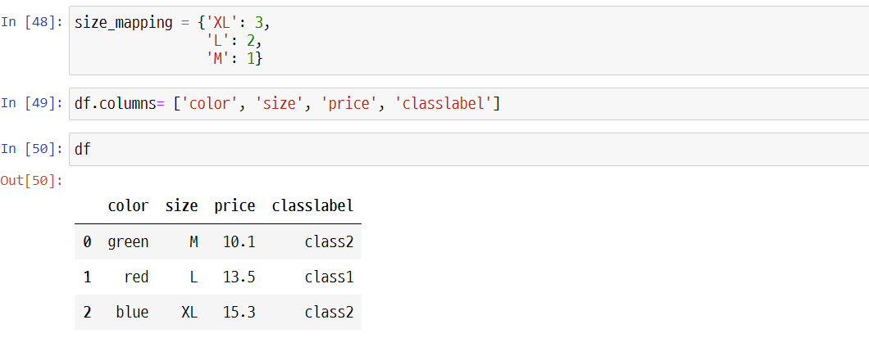
1.4. Data Pre-processing for Making a Good Training Dataset
UNIT 01
Categorical data processing
Convert ordered data into numerical values. The reason why changing text data into numerical data is to allow a computer to process arithmetic operations.

Slide 81
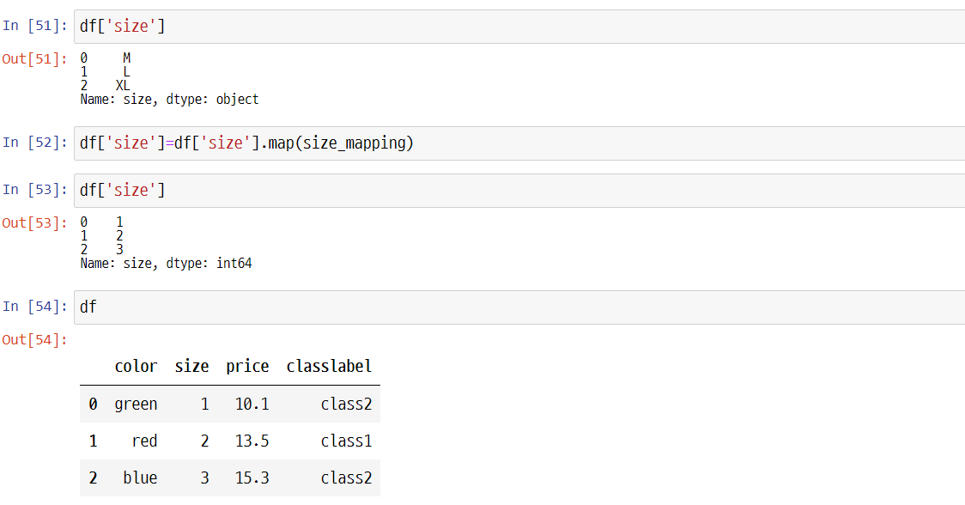
1.4. Data Pre-processing for Making a Good Training Dataset
UNIT 01
Categorical data processing

Slide 82
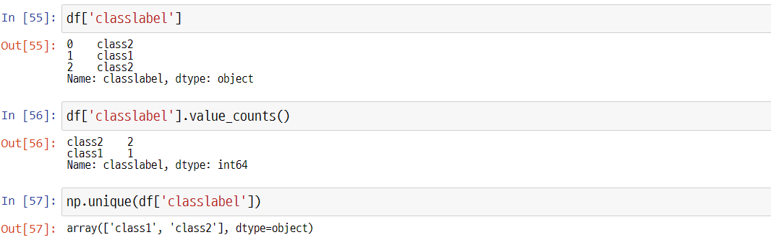
1.4. Data Pre-processing for Making a Good Training Dataset
UNIT 01
Class label encoding
The class refers to the y value, a column with an actual value.
Create a mapping to convert the class label from strings to integers.

Slide 83
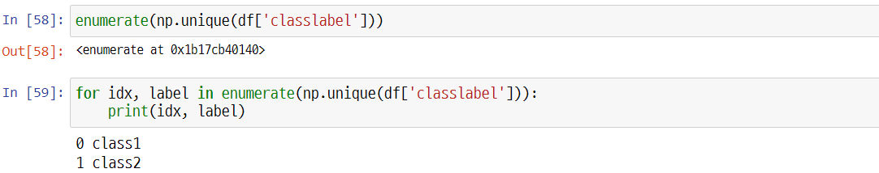

1.4. Data Pre-processing for Making a Good Training Dataset
UNIT 01
Class label encoding
‘enumerate’ creates an object with an index.
‘enumerate’ creates an object with an index.

Slide 84

1.4. Data Pre-processing for Making a Good Training Dataset
UNIT 01
Class label encoding
‘enumerate’ creates an object with an index.
Line 62
Change the class label from strings to integers.

Slide 85

1.4. Data Pre-processing for Making a Good Training Dataset
UNIT 01
Class label encoding
Since the method in the previous slide is rather inconvenient, scikit-learn supports LabelEncoder for easy conversion.

Slide 86

1.4. Data Pre-processing for Making a Good Training Dataset
UNIT 01
Class label encoding
enumerate는 열거형으로 인덱스가 있는 형태의 객체로 만들어 준다.

Slide 87
Unit 1.
Machine Learning Based Data Analysis
1.1. What is Machine Learning?
1.2. Python scikit-learn Library for Machine Learning
1.3. Preparation and Division of Dataset
1.4. Data Pre-processing for Making a Good Training Dataset
1.5. Practicing to Find an Optimal Method to Solve Problems with scikit-learn

Slide 88

1.5. Practicing to Find an Optimal Method to Solve Problems with scikit-learn
UNIT 01
Finding an Optimal Method to Solve Problems with scikit-learn
Practicing
Use the following problem-solving methodology and consider which algorithm to apply. Perform pre-processing and overall process regarding the iris data and compare with the result code provided below.
Notes:
Sometimes, the most difficult task in solving machine learning problems is to find an estimator that is appropriate to the task.
Various kinds of estimators are suitable for different types of data and problems.
The flow chart above is designed to provide brief guidelines regarding methods to approach to the problem with the estimators to be used for the data.

Slide 89

1.5. Practicing to Find an Optimal Method to Solve Problems with scikit-learn
UNIT 01
Practicing
Sample (Instance, observation)
 | Sepal length | Sepal width | Petal length | Petal width | Class label
1 | 5.1 | 3.5 | 1.4 | 0.2 | Setosa
2 | 4.9 | 3.0 | 1.4 | 0.2 | Setosa
…
50 | 6.4 | 3.5 | 4.5 | 1.2 | Versicolor
…
150 | 5.9 | 3.0 | 5.0 | 1.8 | Virginica
Petal
Sepal
Feature (Property,
measurement value, dimension)
Class label (Target)
Notes:
Learn the overall flow of machine learning while practicing classification analysis regarding the iris dataset. Referred to as the bible of introductory machine learning, iris data is an open dataset that is most frequently used.

Slide 90
1.5. Practicing to Find an Optimal Method to Solve Problems with scikit-learn
UNIT 01
Considerations in machine learning
1) Define the problem of the business and check for solutions or best alternative plans.
2) Check if it is possible to define it as a supervised or unsupervised problem.
3) Check which method to use for measuring model performance.
4) Check if the performance index is linked with the business objective and confirm if the project participants made an agreement regarding the performance.
In this practicing problem, define the problem as iris species (supervised) and suppose that the result is satisfactory if the performance predicts 85% or higher classification accuracy.

Slide 91
1.5. Practicing to Find an Optimal Method to Solve Problems with scikit-learn
UNIT 01
Understanding the iris data
Domain knowledge of the iris data
Data name: IRIS
Number of data: 150
Number of variables: 5
Understanding variables
Sepal Length | Length information of the sepal
Sepal Width | Width information of the sepal
Petal Length | Length information of the petal
Petal Width | Width information of the petal
Species | Flower species, classified into setosa / versicolor / virginica
Notes:
The expertise knowledge that contains domain knowledge learning data is called domain knowledge.
Domain knowledge covers general background knowledge of a certain field and also to the meanings of each variable.
For this practicing problem, it is enough to know different kinds of iris species.

Slide 92

1.5. Practicing to Find an Optimal Method to Solve Problems with scikit-learn
UNIT 01
Understanding the iris data

Slide 93

1.5. Practicing to Find an Optimal Method to Solve Problems with scikit-learn
UNIT 01
Understanding the iris data

Slide 94
Unit 2.
Application of Supervised Learning Model for Numerical Prediction
2.1. Training and Testing in Machine Learning
2.2. Linear Regression Basics
2.3. Linear Regression Diagnostics
2.4. Other Regression Types
2.5. Practicing the Supervised Learning Model for Numerical Prediction

Slide 95
2.1. Training and Testing in Machine Learning
UNIT 02
Machine Learning Types
Machine Learning
Supervised
Unsupervised
Reinforcement
Target pattern is given.
Target pattern must be found out.
Policy optimization
Notes:
From now and on, we will stick the supervised learning.
A supervised learning algorithm is applicable when we have a response variable that provides the “target” pattern.

Slide 96
2.1. Training and Testing in Machine Learning
UNIT 02
Training and Testing in Machine Learning
What is learning (human)?
True learning is not just having a good memory.
Learned material must be put to test.
Training and testing in machine learning
A trained model must be put to test to generalize.
Testing result is measured by errors.
Notes:
Now, we take a step back and ask ourselves what “learning” means.
+Learning does not mean just a good memory.
+To prove that you have learned, you should be tested!
In the supervised learning, the response variable is also present.
The values of the response variable are like the “correct answers” that can be used to grade the test results.

Slide 97

2.1. Training and Testing in Machine Learning
UNIT 02
Error Types
Bias error (Underfitting error)
Associated with simple/rigid/biased models.
Prediction cannot account for the detailed data pattern.
To lower this error type, increase the model complexity.
Data
Predicted
Target
Notes:
Bias error is explained.
Often bias error is referred to as “underfitting error.”

Slide 98

2.1. Training and Testing in Machine Learning
UNIT 02
Variance error (Overfitting error)
Associated with models overly complex and sensitive to noise.
Prediction performance is good while training but worsens when testing with a different dataset.
To lower this error type, increase the amount of training data (*) or decrease the model complexity.
Data
Predicted
Target
(*) By data augmentation method, for example.
Notes:
Variance error is explained.
Often variance error is referred to as “overfitting error.”
This picture shows the result of the “in-sample” prediction: the prediction made on the same dataset that was used for training.

Slide 99

2.1. Training and Testing in Machine Learning
UNIT 02
Total error
Bias Error
Variance Error
Total Error
Model Complexity
The goal is to minimize the Total error = Bias error + Variance error.
Just enough complexity is required to “optimize” the model.
Notes:
Usually, we cannot separately measure the bias and the variance errors.
What we can measure is the total error that is the sum of these two.
The main purpose of the (supervised) machine learning should be to minimize the total error.

Slide 100

2.1. Training and Testing in Machine Learning
UNIT 02
Minimizing Errors
Optimized machine learning model
Prediction performance should be good in both training and testing.
Given a machine learning algorithm, there is a model with just enough complexity (*).
⇦ Underfitting
Optimum
Overfitting ⇨
Testing error (Out of sample)
(*) Complexity is usually controlled by the number of parameters.
Training error (In sample)
Notes:
+Training error means that exactly the same dataset was used for training and evaluation.
This situation is also called “in-sample.”
+Testing error means that the model was trained on one dataset and then evaluated on a different dataset.
This situation is also called “out-of-sample.”
Testing error is what ultimately matters (not the training error).
The training and testing errors diverge when the model becomes too complex and the variance error dominates.
The goal should be to introduce just enough complexity and minimize the testing error.

Slide 101

2.1. Training and Testing in Machine Learning
UNIT 02
Optimized machine learning model
Prediction performance should be good in both training and testing.
Given a machine learning algorithm, there is a model with just enough complexity (*).
Data
Predicted
Target
(*) Complexity is usually controlled by the number of parameters.
Notes:
The optimal model should not be biased nor overly complex.
The prediction made by the optimal model approaches closely to the ideal.

Slide 102
2.1. Training and Testing in Machine Learning
UNIT 02
Machine Learning Types
Error Metric
Numeric 𝑌
Categorical 𝑌
MSE, MAE, RMSE, Correlation, etc.
Accuracy, Precision, Recall, Specificity, etc.
Notes:
So far, we have talked about “errors” a bit loosely.
To be more precise, we should distinguish the case where the response variable $Y$ is numeric from the one where the $Y$ is categorical.
+When the response variable $Y$ is numeric, we would be predicting numeric values.
The suitable metrics are MSE, RMSE, etc. These are truly “errors”; the smaller values mean better performance.
+When the response variable $Y$ is categorical, we would be predicting classes or types.
The suitable metrics are accuracy, recall, etc. These are, in a sense, inverse of “errors”; the larger values mean better performance.

Slide 103
Unit 2.
Application of Supervised Learning Model for Numerical Prediction
2.1. Training and Testing in Machine Learning
2.2. Linear Regression Basics
2.3. Linear Regression Diagnostics
2.4. Other Regression Types
2.5. Practicing the Supervised Learning Model for Numerical Prediction

Slide 104
2.2. Linear Regression Basics
UNIT 02
Linear Regression Basics
Supervised Learning
Numeric 𝑌
Categorical 𝑌
Y = 13.45, 73, 9.5, …..
Y = red, green, blue, …..
Notes:
In a couple of slides back we made a distinction between the case where the response variable $Y$ is numeric from the one where the $Y$ is categorical.
Now, let’s study a machine learning algorithm that is applicable for the case where the response variable $Y$ is numeric.
The machine learning algorithm in question is called “linear regression.”

Slide 105

2.2. Linear Regression Basics
UNIT 02
About linear regression
There is one ore more explanatory variables: 𝑋₁ , 𝑋₂ ,…, 𝑋_{𝑘}
There is one response variable: 𝑌
The variables 𝑋_𝑖 and 𝑌 are connected by a linear relation: 𝑌=𝛽₀+𝛽₁ 𝑋₁+𝛽₂ 𝑋₂+⋯+𝛽_{𝑘} 𝑋_{𝑘}+ $$
Notes:
In the linear regression, we assume that the response variable can be explained with the explanatory variables by a linear model.
Linear model or linear combination means that only “coefficient × variable” type of terms are present.

Slide 106
2.2. Linear Regression Basics
UNIT 02
Purpose of linear regression
a) By modeling, find out which explanatory variables have the most impact on the response variable.
Ex
If real estate price is the response variable 𝑌, which are the most statistically meaningful explanatory variables? Area, location, age, distance to business center, etc.
b) Predict the response given the conditions for the explanatory variables.
Ex
What is the price of a 10-year-old apartment with an area of 100 $m^{2}$ and located 3 km away from the business center? ← “predict” the value that is not open to the public yet.
Notes:
Some examples where the linear regression would be useful.

Slide 107

2.2. Linear Regression Basics
UNIT 02
Historical background
Term “regression” was coined by Francis Galton, 19th-century biologist.
The heights of the descendants tend to regress towards the mean.
Child Height
Parent Height
Francis Galton
Notes:
Linear regression has a long history that dates back to the time before the invention of modern computers.

Slide 108
2.2. Linear Regression Basics
UNIT 02
Pros
Solid statistical and mathematical background
Source of insights
Fast training
Cons
Many assumptions: linearity, normality, independence of the explanatory variables, etc.
Sensitive to outliers
Prone to multi-collinearity
Notes:
Just like any other machine learning algorithms, linear regression has many benefits as well as shortcomings.

Slide 109
2.2. Linear Regression Basics
UNIT 02
Assumptions
The response variable can be explained by a linear combination of the explanatory variables.
There should be no multi-collinearity.
Residuals should be normally distributed centered around 0.
Residuals should be distributed with a constant variance.
Residuals should be randomly distributed without a pattern.
Residual analysis
Notes:
Linear regression relies on a set of assumptions.
It is true that it might be difficult to meticulously check each one of them.
But it is good to keep these assumptions in mind when we apply linear regression.

Slide 110

2.2. Linear Regression Basics
UNIT 02
Linear model
$$Y={β_{0}+β}_{1}X_{1}+β_{2}X_{2}+⋯+β_{k}X_{k}+$$
Response variable
Explanatory variables
Variable values are given by data.
Notes:
Here, we take a close look at the linear model.

Slide 111

2.2. Linear Regression Basics
UNIT 02
Linear model
$$Y={{β_{0}+β}_{1}X}_{1}+β_{2}X_{2}+⋯+β_{k}X_{k}+$$
Regression coefficients
Regression coefficients are model parameters: capture the data patterns.
Notes:
The regression coefficients are the model parameters.

Slide 112


2.2. Linear Regression Basics
UNIT 02
Linear model
$$Y={{β_{0}+β}_{1}X}_{1}+β_{2}X_{2}+⋯+β_{k}X_{k}+$$
$$E[\text{ε}]=0$$
$$Var(\text{ε})=σ_{ε}^{2}$$
The error term $\text{}$ should have zero mean and constant variance.
Notes:
The error term must represent a “white noise”: totally random process with zero mean and fixed variance.

Slide 113
2.2. Linear Regression Basics
UNIT 02
Linear model
Ex
$$Y={β_{0}+β}_{1}X_{1}+β_{2}X_{2}+β_{3}X_{3}+β_{4}X_{4}+\text{ε}$$
MPG
N# of Cylinders
HP
Weight
Auto or Manual
MPG can be explained by other variables.
Notes:
Here, an example of linear model is shown.

Slide 114
2.2. Linear Regression Basics
UNIT 02
Interpreting the regression coefficients
$$Y= β_{1}{X}_{1}+⋯+β_{i}{X}_{i}+⋯+β_{k}{X}_{k}$$
If 𝑋₁, 𝑋₁, …, 𝑋_{𝑘} change by $$𝑋₁, $$𝑋₂, …, $$𝑋_{𝑘}, then the change in 𝑌 is $$𝑌.
Notes:
To interpret the regression coefficients, let’s assume that we can change each explanatory variable by a small amount.
This will cause a “response” in the $Y$ variable.

Slide 115
2.2. Linear Regression Basics
UNIT 02
Interpreting the regression coefficients
$$Y= β_{1}{X}_{1}+⋯+β_{i}{X}_{i}+⋯+β_{k}{X}_{k}$$
1
𝛽_{𝑖} can be interpreted as the change in 𝑌 when the 𝑋_{𝑖} is increased by a unit ( $$𝑋_{𝑖}=1).
Notes:
Each regression coefficient can be interpreted as the change in $Y$ when the corresponding variable is increased by a unit.

Slide 116
2.2. Linear Regression Basics
UNIT 02
Interpreting the regression coefficients
$$Y=β_{0}+β_{1}X_{1}{+β}_{2}X_{2}+⋯+β_{k}X_{k} +$$
Intercept
0
The intercept 𝛽₀ is the value of 𝑌 when all the 𝑋_{𝑖} = 0. It’s like a “baseline.”
Notes:
The intercept $β_{0}$ has a special meaning as we can see here.

Slide 117

2.2. Linear Regression Basics
UNIT 02
Interpreting the regression coefficients
Ex
Wage survey of a company’s employees
$$Y={β_{0}+β}_{1}X_{1}+β_{2}X_{2}+\text{ε}$$
Wage
Experience
Qualification
𝛽₀ can be interpreted as the base wage when there is no experience or qualification.
𝛽₁ can be interpreted as the change in wage when the experience is increased by a unit.
𝛽₂ can be interpreted as the change in wage when the qualification is increased by a unit.
Notes:
In this example, we can make sense out of each regression coefficient.

Slide 118


2.2. Linear Regression Basics
UNIT 02
Ordinary Least Squares (OLS) solution
$$y_{j}={β_{0}+β}_{1}x_{j,1}+β_{2}x_{j,2}+⋯+β_{K}x_{j, k}+ε_{j}$$
j$ε [1,n]$
$$n >>k$$
Over-determined!
Now, we can write the linear relation in term of the actual data values.
Notes:
So far, we expressed the linear relation in terms of the variables.
Now, we can rewrite the linear relation in term of the actual data values.

Slide 119

2.2. Linear Regression Basics
UNIT 02
Ordinary Least Squares (OLS) solution
$$Y=X β+ε$$
A compact notation using matrices
Notes:
Then, we can introduce a compact notation using matrices.
The benefit of doing so is that we have converted the linear regression problem into a linear algebra problem.
What we have is essentially a system of linear equations.

Slide 120


2.2. Linear Regression Basics
UNIT 02
Ordinary Least Squares (OLS) solution
$$Y=X β+ε$$
$$Y=\left[\begin{aligned}y_{1} \\ y_{2} \\ ⋮ \\ y_{n}\end{aligned}\right]$$
A compact notation using matrices
Notes:
Each matrix is explained.

Slide 121


2.2. Linear Regression Basics
UNIT 02
Ordinary Least Squares (OLS) solution
$$Y=X β+ε$$
$$X=\left[\begin{matrix}\begin{matrix}1 & x_{1,1} \\ 1 & x_{2,1}\end{matrix} & \begin{matrix}⋯ & x_{1,k} \\ ⋯ & x_{2,k}\end{matrix} \\ \begin{matrix}⋮ & ⋮ \\ 1 & x_{n,1}\end{matrix} & \begin{matrix}⋮ & ⋮ \\ ⋯ & x_{n,k}\end{matrix}\end{matrix}\right]$$
A compact notation using matrices

Slide 122


2.2. Linear Regression Basics
UNIT 02
Ordinary Least Squares (OLS) solution
$$Y=X β+ε$$
$$β=\left[\begin{aligned}_{0} \\ _{1} \\ ⋮ \\ _{k}\end{aligned}\right]$$
A compact notation using matrices

Slide 123


2.2. Linear Regression Basics
UNIT 02
Ordinary Least Squares (OLS) solution
$$Y=X β+ε$$
$$ε=\left[\begin{aligned}ε_{1} \\ ε_{2} \\ ⋮ \\ ε_{n}\end{aligned}\right]$$
A compact notation using matrices

Slide 124

2.2. Linear Regression Basics
UNIT 02
Ordinary Least Squares (OLS) solution
As we have an overdetermined system of linear equations, the exact solution does not exist.
We can minimize |𝜺|² and get the “best” solution 𝜷.
The minimization condition for |𝜺|² is given by the derivative:
$$\frac{d{\left|ε\right|}^{2}}{dβ}=0$$
Notes:
The number of unknowns (coefficients) is largely outnumbered by the conditions (observations).
So, we have an over-determined system of linear equations.
From now and on, we outline a solution method called “ordinary least squares (OLS).”

Slide 125

2.2. Linear Regression Basics
UNIT 02
Ordinary Least Squares (OLS) solution
The minimization condition for |𝜺|² is given by the derivative that can be expanded as following:
$$\frac{d{\left|ε\right|}^{2}}{dβ}=\frac{d{\left|Y−Xβ\right|}^{2}}{dβ}$$
$$=\frac{d\left\{{\left(Y−Xβ\right)}^{T}\left(Y−Xβ\right)\right\}}{dβ}$$
$$=\frac{d\left\{Y^{T}Y−β^{T}X^{T}Y−Y^{T}Xβ+β^{T}X^{T}Xβ\right\}}{dβ}$$
$$=−2X^{T}Y+2X^{T}Xβ=0$$
Notes:
To derive the OLS solution, we have to rely on calculus.
The minimization condition for ${\left|ε\right|}^{2}$ is given by the derivative.

Slide 126

2.2. Linear Regression Basics
UNIT 02
Ordinary Least Squares (OLS) solution
The solution 𝜷 from the previous slide is given by the following expression:
$$β=\left[{\left(X^{T}X\right)}^{−1}X^{T}\right] Y$$
Pseudo-inverse
The matrix expression within the square parentheses is called “pseudo-inverse.”
Notes:
We can derive the solution $β$which is a matrix (or vector) that contains the regression coefficients.
The solution is given by a linear algebra expression. This is not so hard to calculate using NumPy!

Slide 127


2.2. Linear Regression Basics
UNIT 02
Regression training and prediction (testing)
1) Training step: use the training dataset and get a set of model parameters {𝛽𝑖 }.
$$x_{i}$$
$$y$$
Training dataset
Notes:
Now, we take a break from the math.
Let’s think about what “prediction” means in the context of linear regression.
First, we should train the model. That is, we should get the regression parameters $\left\{β_{i}\right\}$ using a training dataset.

Slide 128


2.2. Linear Regression Basics
UNIT 02
Regression training and prediction (testing)
2) Prediction step: when a new set of {𝑥_{𝑖}′} is given, calculate the value of 𝑦′, which was unknown.
$x_{i}′$
$$y^{′}?$$
The predicted value of 𝑦′ is denoted as $\hat{y}$ , which is a conditional expectation $\hat{y}$=𝐸[𝑦|𝑑𝑎𝑡𝑎].
Given the values 𝑥₁′, 𝑥₂′, …, 𝑥_{𝑘}′, calculate 𝑦 ̂=𝛽₀+𝛽₁ 𝑥₁′+𝛽₂ 𝑥₂′+⋯+𝛽_{𝐾} 𝑥_{𝑘}′.
Notes:
The “prediction” means to calculate the most probable value of the response variable given the conditions (of the explanatory variables).

Slide 129












2.2. Linear Regression Basics
UNIT 02
Regression training and prediction (testing)
$$1$$
$$β_{0}$$
$$X_{1}$$
$$β_{1}$$
Input
$$X_{2}$$
$$β_{2}$$
$$ε$$
Σ
Output
$$Y$$
$$\begin{matrix}⋮ \\ ⋮\end{matrix}$$
$$β_{k}$$
Summed over
$\hat{y}=E[y|data]$
$$X_{k}$$
Parameters
Schematic view of the prediction step
Notice some disagreement between the predicted $\hat{y}$ and the true 𝑦.
Notes:
Linear regression prediction is illustrated by a picture.
Please notice that almost always some disagreement exists between the predicted $\hat{y}$ and the true $y$.
This is the source of error in the prediction.

Slide 130

2.2. Linear Regression Basics
UNIT 02
Error metrics
$$MSE=\frac{\sum_{i=1}^{n}{{\left(y_{i}−\hat{y_{i}}\right)}^{2}}}{n}$$
$$RMSE=\sqrt{MSE}$$
$$MAE=\frac{\sum_{i=1}^{n}{\left|y_{i}−\hat{y_{i}}\right|}}{n}$$
$$MAPE=\frac{100}{n}×\sum_{i=1}^{n}{\left|\frac{y_{i}−\hat{y_{i}}}{y_{i}}\right|}$$
Notes:
The errors can be summarized using the error metrics as defined here.

Slide 131

2.2. Linear Regression Basics
UNIT 02
Confidence interval (95%) when there is only one explanatory variable
$$\left[\hat{y}−quantile\left(0.975,n−2\right) σ_{\hat{y}} , \hat{y}+quantile\left(0.975,n−2\right){ σ}_{\hat{y}}\right]$$
with
$$σ_{\hat{y}}=RMSE×\sqrt{\left(\frac{1}{n}+\frac{{(x^{′}−\overline{x})}^{2}}{\sum{{(x−\overline{x})}^{2}}}\right)}$$
𝑞𝑢𝑎𝑛𝑡𝑖𝑙𝑒(𝛼,𝑘) is Student-t quantile of degree of freedom 𝑘.
Notes:
In the simple linear regression where there is only one explanatory variable, we can even set a confidence interval for the response $Y$.

Slide 132



2.2. Linear Regression Basics
UNIT 02
Role of categorical variables
Without categorical variable: weight ~ height
$$=male$$
$$=female$$
weight
height
Notes:
When there is no categorical variable, we get the main “trend” as prediction.

Slide 133

2.2. Linear Regression Basics
UNIT 02
Role of categorical variables
With a categorical variable gender: weight ~ height + gender
$$=male$$
$$=female$$
weight
height
The categorical variable must be turned into dummy variable(s) first.
Effectively raises or lowers the intercept.
Notes:
The inclusion of a categorical variable introduces an effect that can be easily interpreted.
We can assume that the categorical variable has been “treated”: dummy variables.
Here, we include a categorical variable as an independent variable.
This makes the intercept dependent on the category or type.

Slide 134

2.2. Linear Regression Basics
UNIT 02
Role of categorical variables
With a categorical variable gender that “interacts”: weight ~ height + gender + height × gender
$$=male$$
$$=female$$
weight
height
Both the intercept and slope are dependent on the categorical variable.
Further improves the error metrics.
Notes:
Here, we include a categorical variable as an independent variable and as an interacting term (height × gender).
Now, the intercept and slope are dependent on the category or type.

Slide 135

2.2. Linear Regression Basics
UNIT 02
Coding Exercise #0301
Follow practice steps on 'ex_0301.ipynb’ file.
Notes:
WHAT THIS PRACTICE ABOUT
In this practice, we apply simple linear regression to the classical Galton’s data. Due to many repeated values, we have to prepare the data in a suitable way to visualize correctly.
PRACTICE INSTRUCTION
Start Jupyter Notebook.
In Jupyter Notebook, click the ex_0301.ipynb files in the Coding Exercise folder.
Review the examples on the topics below: A. Linear regression with 'Galton' data. i. Read in data and visualize. ii. Linear regression training. iii. Visualization of the regression line.
(Optional) Use the blank cell at the bottom to practice your own personal needs.

Slide 136
Unit 2.
Application of Supervised Learning Model for Numerical Prediction
2.1. Training and Testing in Machine Learning
2.2. Linear Regression Basics
2.3. Linear Regression Diagnostics
2.4. Other Regression Types
2.5. Practicing the Supervised Learning Model for Numerical Prediction

Slide 137

2.3. Linear Regression Diagnostics
UNIT 02
Linear Regression Diagnostics
Linear regression diagnostic methods:
1) Error metrics: MSE, RMSE, MAE, MAPE, etc.
2) Coefficient of determination or “r-squared” 𝑅2
3) F-test for overall significance of the linear model
4) t-test for significance of individual regression coefficients
5) Correlation between 𝑌 and $\hat{Y}$
6) Variance inflation factor (VIF)
Modelling: optimization of the information criteria: AIC or BIC
Residual and leverage analysis
Notes:
There are many diagnostic methods related to the linear regression.

Slide 138

2.3. Linear Regression Diagnostics
UNIT 02
Error metrics
$$MSE=\frac{\sum_{i=1}^{n}{{\left(y_{i}−\hat{y_{i}}\right)}^{2}}}{n}$$
$$RMSE=\sqrt{MSE}$$
$$MAE=\frac{\sum_{i=1}^{n}{\left|y_{i}−\hat{y_{i}}\right|}}{n}$$
$$MAPE=\frac{100}{n}×\sum_{i=1}^{n}{\left|\frac{y_{i}−\hat{y_{i}}}{y_{i}}\right|}$$
The smaller, the better!
Notes:
We have already covered about the error metrics.
Please, remember that smaller errors are better.

Slide 139


2.3. Linear Regression Diagnostics
UNIT 02
Coefficient of determination or 𝑅2
$R^{2}=1−\frac{SSE}{SST}$
with $SSE=\sum_{i=1}^{n}{{\left(y_{i}−{\hat{y}}_{i}\right)}^{2}}$ and $SST=\sum_{i=1}^{n}{{\left(y_{i}−\overline{y}\right)}^{2}}$
𝑅² is bounded above and below: 0<𝑅²<1.
𝑅² close to one means that the response variable is well explained.
As more explanatory variables are added, 𝑅² tends to increase spuriously: adjusted 𝑅² introduced.
If there is only one explanatory variable 𝑋, then:
$$R^{2}={Cor(X,Y) }^{2}$$
Notes:
Here, coefficient of determination or $R^{2}$ is defined.
Adjusted $R^{2}$ would be more useful when there are many explanatory variables.

Slide 140

2.3. Linear Regression Diagnostics
UNIT 02
F-test for overall significance of the linear model
Null hypothesis 𝑯𝟎: 𝛽1=𝛽2=⋯=𝛽𝐾=0
Alternate hypothesis 𝑯𝟏: At least a 𝛽𝑖 is non zero.
⇦ F-test statistic =
⇦ If the p-value is below a reference (say 0.05), then 𝑯𝟎 is rejected in favor of 𝑯𝟏.
In this case, the linear model has an overall significance.
$$\frac{Variance that can be explained}{Variance that cannot be explained}$$
Notes:
The F-test in the context of linear regression is explained.
The p-value must come out small (<0.05) in order for the linear model to have an overall significance.

Slide 141

2.3. Linear Regression Diagnostics
UNIT 02
t-test for significance of the individual regression coefficients
Null hypothesis 𝑯𝟎: 𝛽𝑖=0
Alternate hypothesis 𝑯𝟏: 𝛽𝑖≠0
⇦ t-test statistic =
⇦ If the p-value is below a reference (say 0.05), then 𝑯𝟎 is rejected in favor of 𝑯𝟏.
In this case, inclusion of the explanatory variable 𝑋𝑖 is justified.
$$\frac{\hat{β_{i}}}{{Standard error of β}_{i}}\text{, }\text{where} \hat{β_{i}}= \text{estimated} \text{coefficient}\text{.}$$
Notes:
The t-test in the context of linear regression is explained.
The p-value must come out small (<0.05) in order for each parameter (and variable) to be meaningful.

Slide 142




2.3. Linear Regression Diagnostics
UNIT 02
Correlation between $Y$ and $\hat{Y}$
$$Y$$
$$Y$$
<
$$\hat{Y}$$
$$\hat{Y}$$
Weak positive correlation
Strong positive correlation
Notes:
The t-test in the context of linear regression is explained.
The p-value must come out small (<0.05) in order for each parameter (and variable) to be meaningful.

Slide 143
2.3. Linear Regression Diagnostics
UNIT 02
Variance inflation factor (VIF)
Can measure the “seriousness” of multi-collinearity.
In general, 𝑉𝐼𝐹>10 is considered serious. However, this reference point is rather subjective.
In case serious multi-collinearity is detected, model simplification is required.
Notes:
The variance inflation factor (VIF) measure the “seriousness” of multi-collinearity due to the inclusion of a particular explanatory variable.

Slide 144

2.3. Linear Regression Diagnostics
UNIT 02
Variance inflation factor (VIF)
VIF is calculated individually for each explanatory variable 𝑋_{𝑖}.
1) Place $X_{i}$ as the response and then regress using the expression:
$$X_{i}={β_{0}+β}_{1}X_{1}+β_{2}X_{2}+⋯+β_{i−1}X_{i−1}+β_{i+1}X_{i+1}+…+ε$$
2) Using the corresponding $R_{i}^{2}$ calculate 𝑉𝐼𝐹𝑖:
${VIF}_{i}=\frac{1}{1−R_{i}^{2}}$
Notes:
Here, the calculation method of VIF is explained.
VIF is calculated for each explanatory variable.

Slide 145



2.3. Linear Regression Diagnostics
UNIT 02
Information criteria and modelling
Akaike information criteria (AIC) with 𝑝=number of parameters:
$$AIC=−2\frac{Log likelihood}{\text{n}}+2\frac{p}{n}$$
Bayes information criteria (BIC) with 𝑝=number of parameters:
$$BIC=−2\frac{Log likelihood}{n}+p\frac{Ln\left(n\right)}{n}$$
In the expressions above, we have:
$$Log Likelihood=−\frac{n}{2}\left(1+Ln\left(2π\right)+Ln\left(\frac{SSE}{n}\right)\right)$$
Notes:
Here, the information criteria is defined.
As the regression coefficients are labeled from the index zero: $0\sim k$, the number of parameters $p=k+1$.
AIC (or BIC) offers a criteria for model optimization.
However, this is just one of several possible measures for consideration.
Please, be aware that improving on all of the diagnostic measures is not easy and often impossible.

Slide 146



2.3. Linear Regression Diagnostics
UNIT 02
Information criteria and modelling
$$AIC=−2\frac{Log likelihood}{\text{n}}+2\frac{p}{n}$$
$$BIC=−2\frac{Log likelihood}{n}+p\frac{Ln\left(n\right)}{n}$$
AIC
BIC
AIC
BIC
Complexity (~$p$)
Complexity (~$p$)
Notes:
AIC and BIC are in fact sums of two opposing trends.
As the model complexity increases, the first term decreases monotonically while the second term does the opposite.

Slide 147
2.3. Linear Regression Diagnostics
UNIT 02
Information criteria and modelling
$$AIC=−2\frac{Log likelihood}{\text{n}}+2\frac{p}{n}$$
$$BIC=−2\frac{Log likelihood}{n}+p\frac{Ln\left(n\right)}{n}$$
AIC
BIC
⇨ There is a minimum.
Complexity (~$p$)
Notes:
When we combine two opposing trends, we have a “U” shaped general trend.
One thing we can notice is that in that U shape there is a bottom minimum. This is where the model should be.

Slide 148
2.3. Linear Regression Diagnostics
UNIT 02
Residual analysis
Y
X
Residual is the difference between the predicted $\hat{y}$ and the real 𝑦.
We can easily detect outliers in 𝑌 that deviate substantially from the main trend.
Notes:
Residual is defined as the difference between the predicted $\hat{y}$ and the real $y$.

Slide 149
2.3. Linear Regression Diagnostics
UNIT 02
Residual analysis
Reasons for residual analysis:
1) To detect outliers in 𝑌.
2) To verify the assumptions of linear regression.
Residuals should be normally distributed centered around 0.
Residuals should be distributed with a constant variance.
Residuals should be randomly distributed without a pattern.
Notes:
There are many reasons to do residual analysis.
With residual analysis, we can also verify the basic assumptions of linear regression.

Slide 150



2.3. Linear Regression Diagnostics
UNIT 02
Leverage analysis
Leverage of the i-th observation
$Leverage=H_{ii}$ , where $\tilde{H}=\tilde{X}{\left({\tilde{X}}^{t}\tilde{X}\right)}^{−1}{\tilde{X}}^{t}$
There is a “sum rule.”
Mean leverage $≅\frac{p}{n}$
Large leverage $>\frac{p}{n}$
Small leverage $<\frac{p}{n}$
$$\sum_{i=1}^{n}{H_{ii}=p}$$
Leverage tells how distant 𝑋 is from the center => Detection of outliers in 𝑋.
Notes:
Here, leverage is defined.
Leverage is useful for detecting influential observations: those with outliers in the explanatory variables.

Slide 151
Unit 2.
Application of Supervised Learning Model for Numerical Prediction
2.1. Training and Testing in Machine Learning
2.2. Linear Regression Basics
2.3. Linear Regression Diagnostics
2.4. Other Regression Types
2.5. Practicing the Supervised Learning Model for Numerical Prediction

Slide 152
2.4. Other Regression Types
UNIT 02
Regularized Regression
Bias-Variance trade off
Bias Error
Variance Error
Total Error
Model Complexity
Tradeoff relation between the Bias error and the Variance error.
The goal should be to minimize the Total error = Bias error + Variance error.
Notes:
Let’s remember that $total error = bias error + variance error$.
Also, let’ remember that there is a tradeoff relation between the bias error and the variance error.
+When there is an excessive amount of variance error, we can apply regularized regressions such as Ridge and Lasso to bring the model towards the optimal point.
+When there is an excessive amount of bias error, we can apply polynomial regression to bring the model towards the optimal point.

Slide 153

2.4. Other Regression Types
UNIT 02
Ridge regression
Useful when the usual linear regression overfits (bias error << variance error).
We remember that the OLS solution consists in minimizing |𝜺|².
In the Ridge regression, we minimize the following “loss function”:
$$L={\left|ε\right|}^{2}+λ\sum_{i=0}^{k}{β_{i}^{2}}$$
In the loss function, $λ\sum_{i=0}^{k}{β_{i}^{2}}$ is included as penalty: “L2 regularization.”
Notes:
Here, Ridge regression is explained.
Ridge regression is useful when there is an excessive amount of variance error.

Slide 154



2.4. Other Regression Types
UNIT 02
Ridge regression
Positive and larger λ further constrains the coefficients $β_{i}$, decreasing the variance (overfitting) error.
$$L={\left|ε\right|}^{2}+λ\sum_{i=0}^{k}{β_{i}^{2}}$$
$$Y={β_{0}+β}_{1}X_{1}+β_{2}X_{2}+⋯+β_{k}X_{k}+ε$$
However, too large λ can make the model too “biased.”
Even when λ is large, the coefficients $β_{i}$ never become exactly equal to zero.
Notes:
$λ$ can be interpreted as the strength of regularization (or constraint on the coefficients).

Slide 155


2.4. Other Regression Types
UNIT 02
Lasso regression
Useful when the usual linear regression overfits (bias error << variance error).
In the Lasso regression, we minimize the following “loss function”:
$$L={\left|ε\right|}^{2}+λ\sum_{i=0}^{k}{|β_{i}|}$$
In the loss function, $λ\sum_{i=0}^{k}{\left|β_{i}\right|}$ is included as penalty: “L1 regularization.”
Positive and larger λ further constraints the coefficients $β_{i}$ decreasing the variance (overfitting) error.
However, too large λ can make the model too “biased.”
When λ is large, the coefficients $β_{i}$ can become exactly equal to zero.
Notes:
Here, Lasso regression is explained.
Lasso regression is useful when there is an excessive amount of variance error.
$λ$ can be interpreted as the strength of regularization (or constraint on the coefficients).
An important different from Ridge is that in Lasso the coefficients $β_{i}$ can become exactly equal to zero.

Slide 156

2.4. Other Regression Types
UNIT 02
Polynomial Regression
Polynomial regression
Useful when the usual linear regression underfits (bias error >> variance error).
We can model the relationship between 𝑋 and 𝑌 using the polynomials:
$$Y={β_{0}+β}_{1}X+ε$$
$$Y={β_{0}+β}_{1}X+β_{2}X^{2}+ε$$
$$Y={β_{0}+β}_{1}X+β_{2}X^{2}+β_{3}X^{3}+ε$$
We notice that there is only one explanatory variable 𝑋.
When the polynomial power is too high, overfitting may incur.
Notes:
Polynomial regression is useful when the linear model is too biased.
Here, higher polynomial terms are introduced to the model to make it more flexible.
However, be cautious that we can easily overshoot and cause overfitting.

Slide 157



2.4. Other Regression Types
UNIT 02
Poisson Regression
Poisson regression
Useful when we would like to model the response 𝑌 that represents counts or frequencies.
$$Log(λ)={β_{0}+β}_{1}X_{1}+β_{2}X_{2}+⋯+β_{K}X_{K}+ε$$
We are assuming that Y follows the Poisson distribution.
$$P\left(y\right)=\frac{λ^{y}e^{−λ}}{y!}$$
a) Mean $=λ$
b) Variance $=λ$
c) Standard deviation $=\sqrt{λ}$
Notes:
Poisson regression is useful when we model the response that represents counts.
The underlying probability distribution is……. Poisson distribution (no surprise here!)

Slide 158
Unit 2.
Application of Supervised Learning Model for Numerical Prediction
2.1. Training and Testing in Machine Learning
2.2. Linear Regression Basics
2.3. Linear Regression Diagnostics
2.4. Other Regression Types
2.5. Practicing the Supervised Learning Model for Numerical Prediction

Slide 159

2.5. Practicing the Supervised Learning Model for Numerical Prediction
UNIT 02
Practicing the Supervised Learning Model for Numerical Prediction
Import modules.

Slide 160
2.5. Practicing the Supervised Learning Model for Numerical Prediction
UNIT 02
Coding Exercise #0302
Follow practice steps on 'ex_0302.ipynb’ file.
Notes:
WHAT THIS PRACTICE ABOUT
In this practice, we go through some examples of linear regression and diagnostics.
PRACTICE INSTRUCTION
Start Jupyter Notebook.
In Jupyter Notebook, click the ex_0302.ipynb files in the Coding Exercise folder.
Review the examples on the topics below: A. Linear regression and diagnostics. i. Load the 'Boston' dataset from scikit-learn. ii. Convert the data into a DataFrame and then explore. iii. Train by linear regression. iv. Diagnostics. v. In-sample and out-of-sample testing. vi. Residual analysis. vii. Given a new set of values for the explanatory variables, predict the response.
(Optional) Use the blank cell at the bottom to practice your own personal needs.

Slide 161
2.5. Practicing the Supervised Learning Model for Numerical Prediction
UNIT 02
Coding Exercise #0303
Follow practice steps on 'ex_0303.ipynb’ file.
Notes:
WHAT THIS PRACTICE ABOUT
In this practice, we will use the StatsModels library for modeling and diagnosing. We can use formulas similar in fashion to those in the R language.
PRACTICE INSTRUCTION
Start Jupyter Notebook.
In Jupyter Notebook, click the ex_0303.ipynb files in the Coding Exercise folder.
Review the examples on the topics below: A. Linear regression diagnostics and modeling using StatsModels library. i. Load the 'Boston' dataset from scikit-learn and convert it into a DataFrame. ii. Linear modeling using R-styled formula.
(Optional) Use the blank cell at the bottom to practice your own personal needs.

Slide 162
2.5. Practicing the Supervised Learning Model for Numerical Prediction
UNIT 02
Coding Exercise #0304
Follow practice steps on 'ex_0304.ipynb’ file.
Notes:
WHAT THIS PRACTICE ABOUT
In this practice, we go through an example of confidence interval calculation for the true values of the response variable.
PRACTICE INSTRUCTION
Start Jupyter Notebook.
In Jupyter Notebook, click the ex_0304.ipynb files in the Coding Exercise folder.
Review the examples on the topics below: A. Linear regression prediction and confidence interval. i. Data. ii. Training. iii. Confidence interval and visualization.
(Optional) Use the blank cell at the bottom to practice your own personal needs.

Slide 163
2.5. Practicing the Supervised Learning Model for Numerical Prediction
UNIT 02
Coding Exercise #0305
Follow practice steps on 'ex_0305.ipynb’ file.
Notes:
WHAT THIS PRACTICE ABOUT
In this practice, we learn how to convert a categorical variable into dummy variables. We will see that dummy variables can interact with other variables further improving the diagnostic metrics.
PRACTICE INSTRUCTION
Start Jupyter Notebook.
In Jupyter Notebook, click the ex_0305.ipynb files in the Coding Exercise folder.
Review the examples on the topics below: A. Dummy variable and interaction. i. Read in the data. ii. Linear regression without dummy variable. iii. Linear regression with dummy variable. iv. Linear regression with dummy variable that interacts. v. Compare 𝑅2 , RMSE for the different cases.
(Optional) Use the blank cell at the bottom to practice your own personal needs.

Slide 164
2.5. Practicing the Supervised Learning Model for Numerical Prediction
UNIT 02
Coding Exercise #0306
Follow practice steps on 'ex_0306.ipynb’ file.
Notes:
WHAT THIS PRACTICE ABOUT
In this practice, we apply regularized regression algorithms such as Ridge and Lasso. We tune the hyperparameter lambda ($λ$) and interpret the results.
PRACTICE INSTRUCTION
Start Jupyter Notebook.
In Jupyter Notebook, click the ex_0306.ipynb files in the Coding Exercise folder.
Review the examples on the topics below: A. Regularized regressions i. Read in data ii. Ridge regression iii. Lasso regression
(Optional) Use the blank cell at the bottom to practice your own personal needs.

Slide 165
Unit 3.
Application of Supervised Learning Model for Classification
3.1. Training and Testing in Machine Learning
3.2. Logistic Regression Basics
3.3. Logistic Regression Performance Metrics

Slide 166
3.1. Training and Testing in Machine Learning
UNIT 03
Training and Testing in Machine Learning
Select a machine learning algorithm suitable for the data.
START
classification
>50k
samples
get
regression
NO
more data
Kernel
approximation
SGD
Classifier
NO
YES
Lasso
Predicting a
Predicting a
<100k
samples
few features should
be important
category
NO
quantity
YES
YES
YES
ElasticNet
SVC
NOT WORKING
YES
NO
NO
Ensembile
Classifiers
Kneighbors
Classifier
<100k
samples
do you have
SGD
Regressor
Ridge Regresson
YES
Labeled data
SVR (kernel= ‘linear’
NOT WORKING
NO
NOT WORKING
Naïve
Bayes
Text
Data
Linear
SVC
NO
SVR(kernel=‘rbf'
YES
NOT WORKING
YES
EnsembleRegressors
NO
clustering
Dimensionality reduction
KMeans
<10k
samples
Number of
Categoties known
just
Randomized
PCA
YES
YES
lookong
YES
NOT WORKING
NO
NO
NO
NOT WORKING
Spectral
Clustering
MiniBatch
KMeans
<10k
samples
tough
luck
predicting
<10k
samples
Isomap
LLE
NO
structure
YES
Spectral Embedding
GMM
NO
NO
NOT WORKING
MeanShift
kernel
approximation
VBGMM
Notes:
Now, let’s study machine learning algorithms that are applicable when the response variable $Y$ is categorical.
The first of such algorithms is the so-called “logistic regression.”

Slide 167
3.1. Training and Testing in Machine Learning
UNIT 03
Select a machine learning algorithm suitable for the data.
Supervised learning is machine learning tasks that try to predict or classify the values of objective variables (or response variables) in unseen data as the training dataset has the objective variables (or response variables) to be predicted (Y).
It is called supervised learning because the algorithm is told to predict a certain target.
Supervised learning is mainly classified into classification and regression problems depending on the types of objective variables (or response variables).
In other words, classification is applied if the objective variables (or response variables) are discrete or nominal, such as ‘male/female,’ ‘spam mail/ham mail,’ ‘positive/neutral/negative,’ ‘Seoul/Busan/Gyeonggi/Gangwon,’ etc. On the other hand, regression is applied if the objective variables (or response variables) are numerical, such as 0~10, -500~500, -3.5~3.5, -∞~∞, etc.
When the given data does not have classification marks or objective variables (or response variables), and if it’s not trying to predict target value, unsupervised learning is applied.
Unsupervised learning is classified into clustering, association, dimension reduction, and others depending on the analysis purpose and methods. Further details will be explained in other chapters.
Notes:
Here, Lasso regression is explained.
Lasso regression is useful when there is an excessive amount of variance error.
$λ$ can be interpreted as the strength of regularization (or constraint on the coefficients).
An important different from Ridge is that in Lasso the coefficients $β_{i}$ can become exactly equal to zero.

Slide 168
3.1. Training and Testing in Machine Learning
UNIT 03
Select a machine learning algorithm suitable for the data.
As shown in the figure above, neural networks can be applied if there are correct answers and it is for classification purposes or has a lot of data. If not, it is possible to use a decision tree or SVC algorithm.
Also, the Naïve Bayes algorithm can be used if the data is in text.
The KNN method is used if it’s not text data. It is also possible to use the ensemble method with a better performance.

Slide 169
3.1. Training and Testing in Machine Learning
UNIT 03
Machine learning for classification
Classification is used if the objective variables (or response variables) can be classified into certain categories, such as discrete or nominal type. It is the most common and frequently found in machine learning-based data analysis.
Machine learning algorithms for classification can be applied to extensive daily and business problems.
Ex
Frequently used examples
(1) Classifying spam mails
(2) Prediction of corporate bankruptcy
(3) Prediction of customer loss
(4) Classifying customers’ credit rating
(5) Prediction of occurrence of a certain disease (e.g. cancer, heart disease, etc.)
(6) Prediction of customer reaction to a specific marketing event
(7) Prediction of customer’s purchase
The examples provided above are extremely few real-life applications; there are infinite fields of business that classification type machine learning is applied. This type of machine learning has been continuously applied with new R&D and business methods.

Slide 170
3.1. Training and Testing in Machine Learning
UNIT 03
Types of machine learning algorithm for classification (1/2)
There are many different classification-type machine learning algorithms. Some of those can be used for regression problems. The following table provides descriptions of frequently used classification methods.
Type | Concept | Note
K-Nearest Neighbor | A classification method that uses the majority rule on the closest k objective variable values (or response variables) based on the distance between data coordination other than a certain data. | Lazy Learning
Naïve Bayes | A method based on Bayes’ theorem that makes classification towards the higher probability by expressing the conditional probability of objective variables (or response variables) as a multiplication of the prior probability and likelihood function. All observed values are assumed to occur statistically independently from other observed values. (Referred to as a Naïve model since the assumption is given without confidence.) | Provability model (Bayes’ theorem based conditional probability)
Logistic Regression | A method to estimate the probability of objective variables through the maximum likelihood estimation by assuming that the probability of the objective variable value being in a certain category is in the logistic function shape when the explanatory value is given. | Provability model (maximum likelihood estimation)
Decision Tree | A method to create classification rules by splitting the branches towards lower impurity or entropy in the order of variables most associated with objective variables. | Divide & Conquer

Slide 171
3.1. Training and Testing in Machine Learning
UNIT 03
Types of machine learning algorithm for classification (2/2)
There are many different classification-type machine learning algorithms. Some of those can be used for regression problems. The following table provides descriptions of frequently used classification methods.
Type | Concept | Note
Artificial Neural Network | A method inspired by the human neuron network. Comprised of the input node, hidden node, and output node, this analysis method is used to solve complicated classification or black box value prediction problems. | Black box test
Support Vector Machine | A method to classify certain data by finding a plane that maximizes the margin between data in different categories. | Linear and non-linear (Kernel trick)
Random Forest | An ensemble method to decide the final classification result by making various decision trees based on given data and aggregating the predicted results of each decision tree through voting. | Ensemble model

Slide 172
Unit 3.
Application of Supervised Learning Model for Classification
3.1. Training and Testing in Machine Learning
3.2. Logistic Regression Basics
3.3. Logistic Regression Performance Metrics

Slide 173
3.2. Logistic Regression Basics
UNIT 03
Logistic Regression Basics
What is logistic regression analysis?
In contrast to general linear regression analysis used for numerical prediction, logistic regression analysis is used to classify the category of objective variables (y) to be predicted. In other words, what is being predicted is not the y value which is an objective variable. It is P(Y=i), which is the probability of the objective variable y becoming a certain category (i).
Supervised Learning
Numeric 𝑌
Categorical 𝑌
Y = 13.45, 73, 9.5, …..
Y = red, green, blue, …..
Notes:
In the logistic regression, we assume one or more explanatory variables.
The choice of the explanatory variables is quite flexible; they can be numeric, categorical, etc. in nature.
However, the response variable must be binary, that is, categorical with two classes.
We notice that an integer variable with two possible values is essentially a categorical variable that represent two classes.

Slide 174

3.2. Logistic Regression Basics
UNIT 03
About linear regression
There is one ore more explanatory variables: $X_{1},X_{2},…,X_{k}$
There is one response variable: $Y$
The response variable $Y$ is binary where possible values are {0,1}, {𝐹𝑎𝑙𝑠𝑒,𝑇𝑟𝑢𝑒}, {𝑁𝑜,𝑌𝑒𝑠}, etc.
One of the most basic classification algorithms.

Slide 175
3.2. Logistic Regression Basics
UNIT 03
Pros
Simple and relatively easy to implement
Source of intuitive insights
Fast training
Cons
Not among the most accurate classification algorithms
Assumes that the explanatory variables are independent without multi-collinearity
Notes:
Logistic regression is often a benchmark algorithm against which others are compared.
Logistic regression provides insights that are difficult to obtain from other algorithms.
Logistic regression is not among the best performing classification algorithms.

Slide 176



3.2. Logistic Regression Basics
UNIT 03
About logistic regression
The linear combinations of variables 𝑋_𝑖 is the so-called “Logit” denoted here as 𝑆.
$$S={β_{0}+β}_{1}X_{1}+β_{2}X_{2}+⋯+β_{k}X_{k}$$
The conditional probability of 𝑌 being equal to 1 is denoted as $P(Y=1|\left\{x_{i}\right\})$.
“Sigmoid” or “Logistic” function connects the probability with the logit.
$$f\left(S\right)=\frac{e^{ S}}{1+e^{ S}}$$
0.5
Notes:
A linear relation is assumed between the explanatory variables and the logit.
The response $Y$ is connected to the logit by the “Sigmoid” function.
We can interpret that a large positive logit gives a higher probability of the response $Y$ being equal to 1.
We can interpret that a large negative logit gives a lower probability of the response $Y$ being equal to 1.

Slide 177



3.2. Logistic Regression Basics
UNIT 03
About logistic regression
If 𝑝 = 𝑝𝑟𝑜𝑏𝑎𝑏𝑖𝑙𝑖𝑡𝑦 𝑜𝑓 𝑌=1, we can define:
$$Odds=\frac{p}{1−p}$$
$$Logit = Log(Odds)=Log\left(\frac{p}{1−p}\right)$$
The logistic function is the inverse of the logit (and vice versa):
$$S=Log\left(\frac{p}{1−p}\right)$$
$$p=\frac{e^{ S}}{1+e^{ S}}$$
Notes:
Here, quantities such as “odds” and “logit” are formally defined.

Slide 178


3.2. Logistic Regression Basics
UNIT 03
About logistic regression
For logistic regression, the categories of objective variable (Y) to be predicted are 0 and 1 (binomial logistic regression model). The possibility of the objective variable Y category becoming 1 is expressed as p(Y=1) = P(Y). Start by expressing the description as a regression equation. The left side of the equation is commonly referred to as ’odds.’
The ‘odds’ signify dividend rate, which categorizes into success/failure probabilities. If the success probability is high, it becomes 1; if it is low, it becomes 0. In other words, it is a success rate. Adding a log to odds becomes logit, and this function is logistic.
$$\frac{P(Y)}{1−P(Y)}=exp⁡(β_{0}+β_{1}X)$$
The left side of the equation is a ratio of probability; the right side is an exponential function that has a (0, $∞$) range. Add a log on both sides of the equation to give a range with ($−∞$, $∞$) values on both.
$$log⁡(\frac{P\left(Y\right)}{1−P\left(Y\right)})=β_{0}+β_{1}X$$
When looking at the equation in detail, the $β_{0}+β_{1}X$ on the right side is a linear model with a range (−∞, ∞); the left side also has a range (−∞, ∞). The log(P(Y))/(1-P(Y)) on the left side of the equation is called the logit function.
Or add ‘exp’ to both sides of the equation and arrange it regarding P(Y) to get the following equation.

Slide 179


3.2. Logistic Regression Basics
UNIT 03
About logistic regression
$$P\left(Y=1\right)=\frac{e^{(β_{o}+β_{1}X)}}{1+e^{(β_{o}+β_{1}X)}}=\frac{1}{1+e^{−(β_{o}+β_{1}X)}}$$
To sum up, logistic regression analysis is an algorithm that establishes a model by using the logistic function from the above equation and predicting parameters $β_{0}, β_{1}$ from the probability P(Y=1) = P(Y) where objective variable Y having categorical value 1 from the training data. Maximum likelihood estimation is generally used for predicting parameters $β_{0}$ and $β_{1}$. This is an analytical method that changes the formula. Since the direct calculation is difficult, estimation is done by giving a certain initial value and performing repeated calculations to adjust the value as a numerical calculation.

Slide 180

3.2. Logistic Regression Basics
UNIT 03
About logistic regression
The following figure shows a graph of the logistic function. As shown in the graph, the range of the X-axis is $−∞ to$ $∞.$ The Y-axis is the probability of objective variable Y occurrence, which ranges between 0 and 1. Thus, the function P(Y=1) shows an S-shaped curve from 0 to 1 as the x value increases.
P(Y=1)
Predictor
Logistic regression graph

Slide 181



3.2. Logistic Regression Basics
UNIT 03
Logistic regression training and prediction (testing)
2) Prediction step: when a new set of {$x_{i}′$} is given, calculate the value of $y′$, which was unknown.
$$x_{i}′$$
$$y′\text{?}$$
Compare the conditional probability with a cutoff.
$$P(Y^{′}=1|\left\{x_{i}′\right\}) \text{>} \text{Cutoff}\text{ ?}$$
$$⇨ \hat{y}\text{ = 1 }\text{or}\text{ 0}$$
Notes:
First, we should train the logistic regression model.
That is, we should get the regression parameters $\left\{β_{i}\right\}$ using a training dataset.
If there were any pattern in the data, it is summarized by the parameters $\left\{β_{i}\right\}$.
This makes the prediction step fast and efficient.

Slide 182













3.2. Logistic Regression Basics
UNIT 03
Logistic regression training and prediction (testing)
$$1$$
$$β_{0}$$
$$0, 0, 1, 1, 0, …$$
$$X_{1}$$
$$β_{1}$$
Input
$$X_{2}$$
$$β_{2}$$
Σ
Output
$$Y$$
$$\begin{matrix}⋮ \\ ⋮\end{matrix}$$
$$β_{k}$$
$$P(Y=1|data)$$
$$X_{k}$$
S
$$0.3, 0.72, 0.12, …$$
Parameters
Notes:
Logistic regression prediction is illustrated by a picture.
Please notice that the output is not directly the predicted $\hat{y}$.
It has to be compared to a cutoff probability to make the final prediction.

Slide 183

3.2. Logistic Regression Basics
UNIT 03
Training by gradient descent algorithm
We can get the parameter set $\left\{β_{i}\right\}$ by minimizing a target function $L(β)$.
We get to minimize the difference between the real 𝑌 and the predicted 𝑌 ̂.
We can think of $L(β)$ as a “loss” or “cost.”
$L(β)$ is a function of the parameter set $\left\{β_{i}\right\}$, which can be represented by a vector $β$.
Notes:
We will go a bit deeper into the details.
Please, remember that,
+For linear regression (OLS): the minimization target is ${\left|ε\right|}^{2}$.
+For Lasso regression: the minimization target is $L={\left|ε\right|}^{2}+λ\sum_{i=0}^{k}{β_{i}^{2}}$.
+For Ridge regression: the minimization target is $L={\left|ε\right|}^{2}+λ\sum_{i=0}^{k}{\left|β_{i}\right|}$.
Similarly, we will define an appropriate loss function for the logistic regression.

Slide 184

3.2. Logistic Regression Basics
UNIT 03
Training by gradient descent algorithm
$L(β)$ is the negative of logarithmic likelihood defined as following:
$$L(β)=\sum_{i=1}^{n}{Log\left(1+e^{−y_{i} β^{T} x_{i}}\right)}$$
In the above relation, $x_{i}$ and $y_{i}$ represent values given by the training dataset.
Here, we assumed the conversion from $y_{i}=\left\{0,1\right\}$ to $y_{i}=\left\{−1,+1\right\}$.
Notes:
Instead of pursuing the maximization of the logarithmic likelihood, we will minimize the negative logarithmic likelihood.
We assume that the response $Y$ has classes $\left\{−1,+1\right\}$ instead of $\left\{0,1\right\}$.

Slide 185

3.2. Logistic Regression Basics
UNIT 03
Training by gradient descent algorithm
$L(β)$ is the negative of logarithmic likelihood defined as following:
$$L(β)=\sum_{i=1}^{n}{Log\left(1+e^{−y_{i} β^{T} x_{i}}\right)}$$
$$x_{i}=\left[\begin{aligned}1 \\ x_{i,1} \\ x_{i,2} \\ ⋮ \\ x_{i,k}\end{aligned}\right] \text{,} x_{i}^{t} =\left[1,x_{i,1},x_{i,2},⋯,x_{i,k}\right]$$
$$β=\left[\begin{aligned}β_{0} \\ β_{1} \\ ⋮ \\ β_{k}\end{aligned}\right] \text{ ,} β^{T} =\left[β_{0},β_{1},⋯,β_{k}\right]$$
Notes:
$x_{i}$ is a single column matrix that corresponds to an observation. The sub-index $i$ goes from $1$ to $n$.
$x_{i}^{t}$ is the transpose of $x_{i}$.
$β$ is a single column matrix that contains the model parameters.
$β^{t}$is the transpose of $β$.

Slide 186

3.2. Logistic Regression Basics
UNIT 03
Training by gradient descent algorithm
The gradient of $L(β)$ is denoted as $∇L(β)$, which is also a function of the parameter set $\left\{β_{i}\right\}$ or $β$.
The expression for the gradient $∇L(β)$ is:
$$∇L(β)=−\sum_{i=1}^{N}{\frac{y_{i}x_{i}e^{−β^{t}x_{i}}}{1+e^{−β^{t}x_{i}}}}$$
The growth of $L(β)$ is steepest along the direction of $∇L(β)$.
⇔ The descent of $L(β)$ is steepest along the direction of − $∇L(β)$.
Notes:
Here, the expression for the gradient is given.
The gradient is a vector (or a single column matrix) that contains the direction of steepest growth of $L(β)$.
Inversely, the negative gradient contains the direction of steepest descent of $L(β)$.

Slide 187


3.2. Logistic Regression Basics
UNIT 03
Training by gradient descent algorithm
The expression for the gradient $∇L(β)$ is:
$$∇L(β)=−\sum_{i=1}^{N}{\frac{y_{i}x_{i}e^{−β^{t}x_{i}}}{1+e^{−β^{t}x_{i}}}}$$
The gradient $∇L(β)$ is obtained by calculating the partial derivatives of $L(β)$:
$$∇L(β)=\left[\begin{aligned}\frac{∂L}{{∂β}_{0}} \\ \frac{∂L}{{∂β}_{1}} \\ ⋮ \\ \frac{∂L}{{∂β}_{K}}\end{aligned}\right]$$
Notes:
The gradient $∇L(β)$ is a single column matrix that contains the partial derivatives.

Slide 188

3.2. Logistic Regression Basics
UNIT 03
Training by gradient descent algorithm
𝐿(𝜷) is minimized iteratively in small “steps” pushing 𝜷 along the direction −𝜵𝐿(𝜷).
1) $β$ is randomly initialized.
2) Calculate the gradient $∇L(β$).
3) Update $β$ by one step: $β ← β−η ∇L(β\text{)}$.
Convergence speed is controlled by the “Learning rate” η.
4) Repeat from step 2) a fixed number of times (epochs).
Notes:
Here, the gradient descent algorithm is laid out.
This is an iterative algorithm that approaches the optimal solution in small steps.
We notice that the hyperparameter eta ($η$) controls the convergence speed.

Slide 189


3.2. Logistic Regression Basics
UNIT 03
Training by gradient descent algorithm
𝐿(𝜷) is minimized iteratively in small “steps” pushing 𝜷 along the direction −𝜵𝐿(𝜷).
$$L(β)$$
Optimized $β$
Notes:
This picture illustrates the gradient descent algorithm.

Slide 190

3.2. Logistic Regression Basics
UNIT 03
Training by gradient descent algorithm
The gradient function in Python
Notes:
It is quite straightforward to implement the Sigmoid function and the gradient in Python.

Slide 191

3.2. Logistic Regression Basics
UNIT 03
Training by gradient descent algorithm
The gradient function in Python
Notes:
It does not require a lot of coding to implement the gradient descent algorithm in Python.
The “train()” function is implemented as a member method of a class.

Slide 192
Unit 3.
Application of Supervised Learning Model for Classification
3.1. Training and Testing in Machine Learning
3.2. Logistic Regression Basics
3.3. Logistic Regression Performance Metrics

Slide 193
3.3. Logistic Regression Performance Metrics
UNIT 03
Logistic Regression Performance Metrics
Confusion matrix
In the classification machine learning method, the most common method for evaluating the analysis model’s result is the metric calculation, including classification accuracy, using a confusion matrix.
The confusion matrix refers to the matrix that makes a crosstable of the predicted classification category from the analysis model and the actual classified category of data.
Notes:
The test result of a classification prediction can be summarized by a confusion matrix.
The columns correspond to the actual class labels while the rows correspond to the predicted class labels.
When the response variable represents two classes, the confusion matrix is $2×2$ in shape.
For a given number of classes $K$, the confusion matrix is $K×K$ in shape.

Slide 194
3.3. Logistic Regression Performance Metrics
UNIT 03
Confusion matrix
Predicted categorical value
 | Y | N
Y | O (TP: True Positive) | X (FN: False Negative)
N | X (FP: False Positive) | O (TN: True Negative)
Actual
categorical value

Slide 195
3.3. Logistic Regression Performance Metrics
UNIT 03
Confusion matrix
Confusion matrix can be made with a 2X2 crosstable, along with 3X3 and higher crosstables. For convenience, we will only use a 2X2 confusion matrix in this chapter.
In the confusion matrix from the previous slide, the diagonally placed ‘O’ cases means the predicted and actual categorical values are the same. In other words, the classification machine learning predicted the results properly.
On the other hand, if the predicted and actual categorical values differ, the machine learning model has made incorrect predictions.
The categories that the analysis is mostly interested in are positive categories; the others are called negative categories. Depending on the accuracy of prediction (true or false) regarding positive and negative categories, the accurate classification of interested categories is called TP (True Positive). The accurate classification of uninterested categories is called TN (True Negative).
The inaccurate classification of uninterested categories into interested categories is called FP (False Positive). The inaccurate classification of interested categories into uninterested categories is called FN (False Negative).
There are various metrics based on different combinations of TP, TN, FP, and FN of the confusion matrix for evaluating the analysis result of classification machine learning methods.

Slide 196
3.3. Logistic Regression Performance Metrics
UNIT 03
Metric
Major metrics calculated from the confusion matrix include accuracy, error rate = 1-accuracy, sensitivity (also referred to as recall, hit ratio, TP rate, etc.), specificity, FP rate, precision, and others. Among those, accuracy, sensitivity, and precision are the most frequently used metrics.
Also, there are F-Measure (or F1-Score) that combines sensitivity, precision, and Kappa Statistics, where the predicted and actual values of the analysis model are exactly the same. The calculation formulas and definitions of various metrics are in the following table.

Slide 197

3.3. Logistic Regression Performance Metrics
UNIT 03
Metric
Metric | Calculation Formula | Definition
accuracy | (TP+TN) / (TP+TN+FP+FN) | Ratio of accurate prediction of actual classification category (Ratio of TP and TN from the entire prediction)
error rate | (FP+FN) / (TP+TN+FP+FN) | Ratio of inaccurate prediction of actual classification category (Identical to 1-accuracy)
sensitivity = TP Rate | (TP) / (TP+FN) | Ratio of accurate prediction to ’positive’ from actual ‘positive’ categories (True Positive – also referred to as Recall, Hit Ratio, and TP Rate)
specificity | (TN) / (TN+FP) | Ratio of accurate prediction to ‘negative’ from actual ‘negative’ categories (True Negative)
FP Rate | (FP) / (TN+FP) | Ratio of inaccurate prediction to ‘positive’ from actual ‘negative’ categories = 1-specificity
precision | (TP) / (TP+FP) | Ratio of actual ’True Positive’ from the ratio of predicted ‘positive’
F-Measure (F1-Score) | $$\left\{2∗\left(precision\right)∗\left(recall\right)\right\}÷\left(precision+recall\right)=\frac{\left(2∗TP\right)}{2∗TP+FP+FN}$$ | Ranged between 0~1. It is the harmonic mean between precision and sensitivity (recall). If both precision and sensitivity are high, f-Measure also tends to have a larger value.
Kappa Statistic | $$\left\{\operatorname{Pr}\left(a\right)−\operatorname{Pr}\left(e\right)\right\}÷\left(1−\operatorname{Pr}\left(e\right)\right)$$ | The value after eliminating coincidental agreement between predicted and actual values of the model (Ranged between 0~1. When the value is closer to 1, the predicted and actual values of the model accurately coincide. The values do not coincide when the value gets closer to 0.)

Slide 198
3.3. Logistic Regression Performance Metrics
UNIT 03
Metric
Among the metrics from the previous slide, sensitivity signifies how well the actual ‘positive’ category is predicted ‘positive.’ The precision is the index showing the ratio of actual ‘positive’ from the predicted ‘positive’ categories. Thus, they are metrics that directly explain how well the classification machine learning analysis model classifies interested categorical values of objective variables.
Sensitivity and precision are the most significant and frequently used metrics for classification machine learning results in real life.

Slide 199
3.3. Logistic Regression Performance Metrics
UNIT 03
Confusion matrix
Ex
 | Actual 0 | Actual 1
Predicted 0 | 120 | 5
Predicted 1 | 15 | 20
Confusion matrix is a contingency table that counts the frequencies of the actual vs. predicted.

Slide 200

3.3. Logistic Regression Performance Metrics
UNIT 03
Confusion matrix: Accuracy
Ex
 | Actual 0 | Actual 1
Predicted 0 | 120 | 5
Predicted 1 | 15 | 20
Accuracy = $\frac{Number of correct predictions}{Total number of predictions}$
Accuracy is the ratio between the diagonal sum and the total sum.
Notes:
Accuracy does not distinguish the class; it is the ratio between the correctly predicted counts and the total counts.
Accuracy can be as low as 0 and as high as 1.

Slide 201

3.3. Logistic Regression Performance Metrics
UNIT 03
Confusion matrix: Sensitivity
Ex
 | Actual 0 | Actual 1
Predicted 0 | 120 | 5
Predicted 1 | 15 | 20
Sensitivity = $\frac{Number of correctly predicted 1s}{Total number of 1s}$
Notes:
Sensitivity is the ratio between the number of accurately predicted 1s and the total number of actual 1s.

Slide 202

3.3. Logistic Regression Performance Metrics
UNIT 03
Confusion matrix: Specificity
Ex
 | Actual 0 | Actual 1
Predicted 0 | 120 | 5
Predicted 1 | 15 | 20
Specificity = $\frac{Number of correctly predicted 0s}{Total number of 0s}$
Notes:
Specificity is the ratio between the number of accurately predicted 0s and the total number of actual 0s.

Slide 203

3.3. Logistic Regression Performance Metrics
UNIT 03
Confusion matrix: Precision
Ex
 | Actual 0 | Actual 1
Predicted 0 | 120 | 5
Predicted 1 | 15 | 20
Precision = $\frac{Number of correctly predicted 1s}{Total number of 1s}$
Notes:
Precision is the ratio between the number of correctly predicted 1s and the total number of predicted as 1s.
Precision and sensitivity are not the same; often they do not go “hand in hand.”
In fact, it is possible to have a high precision while the sensitivity is low.

Slide 204
3.3. Logistic Regression Performance Metrics
UNIT 03
Note
Accuracy alone is not sufficient for testing.
Ex
If frauds constitute only 1% of all transactions, the accuracy of a fraud detection system (FDS) that predicts non-fraud in all transactions would be quite high at 99%.
However, such FDS would be useless because it misses the 1% that really matters.
We should also consider metrics other than just the accuracy.
Notes:
Why not just rely on the accuracy to test the prediction performance?
This example shows that accuracy is not sufficient to measure the classification performance.
When we have high unbalance in the class distribution, we should definitely consider sensitivity, precision, etc. in addition to the accuracy.

Slide 205





3.3. Logistic Regression Performance Metrics
UNIT 03
Terminology
Accuracy = $\frac{Number of correct predictions}{Total number of predictions}$
Sensitivity = $\frac{Number of correctly predicted 1s}{Total number of 1s}$
Specificity = $\frac{Number of correctly predicted 0s}{Total number of 0s}$
Precision = $\frac{Number of correctly predicted 1s}{Total number of 1s}$
Cohen’s kappa $κ=\frac{Accuracy−p_{e}}{1−p_{e}}$
where $p_{e}$ is the probability of correct prediction by chance.
Notes:
Here, the performance metrics are summarized.

Slide 206
3.3. Logistic Regression Performance Metrics
UNIT 03
Terminology
True Positive Rate = Sensitivity
True Negative Rate = Specificity
False Positive Rate = $\frac{Number of actual 0s that are incorrectly predicted as 1}{Total number of 0s}$ = 1-Specificity
False Negative Rate = $\frac{Number of actual 1s that are incorrectly predicted as 0}{Total number of 1s}$ = 1-Sensitivity
Positive Predicted Value = Precision
Notes:
Sensitivity is also called True Positive Rate.
Specificity is also called True Negative Rate.
There are alternative names for the quantities previously defined.

Slide 207

3.3. Logistic Regression Performance Metrics
UNIT 03
ROC curve
True positive rate
False positive rate
ROC curve is a parametric plot with respect to the cutoff probability.
Notes:
ROC stands for “receiver operating characteristic.” ROC curve predates the machine learning;
its historic origin can be found in the radio technology.
In the machine learning, ROC curve summarizes the overall performance of a binary classifier where the cutoff (discriminating threshold) can be varied continuously (as in the logistic regression).
ROC curve is a parametric plot because:
Vertical coordinate = True Positive Rate = Sensitivity = function of the cutoff.
Horizontal coordinate = False Positive Rate = 1 - Specificity = function of the cutoff.
Both the vertical and the horizontal coordinates are functions of a common parameter “cutoff.”

Slide 208
3.3. Logistic Regression Performance Metrics
UNIT 03
ROC curve
As the cutoff increases (closer to 1)
Performance Metric | Increase/ Decrease
True Positive Rate (Sensitivity) | ⇓
Specificity | ⇑
False Positive Rate (1-Specificity) | ⇓
Precision | ⇑
True positive rate
As the cutoff
increases
False positive rate
ROC curve is a parametric plot with respect to the cutoff probability.
Notes:
As the cutoff increases towards 1, the coordinate is pushed towards the lower left corner.
This is the situation where the sensitivity decreases while the specificity increases.
Please, notice that sensitivity and specificity are in a “trade-off” relation.

Slide 209
3.3. Logistic Regression Performance Metrics
UNIT 03
ROC curve
As the cutoff decreases (closer to 0)
Performance metric | Increase/ Decrease
True Positive Rate (Sensitivity) | ⇑
Specificity | ⇓
False Positive Rate (1-Specificity) | ⇑
Precision | ⇓
As the cutoff
decreases
True positive rate
False positive rate
ROC curve is a parametric plot with respect to the cutoff probability.
Notes:
As the cutoff decreases towards 0, the coordinate is pushed towards the upper right corner.
This is the situation where the sensitivity increases while the specificity decreases.
Here, we confirm again that sensitivity and specificity are in a “trade-off” relation.

Slide 210

3.3. Logistic Regression Performance Metrics
UNIT 03
ROC curve
True positive rate
False positive rate
AUC stands for Area Under the Curve.
AUC closer to 1 means good overall performance.
Notes:
The more bent towards the ceiling a ROC curve is, the better overall prediction performance is.
This can be quantified by the AUC which stands for area under the curve.

Slide 211

3.3. Logistic Regression Performance Metrics
UNIT 03
Interpretation using Bayes’ theorem
Ex
There are 100 observations. In 6 cases, the actual response is 1.
In the rest of the 94 cases, the actual response is 0. It is known that for a given logistic regression model, the sensitivity = 0.92 and the specificity = 0.90.
For a new observation (only explanatory variables), this model predicts 1 as the response.
What is the probability of this prediction being correct?
a) We have 𝑃(1) = 0.06, 𝑃(0) = 0.94.
$\text{P}\text{(}\text{Predicted} \text{1} \text{|} \text{Actual} \text{1) =} \text{0.92}$ ⇦ “Sensitivity”
$\text{P}\text{(}\text{Predicted} \text{0│}\text{Actual} \text{0)} \text{=} \text{0.90}$ ⇦ “Specificity”
We can also derive $\text{P}\text{(}\text{Predicted} \text{1│}\text{Actual} \text{0)} \text{=} \text{1−}\text{P}\text{(}\text{Predicted} \text{0│}\text{Actual} \text{0)} \text{=} \text{0.1}$
Notes:
Question: How do we interpret and “use” the sensitivity and specificity numbers?
We should apply Bayes’ theorem for correct interpretation.
This example illustrates a simulated case.

Slide 212

3.3. Logistic Regression Performance Metrics
UNIT 03
Interpretation using Bayes’ theorem
Ex
There are 100 observations. In 6 cases, the actual response is 1.
In the rest of the 94 cases, the actual response is 0. It is known that for a given logistic regression model, the sensitivity = 0.92 and the specificity = 0.90.
For a new observation (only explanatory variables), this model predicts 1 as the response.
What is the probability of this prediction being correct?
b) The answer we are seeking is given by
$P(Actual 1|Predicted 1)=\frac{P\left(Predicted 1|Actual 1\right)P\left(1\right)}{P\left(Predicted 1|Actual 1\right)P\left(1\right) + P\left(Predicted 1|Actual 0\right)P\left(0\right)}$
$= \frac{0.92 × 0.06}{0.92 ×0.06+0.1×0.94}≅0.37$
Notes:
We can see that although the sensitivity and specificity values are quite high,
the positive prediction should not be taken at face value.
The probability $P(Actual 1|Predicted 1)$ is mediocre at best.

Slide 213
3.3. Logistic Regression Performance Metrics
UNIT 03
Coding Exercise #0307
Follow practice steps on 'ex_0307.ipynb’ file.
Notes:
WHAT THIS PRACTICE ABOUT
In this practice, we apply classification with logistic regression.
PRACTICE INSTRUCTION
Click Window button.
Search the “anaconda prompt” and Run.
Type the command "Jupyter Notebook" and press Enter.
In Jupyter Notebook, go to the folder containing the practice files. (If you don’t have practice files yet, ask your instructor)
Click Coding Exercise folder.
Click the ex_0307.ipynb file.
Review the examples on the topics below: A. Classification with logistic regression i. Read in data and explore. ii. Train and test iii. Cutoff (threshold) iv. ROC curve v. ROC curve (scikit-learn)
(Optional) Use the blank cell at the bottom to practice your own personal needs.

Slide 214
Unit 4.
Decision Tree
4.1. Tree Algorithm

Slide 215
4.1. Tree Algorithm
UNIT 04
Overview of Decision Tree
Definition
A classification model that analyzes data collected from the past and expresses the patterns found (characteristics of each category) as a combination of features
Purpose
Classification of unseen data and prediction of categorical values
Extraction of generalized knowledge in a tree structure from the data
Classification depending on the objective variable types
Categorical variable: Classification Tree
Continuous variable: Regression Tree

Slide 216

4.1. Tree Algorithm
UNIT 04
Composition
Node, Branch, Depth
X₁ <.47
Root node
yes
no
yes
X₂ <.39
no
0
X₂ <.84
Parent node
0
yes
no
X₁ <.87
Child node
yes
no
0
Terminal node
or Leaf node
1
0

Slide 217
4.1. Tree Algorithm
UNIT 04
How to Construct a Decision Tree Model
Construction of a decision tree
Construction of a decision tree
Making a decision tree by designating an appropriate split criterion and stopping rules according to the purpose and data structure of analysis
Branching
Removing branches that have a high risk of error rate or inappropriate rules
Validity evaluation
Evaluation of the decision tree through cross-validation using the gain chart, risk chart, or test data
Interpretation and prediction
Interpretation of the decision tree and setting a prediction model

Slide 218
4.1. Tree Algorithm
UNIT 04
Split Criterion of the Decision Tree
Analysis process of a decision tree
Repetitive splitting: Repetitive splitting of the dimensional space of independent variables using training data
Branching: Branching with evaluation data
Split criterion
Create the classification tree so that the purity of the child node is greater than that of the parent node.
40
60
40
60
28
42
12
18
40
60
No Improvement
Perfect Split

Slide 219



4.1. Tree Algorithm
UNIT 04
Repetitive splitting process
Purpose
Divide the entire space into rectangles and make each as pure or homogeneous as possible.
Definition of ‘pure’:
Divide the area into pure or homogenous rectangular spaces as much as possible
All variables in the final rectangle belong to the same group.
25
23
21
19
Owner
Non-owner
17
Size of the housing site (1,000 ${ft}^{2}$)
15
13
20
40
60
80
100
120
Income (1,000 USD)

Slide 220

4.1. Tree Algorithm
UNIT 04
Repetitive splitting process
1) Select $x_{i}$, one of the variables, and the $x_{i}$ value ($s_{i}$ as a split criterion) is designated to split the p-dimension space into two.
2) $x_{i}$ → {$x_{i}$<= $s_{i}$} ∪ {$x_{i}$> $s_{i}$}
3) Select a variable again and split it in the same way.
4) Repeat the process until it reaches desired purity.

Slide 221
4.1. Tree Algorithm
UNIT 04
Split Criterion
Discrete objective variables
Chi-squared statistic – p-value: Creates child nodes with a predictor variable with the lowest p-value and the optimal partitioning
Gini index: Selects child nodes with a predictor variable that reduces the Gini index and the optimal partitioning
Entropy measure: Creates child nodes with a predictor variable with the lowest entropy measure and the optimal partitioning
Notes:
Vs. Gini coefficient in economics:0 (equality) ~ 1(inequality)
Entropy: Degree of uncertainty
Entropy can be defined both thermodynamically and statistically.
Entropy is a state function used to explain the flow of thermodynamically not useful energy (energy that cannot be converted to work). Statistically, entropy is a log of microscopic state number responding to the macroscopic state. In general, entropy is not conserved. It increased through time according to the second law of thermodynamics.

Slide 222
4.1. Tree Algorithm
UNIT 04
Split Criterion
Continuous objective variables
F statistic in ANOVA: Creates child nodes with a predictor variable with the lowest p-value and the optimal partitioning
Variance reduction: Creates child nodes with the optimal partitioning that maximizes variance reduction
Selection of algorithms and classification variables
 | Discrete objective variables | Continuous objective variables
CHAID (multi space partitioning) | Chi-squared statistic | ANOVA F statistic
CART (binary space partitioning) | Gini index | Variance reduction
C4.5 | Entropy measure
Notes:
Vs. Gini coefficient in economics:0 (equality) ~ 1(inequality)
Entropy: Degree of uncertainty
Entropy can be defined both thermodynamically and statistically.
Entropy is a state function used to explain the flow of thermodynamically not useful energy (energy that cannot be converted to work). Statistically, entropy is a log of microscopic state number responding to the macroscopic state. In general, entropy is not conserved. It increased through time according to the second law of thermodynamics.

Slide 223








4.1. Tree Algorithm
UNIT 04
Impurity measure
Gini index
Selects child nodes with a predictor variable that reduces the Gini index and the optimal partitioning.
If the T dataset is split into k categories and the category performance ratios are $p_{1},…, p_{k}$, it is expressed as the following equation.
$$Gini\left(T\right)=1−\sum_{l=1}^{k}{p_{l}^{2}}$$
high impurity(diversity), low purity
$$\text{GI}\text{ = 1 –(3/8)²−(3/8)²−(1/8)²−(3/8)²= .69}$$
low impurity(diversity), high purity
$$\text{GI}\text{ = 1 –(6/7)²−(1/7)²= .24}$$
Notes:
0~1

Slide 224



4.1. Tree Algorithm
UNIT 04
Entropy measure
In thermodynamics, entropy measures the degree of disorder.
Creates child nodes with a predictor variable with the lowest entropy measure and the optimal partitioning.
If the T dataset is split into k categories and the category performance ratios are $p_{1},…, p_{k}$, it is expressed as the following equation.
$$Entropy\left(T\right)=−\sum_{l=1}^{k}{p_{l}\log_{2}{p_{l}}}$$
Ex
If 4 categories consist of ratios of 0.25, 0.25, 0.25, 0.25 (T0):
$$Entropy\left(T_{0}\right)=−(0.25\log_{2}{0.25)}∗4=1.39$$
Ex
If 4 categories consists of ratios of 0.5, 0.25, 0.25, 0 (T1):
$$Entropy\left(T_{1}\right)=−(0.5\log_{2}{0.5+0.25\log_{2}{0.25}+0.25\log_{2}{0.25})}=1.04$$

Slide 225
4.1. Tree Algorithm
UNIT 04
Stopping Criteria
A rule to designate the current node as a terminal node without further splitting
Designates the depth of the decision tree
Designates the minimum number of records in the terminal node
Branching Criteria
Application of test data
Application of the test data to the constructed model
Reviewing the predictive value of the constructed model through test data
Removing the branches that have a high risk of error rate or inappropriate rule of inference
By an expert
An expert reviewing the validity of rules suggested in the constructed model
Removing rules without validity

Slide 226
4.1. Tree Algorithm
UNIT 04
Overfitting Problem
Overfitting problem graph
Evaluation data
Error rate
Training data
Number of split nodes
Notes:
Greater error rate between training data and evaluation data -> Overfitting only to the training data

Slide 227
4.1. Tree Algorithm
UNIT 04
Pros
Creation of understandable rules (can be expressed with SQL)
Useful in classification prediction
Able to work with both continuous and discrete variables
Shows a more relatively significant variable
Cons
Not suitable to predict continuous variable values
Unable to perform time series analysis
Not stable

Slide 228
4.1. Tree Algorithm
UNIT 04
Tree Algorithm
Pros
Intuitive and easy to understand
No assumptions about the variables
No need to scale or normalize data
Not that sensitive to the outliers
Cons
Not that powerful in the most basic form
Prone to overfitting. Thus, “pruning” is often required.
Notes:
In this unit, we will be dealing with the “Tree-like” algorithms: Tree, Random Forest, AdaBoost, etc.
The basic ingredient is the Tree algorithm also known as “decision tree.”
The pros and cons of the Tree algorithm are listed here.

Slide 229
4.1. Tree Algorithm
UNIT 04
Classification Tree
Ex
Do you eat meat?
no
yes
Do you eat dairy?
Regularly?
no
yes
no
yes
Vegan
Vegetarian
Flexitarian
Meat lover
Predicted response
Training step creates an inverted tree structure as above.
Conditions are evaluated at the nodes and then branch out.
Each leaf node corresponds to a region in the configurational space.
Notes:
When the response variable is categorical, we can apply the classification Tree.
In this example, a pre-trained tree structure is shown.
You can follow through the nodes by answering the questions.
The leaf nodes contain the predictions for the response variable.

Slide 230






4.1. Tree Algorithm
UNIT 04
Classification Tree
The tree structure is trained by minimizing the Gini impurity (or entropy).
$$G_{m}=\sum_{k=1}^{K}{{\hat{p}}_{mk}\left(1−{\hat{p}}_{mk}\right)}=1−\sum_{k=1}^{K}{{{\hat{p}}_{mk}}^{2}}$$
$${\hat{p}}_{mk}\left(1−{\hat{p}}_{mk}\right)$$
or
$${Entropy}_{m}=−\sum_{k=1}^{K}{{\hat{p}}_{mk}Log\left({\hat{p}}_{mk}\right)}$$
$${\hat{p}}_{mk}$$
$G_{m}$ is the Gini impurity in the leaf node $m$.
${Entropy}_{m}$ is the entropy in the leaf node $m$.
Here, ${\hat{p}}_{mk}$ is the proportion of the class $k$ in the leaf node $m$.
$K$ is the total number of possible classes.
The class with the largest proportion is the prediction at that leaf node.
The smaller, the better.
Notes:
Gini impurity (or entropy) is the “loss” function that needs to be optimized during the training step.
Gini impurity (or entropy) is at the lowest when the leaf node has a clear majority.

Slide 231
4.1. Tree Algorithm
UNIT 04
Classification Tree: Procedure
a) Make a basic tree.
b) Prune branches that do not provide better performance. Pruning can be done during the cross-validation step.
c) Predict with the optimized tree.
Notes:
Often, a single training step is not enough for a tree.
We should make considerations for the overfitting problem prevalent in the trees.
Usually, we carry out cross-validations where the “pruning” happens.
Pruning is carried out by putting restrictions on the growth of the tree structure.

Slide 232
4.1. Tree Algorithm
UNIT 04
Regression Tree
Ex
Experience < 5?
no
yes
Performance < 80%?
no
yes
Wage = 40,000
Wage = 35,000
Wage = 30,000
Predicted response
Predicts numeric values rather than categories or classes.
Conditions are evaluated at the nodes and then branch out.
Each leaf node corresponds to a region in the configurational space.
Notes:
When the response variable is numeric, we can apply the regression Tree.
In this example, a pre-trained tree structure is shown.
You can follow through the nodes by answering the questions.
The leaf nodes contain the predictions for the response variable.

Slide 233



4.1. Tree Algorithm
UNIT 04
Regression Tree
Ex
100 %
$$R_{2}$$
80%
Performance
$$R_{3}$$
$$R_{1}$$
0 %
0 year
5 years
20 years
Experience
Each leaf node corresponds to a region in the configurational space.
Notes:
Each leaf node corresponds to a region in the configurational space.
The prediction for each leaf node is given by the average in the region.

Slide 234


4.1. Tree Algorithm
UNIT 04
Regression Tree
The configurational space is split into regions: $\{R_{1},R_{2}, …,R_{J}\}$.
The tree structure is trained by minimizing the RSS (residual sum of squares):
$$RSS=\sum_{j=1}^{J}{\sum_{i∈R_{j}}{{\left(y_{i}−{\hat{y}}_{R_{j}}\right)}^{2}}}$$
$J$ is the total number of leaf nodes.
The predicted value in the $j$-th region ${\hat{y}}_{R_{j}}$ is given by the average in that region.
For the observations belonging to the region $R_{j}$, the same predicted response ${\hat{y}}_{R_{j}}$ is assigned analogous to the classification Tree.
Notes:
Here, the training step of the regression tree is explained.
RSS is the loss function that needs to be minimized.

Slide 235
4.1. Tree Algorithm
UNIT 04
scikit-learn DecisionTreeClassifier/Regressor Hyperparameters:
Hyperparameter | Explanation
max_depth | The maximum depth of a tree
min_samples_leaf | The minimum number of sample points required to be at a leaf node
min_samples_split | The minimum number of sample points required to split an internal node
max_features | The number of features to consider when looking for the best split
max_leaf_nodes | The maximum number of leaf nodes in the tree
Need to be tuned for optimized performance.
More information can be found at: Classifier: https://scikit-learn.org/stable/modules/generated/sklearn.tree.DecisionTreeClassifier.html Regressor: https://scikit-learn.org/stable/modules/generated/sklearn.tree.DecisionTreeRegressor.html
Notes:
More information can be found at:
+Classifier: https://scikit-learn.org/stable/modules/generated/sklearn.tree.DecisionTreeClassifier.html
+Regressor: https://scikit-learn.org/stable/modules/generated/sklearn.tree.DecisionTreeRegressor.html

Slide 236
4.1. Tree Algorithm
UNIT 04
Decision Tree
Decision tree refers to a modeling technique as the shape of a tree branching out from root to leaf nodes. It depends on reference values of independent variables (explanatory or input variables) that affect the classification or prediction of objective variables.
In the decision tree, each node is split in the form of if-then depending on explanatory variables’ characteristics or reference values. When following the tree structure, it is possible to easily understand how the attribute value of data is classified into the category.
The figure provided below is a typical form of the decision tree. From the example, ‘age’ is the root. It can be inferred that ‘age’ is the most significant variable when deciding the loan approval.
The squared shape node at the end of each branch is the leaf node.
Age
< = 35
>35
Monthly income
Occupation
< = 2,000,000 KRW
< 2,000,000 KRW
Unemployed / Others
Worker
Loan denied
Loan approved
Family income
Loan approved
< = 3,000,000 KRW
< 3,000,000 KRW
Loan denied
Loan approved

Slide 237


4.1. Tree Algorithm
UNIT 04
Split Criteria of Decision Tree
Decision tree gives a question to each node and separates data by branching according to the response.
To evaluate how well the data is separated, a specific criterion is required. In general, impurity is the evaluation criterion. The impurity becomes higher as various classifications are mixed in the node; it is the lowest when there’s only one classification.
Thus, if each node’s impurity is low after node splitting, we can say that the decision tree is well classified.
Impurity measures include Gini impurity and entropy.
$Gini Coff. =1−\sum_{i=1}^{K}{p_{i}^{2}}, Entropy Coff. =−\sum_{i=1}^{K}{p_{i}\log_{2}{p_{i}}}$
The impurity index is 0 when $p_{i}=0$ or $p_{i}=1$, and it gets the largest when $p_{i}=\frac{1}{2}$ , thus making a parabola. In other words, the impurity index is the lowest when there’s a certain classification in the node or the node is completely free from any classification. In contrast, the impurity becomes the largest when many classifications are found in the same node.

Slide 238
4.1. Tree Algorithm
UNIT 04
Coding Exercise #0308
Follow practice steps on 'ex_0308.ipynb’ file.
Notes:
WHAT THIS PRACTICE ABOUT
In this practice, we will apply how to implement classification and regression with tree algorithm
PRACTICE INSTRUCTION
Start Jupyter Notebook.
In Jupyter Notebook, click the ex_0308.ipynb files in the Coding Exercise folder.
Review the examples on the topics below: A. Classification with Tree i. Read in data ii. Tree hyperparameter optimization B. Regression with Tree i. Read in data ii. Convert the data into a DataFrame and explore iii. Tree hyperparameter optimization
(Optional) Use the blank cell at the bottom to practice your own personal needs.

Slide 239
Unit 5.
Naïve Bayes Algorithm
5.1. Naïve Bayes Algorithm

Slide 240
5.1. Naïve Bayes Algorithm
UNIT 05
Naïve Bayes Algorithm
About Naïve Bayes algorithm
It is a straightforward application of Bayes’ theorem.
Pros
Intuitive and simple
Not that sensitive to the noise and outliers
Fast
Cons
Assumes that the features are independent, which may not be strictly true
Not among the best-performing algorithms
Notes:
Naïve Bayes is not among the most powerful algorithms.
However, it is easy to understand and implement.

Slide 241



5.1. Naïve Bayes Algorithm
UNIT 05
About Naïve Bayes algorithm
Bayes’ theorem:
$$P\left(A | B\right)=\frac{P\left(B | A\right)P\left(A\right)}{P\left(B\right)}$$
Now we take 𝐴=𝐶𝑙𝑎𝑠𝑠 and 𝐵=𝐷𝑎𝑡𝑎, then:
$$P_{post}\left(Class\right)=P\left(Class | Data\right)=\frac{P\left(Data | Class\right)P_{prior}\left(Class\right)}{P\left(Data\right)}$$
We are more interested in comparing relative probabilities:
$$P_{post}(Class)∝P\left(Data | Class\right)P_{prior}\left(Class\right)$$
Notes:
Naïve Bayes is a straight application of the Bayes’ theorem.
In Naïve Bayes classification, we would like to calculate the “posterior” probability of a class given the data.
Then, we will be able to make predictions by comparing the class probabilities.

Slide 242


5.1. Naïve Bayes Algorithm
UNIT 05
About Naïve Bayes algorithm
We can approximate 𝑃(𝐷𝑎𝑡𝑎│𝐶𝑙𝑎𝑠𝑠) by a Gaussian (normal distribution):
$$P_{post}(Class)∝\frac{1}{\sqrt{2π}σ_{j}}exp\left(−\frac{1}{2{σ_{j}}^{2}}{\left(x−μ_{j}\right)}^{2}\right)P_{prior}\left(Class\right)$$
where the parameters 𝜇_𝑗 and 𝜎_𝑗 are “learned” from the training data.
Notes:
We can approximate the likelihood function $P\left(Data | Class\right)$ by a Gaussian (normal distribution).
A Gaussian (normal distribution) is parametrized by $μ$ and $σ$.
In this case, the $μ_{j}$ and $σ_{j}$ that correspond to the class $j$ are “learned” from the training data.

Slide 243

5.1. Naïve Bayes Algorithm
UNIT 05
Random variable
The variable whose values are unknown until the outcome
Independent events
If the probability of the simultaneous occurrence of two cases is identical to the multiplication of the probabilities of each event to occur, then the two events are independent of each other.
$P\left(A∩B\right)=P\left(A\right)P(B)$
Dice
4
6
Conditional probability
Events of B (1,2,3) when the A events (1,3,5) occur
0.6666667
A
1
3
B
5
2
 |  | Total | Event A | Event B | Probability A | Probability B
Event A | Odd number | 1 | 1 | 1 | 0.5 | 0.5
Event B | Less than 3 | 2 |  | 2
 |  | 3 | 3 | 3
 |  | 4
 |  | 5 | 5
 |  | 6
Notes:
We can approximate the likelihood function $P\left(Data | Class\right)$ by a Gaussian (normal distribution).
A Gaussian (normal distribution) is parametrized by $μ$ and $σ$.
In this case, the $μ_{j}$ and $σ_{j}$ that correspond to the class $j$ are “learned” from the training data.

Slide 244
5.1. Naïve Bayes Algorithm
UNIT 05
Random variable
The variable whose values are unknown until the outcome
Independent events
Not affected
Dice
A
2
4
B
1
5
3
6
 |  | Total | Event A | Event B | Probability A | Probability B
Event A | Odd number | 1 | 1 |  | 0.5 | 0.333
Event B | Multiple of 3 | 2
 |  | 3 | 3 | 3
 |  | 4
 |  | 5 | 5 | 6
 |  | 6
Conditional probability
Events of B (3, 6) when the A events (1,3,5) occur
0.333333333

Slide 245
5.1. Naïve Bayes Algorithm
UNIT 05
Random variable
The variable whose values are unknown until the outcome
Exclusive events
Intersection is the null set.
Dice
A
6
1
3
5
B
2
4
Notes:
Note:

Slide 246
5.1. Naïve Bayes Algorithm
UNIT 05
Introduction to Bayesian statistics
1) Differentiate groups of people for ‘shopping’ and ‘window shopping’ through Bayesian interpretation.
Setting prior probability for different types
Prior probability: Probability before getting certain information
0.2
0.8
Shopping
A
Window shopping
B

Slide 247
5.1. Naïve Bayes Algorithm
UNIT 05
Introduction to Bayesian statistics
2) Set the conditional probability of ‘initiating a conversation’ for each type.
 | Probability of initiating a conversation | Probability of not initiating a conversation | Total
Shopping | 0.9 | 0.1 | 1
Window shopping | 0.3 | 0.7 | 1
Shopping
0.2
Window shopping
0.8
Initiating a conversation 0.3
Initiating
a conversation
0.9
Not initiating a conversation
0.7
Not initiating a conversation
0.1
The probability of each section is the area of each rectangle. (0.18, 0.02, 0.24, 0.56)

Slide 248
5.1. Naïve Bayes Algorithm
UNIT 05
Introduction to Bayesian statistics
3) Remove ‘impossible event’ from the observations.
The customer initiated a conversation (additional information).
Shopping
0.2
Window shopping
0.8
Initiating a conversation 0.3
Initiating
a conversation
0.9
Not initiating a conversation
0.7
Not initiating a conversation
0.1

Slide 249
5.1. Naïve Bayes Algorithm
UNIT 05
Introduction to Bayesian statistics
4) Calculate Bayesian probability of the shopping group.
0.24
 | Shopping | Window shopping
Normalization | 3/7 | 4/7
 | 43%
0.18
0.56
0.2
Result
Initiating a conversation
Cause
A certain group
The result is 0.18:0.24, which is 3:4.
Thus, it can be estimated that the probability of the customer who initiated a conversation being in the shopping group is 3/7 (43%). It is either called Bayesian statistics or posterior probability.
Chooses if a person who initiated a conversation is in the shopping or window shopping group based on probability.

Slide 250
5.1. Naïve Bayes Algorithm
UNIT 05
Introduction to Bayesian statistics
The probability of a customer who initiated a conversation making a purchase is now different.
Bayesian updating for customer type
Final summary
The prior probability of being a shopping group
Observing to initiate a conversation
The posterior probability of being a shopping group
0.2
3/7 0.428571
The customer wouldn’t be in the shopping group for sure, but the probability is doubled.
Bayesian estimation is ‘performing Bayesian updating to the posterior probability based on the behavioral observation of the prior probability.’
Such an estimation method is called Bayesian statistics.
Bayes’ theorem
Obtaining the posterior probability based on the prior probability

Slide 251
5.1. Naïve Bayes Algorithm
UNIT 05
Coding Exercise #0309
Follow practice steps on 'ex_0309.ipynb’ file.
Notes:
WHAT THIS PRACTICE ABOUT
In this practice, we will apply how to implement classification with Naïve Bayes
PRACTICE INSTRUCTION
Start Jupyter Notebook.
In Jupyter Notebook, click the ex_0309.ipynb files in the Coding Exercise folder.
Review the examples on the topics below: A. Classification with Naïve Bayes i. Read in data and explore ii. Naïve Bayes train and test iii. Visualize the posterior probabilities
(Optional) Use the blank cell at the bottom to practice your own personal needs.

Slide 252
Unit 6.
KNN Algorithm
6.1. KNN Algorithm

Slide 253
6.1. KNN Algorithm
UNIT 06
KNN Algorithm
About KNN (K-Nearest Neighbors)
One of the simplest algorithms
Prediction is based on the 𝑘 nearest neighboring points.
There are classification and regression variants.
Classification: prediction decided by the majority class of the nearest neighbors.
Regression: prediction given by the average of the nearest neighbors.
Notes:
KNN is another simple machine learning algorithm.

Slide 254
6.1. KNN Algorithm
UNIT 06
About KNN (K-Nearest Neighbors)
KNN is a classification and prediction technique for a dataset with the unknown category of the objective variable. It designates the most similar category of the surrounding dataset.
For KNN, specific criteria are required for measuring the ‘analogy’ between the certain dataset and the surrounding one and how many datasets will be used for the final classification of the objective variable category.
1) Analogy measurement
There are many ways to measure the analogy between data. In general, analogy calculation is done by inversing the squared Euclidean distance between two points or using the Pearson correlation coefficient. If the points are discrete variables, use the Jaccard coefficient.
2) Objective variable classification criteria
K in the KNN refers to the number of surrounding data points being used for classifying objective variables of the specific data point after measuring the analogy between the specific data point and other surrounding datasets.
Likewise, K-nearest neighbor is a technique to determine a new category according to the principle of majority rule. It finds k surrounding data points similar to the specific data point and considers the classification category of the specific data point.
Ex
Take movie recommendations as an example. It recommends a movie that is similar to the customer’s favorite movie and that the customer hasn’t watched yet. When considering only one movie that is the most similar to the customer’s favorite, it is ‘1-nearest neighbor.’ When considering three similar movies, it would be ‘3-nearest neighbor.’
Notes:
The advantage of a parametric model is that the data pattern is summarized by a relatively small set of parameters.
Although time and effort should be spent in training, the prediction using a pre-trained model is usually fast and efficient.
KNN is a so-called non-parametric model.
There is no parameter to fit; no need to spend time in training.
As for the prediction, it is rather inefficient.

Slide 255
6.1. KNN Algorithm
UNIT 06
About KNN (K-Nearest Neighbors)
X2
K=5
K=3
K=1
X1
The figure above conceptualizes the change in objective variables depending on the K value setting in the K-nearest neighbor method. The ‘☆’ point is the data value that needs to be classified; the points shaped in a square and circle are other data points present around.
When setting K=1, since the closest data point to the star is a circle, the objective variable of ‘☆’ will be classified as ‘○.’ On the other hand, if K=3, three points closest to ‘☆’ will be considered, including two squares and one circle. In this case, ‘☆’ will be classified as ‘□.’ Also, if K=5, since there are more circles around ‘☆,’ it will be again classified as ‘○.’

Slide 256
6.1. KNN Algorithm
UNIT 06
About KNN (K-Nearest Neighbors)
X2
K=5
K=3
K=1
X1
Thus, different K values significantly change the K-nearest neighbor’s predicted result of the objective variable category. This is why setting an appropriate K value is important in the K-nearest neighbor method.
However, there are no clear theoretical or statistical standards for an appropriate K value. Different K values are usually set for repeated tests, and the final K value is set once it shows the optimal classification performance. Generally, a random initial K value is designated between K=3 and K=9, which is then used to test the classification performance with training and evaluation data to select the optimal K value.

Slide 257
6.1. KNN Algorithm
UNIT 06
Pros
Simple and intuitive
No model parameters to calculate. So, there is no training step.
Cons
Since there is no “model,” little insight can be extracted.
No model parameters that store the learned pattern. The training dataset is required for prediction.
Prediction is not efficient ⇨ “Lazy algorithm.”

Slide 258


6.1. KNN Algorithm
UNIT 06
KNN classification algorithm
When $k =1$,
$X$ is classified as
$$X$$
Notes:
This picture illustrates the KNN prediction step when $k=$3.

Slide 259
6.1. KNN Algorithm
UNIT 06
KNN classification algorithm
When 𝑘 is too small, overfitting may happen.
Notes:
With an overly small $k$, overfitting may happen.
With an overly large $k$, underfitting may happen.
We should find the optimal $k$ such that the classification boundary closely approximates the ideal (dashed line in the pictures).

Slide 260
6.1. KNN Algorithm
UNIT 06
Coding Exercise #0310
Follow practice steps on 'ex_0310.ipynb’ file.
Notes:
WHAT THIS PRACTICE ABOUT
In this practice, we will apply how to implement classification with KNN
PRACTICE INSTRUCTION
Start Jupyter Notebook.
In Jupyter Notebook, click the ex_0310.ipynb files in the Coding Exercise folder.
Review the examples on the topics below: A. Classification with KNN i. Read in data ii. Missing value processing. iii. Exploratory data analysis. iv. Feature engineering v. KNN train and test vi. KNN bias-Variance tradeoff as function of k vii. KNN hyperparameter optimization
(Optional) Use the blank cell at the bottom to practice your own personal needs.

Slide 261
Unit 7.
SVM Algorithm
7.1. SVM Algorithm

Slide 262
7.1. SVM Algorithm
UNIT 07
SVM Algorithm
About SVM (Support Vector Machine)
Enhanced classification accuracy by maximizing the margin
Effective non-linear classification boundary by the “kernel” transformation
Notes:
SVM introduced many new concepts.
This is a very powerful algorithm that can perform well even when non-linear classification boundary is required.

Slide 263
7.1. SVM Algorithm
UNIT 07
About SVM (Support Vector Machine)
Support vector is a model that classifies data by finding the line (or hyperplane) where the distance (margin) between data in different categories becomes maximum.
As shown in the figure below, the support vector machine model finds the hyperplane that splits the data into two different categories with maximum margin to classify data.
There would be many lines or planes that split data into two different categories. However, points that go over the classification boundary can occur in evaluation data or unknown future data as the points near the boundary slightly change.
Supporting vector
X2
Supporting vector
Max. margin
X1
Notes:
SVM is a powerful algorithm. However, it takes more time and effort to train it properly.

Slide 264
7.1. SVM Algorithm
UNIT 07
About SVM (Support Vector Machine)
To minimize such a possibility, a line (or hyperplane) making the maximum margin between different data categories should be found. In other words, the aim is to find a hyperplane that can induce maximum differentiation for the best possible generalization to classify and predict the future data, not the current training data.
The point in the category closest to the boundary line is called a support vector, and each classification should have at least one support vector.
Supporting vector
X2
Supporting vector
Max. margin
X1

Slide 265
7.1. SVM Algorithm
UNIT 07
About SVM (Support Vector Machine)
However, it is not always possible to classify all data linearly. Sometimes, data classification should be done in a curve or a more complex non-linear classification plane.
If so, use the Kernel trick method for mapping the given data into a higher dimension and find a hyperplane that can classify the data in the converted dimension.
Instead of converting the data to a higher dimension, the Kernel trick method uses the Kernel function that returns a similar value to when performing internal calculations between vectors in the higher dimension. This can result in a non-linear classification without moving data to a higher dimension.
The major Kernel functions include polynomial, Gaussian, and sigmoid kernels.

Slide 266
7.1. SVM Algorithm
UNIT 07
Pros
Not very sensitive to the outliers.
Performance is good.
Cons
Training is relatively slow. Performs poorly for large data.
The kernel and the hyperparameter set should be carefully optimized.
Not much insight can be gained.

Slide 267
7.1. SVM Algorithm
UNIT 07
SVM classification algorithm
Boundary
Notes:
Imagine a classification boundary as in the picture.
This is perfectly valid given the data as shown here.

Slide 268
7.1. SVM Algorithm
UNIT 07
SVM classification algorithm
Boundary
Notes:
Imagine another classification boundary.
Compared to the one in the previous slide, there seems to be ambiguity about which one is a “better” classification boundary.

Slide 269
7.1. SVM Algorithm
UNIT 07
SVM classification algorithm
Support vectors
Boundary
Margin
Notes:
SVM picks as classification boundary the one that maximizes the “margin.”

Slide 270


7.1. SVM Algorithm
UNIT 07
Hyperplane
For a 𝑘 dimensional configurational space, the hyperplane has the dimension 𝑘−1.
Ex
For a two dimensional space, a hyperplane is a bisecting line that can be parametrized as:
$$β_{0}+β_{1}X_{1}+β_{2}X_{2}=0$$
The two dimensional space is subdivided into two:
$$β_{0}+β_{1}X_{1}+β_{2}X_{2}>0$$
$$β_{0}+β_{1}X_{1}+β_{2}X_{2}<0$$
An observation would belong to either one of them ⇨ binary classification!
Notes:
Here, we express mathematically the “hyperplane” that bisects the configurational space.

Slide 271

7.1. SVM Algorithm
UNIT 07
Margin optimization (for the binary 𝑦)
The boundary margin is maximized.
If a clear margin is not possible to establish, an error is allowed within a limit.
Target is to maximize $M$ by optimizing the parameters $β_{0},β_{1},…,β_{k}$ subject to the constraints:
Constraint 1: $\sum_{j=1}^{k}{{β_{j}}^{2}}=1$
Constraint 2: $y_{i}\left(β_{0}+β_{1}x_{i1}+β_{2}x_{i2}+…+β_{k}x_{ik}\right)≥M(1−ε_{i})$, $i=1,2,…,n$ $y_{i}$ is either -1 or +1.
Constraint 3: $ε_{i}≥0$ and $\sum_{i=1}^{k}{ε_{i}}≤C$ ⇦ $C$ is a hyperparameter related to the miss-classification errors.
Notes:
SVM consists in optimizing the hyperplane’s parameters such that the margin is maximized.
By tuning the hyperparameter $C$, we can control the “flexibility.”
Although the explanation is limited to the binary response ($y$),
SVM can be generalized to the multi-class prediction using the “one vs all” scheme.

Slide 272



7.1. SVM Algorithm
UNIT 07
Kernel
Mapping to a higher dimension using the “kernel” functions.
Kernel functions introduce an effective non-linear classification boundary.
Ex
Polynomial kernel
$${\sim X}^{2}$$
$$X$$
$$X$$
1D
2D
Notes:
A kernel function effectively transforms the configurational space into another of higher dimension.
The benefit of doing so is illustrated in this example:
=> In 1D, it is obviously impossible to find a linear boundary for the correct classification.
=> In 2D, it is now possible to find a linear boundary for the correct classification.

Slide 273





7.1. SVM Algorithm
UNIT 07
Kernel
Mapping to a higher dimension using the “kernel” functions.
Kernel functions introduce an effective non-linear classification boundary.
Ex
Polynomial kernel
$$X_{2}$$
$$X_{2}$$
$$\sim X_{1}^{2}+X_{2}^{2}$$
$$X_{1}$$
$$X_{1}$$
2D
3D
Notes:
Another example that shows the benefit of doing the kernel transformation:
=> In 2D, it is impossible to find a linear boundary for the correct classification.
=> In 3D, it is possible to find a linear boundary for the correct classification.

Slide 274

7.1. SVM Algorithm
UNIT 07
Kernel
Effective mapping to a higher dimension by giving the inner product of two vectors $x_{1}$ and $x_{2}$.
Linear: $K\left(x_{1},x_{2}\right)=x_{1}^{t}x_{2}$
Polynomial: $K\left(x_{1},x_{2}\right)={\left(x_{1}^{t}x_{2}+c\right)}^{d}$, where $c>0$
Sigmoid: $K\left(x_{1},x_{2}\right)=tanh\left(a\left(x_{1}^{t}x_{2}\right)+b\right)$, where $a, b>0$
Radial function basis (rbf): $K\left(x_{1},x_{2}\right)=exp\left(−γ{\left\|x_{1}−x_{2}\right\|}^{2}\right)$, where $γ>0$
Notes:
The kernel function gives the inner product in higher dimensions.
There are several different types of kernel functions.

Slide 275
7.1. SVM Algorithm
UNIT 07
Coding Exercise #0311
Follow practice steps on 'ex_0311.ipynb’ file.
Notes:
WHAT THIS PRACTICE ABOUT
In this practice, we will apply how to implement classification with SVM
PRACTICE INSTRUCTION
Start Jupyter Notebook.
In Jupyter Notebook, click the ex_0311.ipynb files in the Coding Exercise folder.
Review the examples on the topics below: A. Classification with SVM i. Read in data ii. SVM hyperparameter optimization (RBF kernel) iii. SVM hyperparameter optimization (Polynomial kernel)
(Optional) Use the blank cell at the bottom to practice your own personal needs.

Slide 276
Unit 8.
Ensemble Algorithm
8.1. The Concept of Ensemble Algorithm and Voting
8.2. Bagging & Random Forest
8.3. Boosting

Slide 277
8.1. The Concept of Ensemble Algorithm and Voting
UNIT 08
Ensemble Algorithms
About ensemble algorithms
Strong predictive model based on the weaker learners.
Voting type:
A collection of basic learners that “vote”
An ensemble of different kinds of learners Combine Tree, KNN, SVM, etc.
Bagging type:
A collection of independent weak learners that “vote”
An ensemble of the same kind of weak learners Random Forest
Boosting type:
A series of weak learners that adaptatively learn and predict AdaBoost, GBM, XGBoost, etc.
The series is grown by adding new learners multiplied by the “boosting weights.”
Ex
Ex
Ex
Notes:
So far, we have covered several machine learning algorithms.
Now, we consider the so-called ensemble algorithms that are based on relatively weak learners.
The main types are as explained here.

Slide 278
8.1. The Concept of Ensemble Algorithm and Voting
UNIT 08
About ensemble algorithms
Making a more suitable decision-making by appropriately combining multiple opinions obtained by different experts
Majority Voting – Analysis using many different classification models with one identical training set
Bagging (different training set)
bootstrap + aggregating
Bootstrap + aggregating
Bagging (random sampling with replacement (random bootstrap))
Ex
Random Forest
Boosting
Retain 50% of incorrectly classified data or use weight for sample selection.
Notes:
It is quite easy to implement a voting ensemble with the scikit-learn library.

Slide 279
8.1. The Concept of Ensemble Algorithm and Voting
UNIT 08
bootstrap
Estimation of unknown statistics
Easy and effective estimation method with the unknown distribution of the model parameter sample
Process of recalculating the statistics and model for each sample through additional sampling with replacement from the current sample
No assumption is required such that the parameters or sample statistics should be in a normal distribution.
bootstrap sample – Aggregation of observed data (sampling with replacement obtained from the record value and dependent variable)
Contents to be learned in the future
Resampling – Involves permutation under-sampling without replacement
Bootstrap aggregation – Making a result from aggregating predicted values obtained from different bootstrap samples

Slide 280
8.1. The Concept of Ensemble Algorithm and Voting
UNIT 08
What is ensemble learning?
Ensemble Learning이란?
The term ‘ensemble’ can be defined as follows:
In statistical mechanics, an ensemble of a system refers to the collection of equivalent systems.
In other words, it is an assembly of similar groups.
Instead of expecting performance results from a single model, ensemble learning draws a better result using the collective intelligence of different models, such as averaging out many different single models or making a decision based on the majority vote.
There are many different ensemble methods using collective intelligence.
Voting – Drawing results through voting
Bagging – Bootstrap aggregating (duplicated creation of various samples)
Boosting – Weighting by supplementing previous errors
Stacking – A meta-model based on different models
There can be other more different methods since ensemble learning applies a certain technique/methodology. Yet, the four methods listed above are the most representative ensemble techniques in the sklearn library.
앙상블이란 단어를 wiki에서 검색해 보면 다음과 같이 나온다.
통계역학에서, 어떤 계의 앙상블 (ensemble)이란 그 계와 동등한 계의 모음을 말한다.
쉽게 말하면, 비슷한 무리들의 집합이다.
즉, 우리는 단일 모델에서 나오는 성능의 결과를 기대하는 것이 아니라, 여러 개의 단일 모델들의 평균치를 내거나, 투표를 해서 다수결에 의한 결정을 하는 등 여러 모델들의 집단 지성을 활용하여 더 나은 결과를 도출해 내는 것에 주 목적이 있다.
집단 지성을 활용하는 방법, 즉 앙상블 기법에는 다양한 방법이 있다.
Voting (투표) – 투표를 통해 결과 도출
Bagging – Bootstrap Aggregating (샘플을 다양하게 중복 생성)
Boosting – 이전 오차를 보완하며 가중치 부여
Stacking – 여러 모델을 기반으로 meta 모델
사실 앙상블 기법은 말 그대로 하나의 기법/방법론 적인 부분이 있어서 다양한 방식들이 추가로 더 있을 수 있다. 하지만 위에 언급한 4개지가 대표적인 앙상블 기법이며 이미 sklearn 라이브러리에도 구현된 기법들이다.

Slide 281
8.1. The Concept of Ensemble Algorithm and Voting
UNIT 08
Voting Ensemble
Voting ensemble
Can be applied to classification and regression.
The learners that form an ensemble should be of different kinds for a good performance.
Two voting methods for the classifier:
Hard: predicted class label is given by the majority rule voting.
Soft: predicted class label is given by the argmax of the sum of the predicted probabilities.
Notes:
We can make a voting ensemble where the basics learners should be of different kinds for a good performance.
The “argmax” means the position at the largest value.

Slide 282
8.1. The Concept of Ensemble Algorithm and Voting
UNIT 08
Voting
As the word itself, voting makes a decision through votes. Voting is similar to bagging as it uses a voting method, but they are highly differentiated from each other as follows:
Voting: Combines different algorithm models.
Bagging: Uses different sample combinations within the same algorithm.
Voting selects final results by having final voting on results deduced by different algorithms.
Voting is classified into hard voting and a soft voting.
Hard voting: Decides the final value of the result through voting.
Soft voting: Draws the final value by adding all the probability values of getting the final result and then calculating every probability of the final result.
Notes:
It is quite easy to implement a voting ensemble with the scikit-learn library.

Slide 283
8.1. The Concept of Ensemble Algorithm and Voting
UNIT 08
Voting
Training set
Use a single training set.
Use different classification models.
Predictive value
If the predictive values of each analysis model are different from voting, choose the result with the most values.
hard voting
soft voting → Predict the highest class by averaging out the prediction of individual classifier.
Logistic regression analysis
Decision tree
Training set
P1
P2
Pn
Voting
Final PI

Slide 284
8.1. The Concept of Ensemble Algorithm and Voting
UNIT 08
Voting
Hard Voting
Taking classification as an example. Suppose the predictive values for classification are 1,0,0,1,1 since 1 has three votes and 0 has 2 votes. In that case, 1 becomes the final predictive value in the hard voting method.
Soft Voting
Soft voting method calculates the average value of each probability and then determines the one with the highest probability.
Suppose the probability of getting class 0 is (0.4, 0.9, 0.9, 0.4, 0.4), and the probability of getting class 1 is (0.6, 0.1, 0.1, 0.6, 0.6). The final probability of getting class 0 is (0.4+0.9+0.9+0.4+0.4) / 5 = 0.6; the final probability of getting class 1 is (0.6+0.1+0.1+0.6+0.6) / 5 = 0.4. Therefore, the selected final value is different from the result of the hard voting above.
In general, using the soft voting method is considered more reasonable than the hard voting method in competitions because the soft voting method provides a much better actual performance result.

Slide 285
8.1. The Concept of Ensemble Algorithm and Voting
UNIT 08
Voting ensemble in scikit-learn
To import the voting ensemble as class:
from sklearn.ensemble import VotingClassifier # For classification from sklearn.ensemble import VotingRegressor # For regression
To instantiate an object that implements voting ensemble:
Ex
myKNN = KNeighborsClassifier(n_neighbors = 3)
myLL = LogisticRegression()
myVotingEnsemble=VotingClassifier(estimators=[('lr',myLL),('knn',myKNN)],voting='hard')

Slide 286
8.1. The Concept of Ensemble Algorithm and Voting
UNIT 08
Voting ensemble in scikit-learn
We can train and predict just like any other estimator:
Ex
myVotingEnsemble.fit(X_train, Y_train)
myVotingEnsemble.predict(X_test)
scikit-learn VotingClassifier/Regressor Hyperparameters:
Hyperparameter | Explanation
estimators | The list of basic learner objects
voting | Either ‘soft’ or ‘hard’ (for classifier only)
More information can be found at: Classifier: https://scikit-learn.org/stable/modules/generated/sklearn.ensemble.VotingClassifier.html Regressor: https://scikit-learn.org/stable/modules/generated/sklearn.ensemble.VotingRegressor.html
Notes:
More information can be found at:
+Classifier: https://scikit-learn.org/stable/modules/generated/sklearn.ensemble.VotingClassifier.html
+Regressor: https://scikit-learn.org/stable/modules/generated/sklearn.ensemble.VotingRegressor.html

Slide 287
Unit 8.
Ensemble Algorithm
8.1. The Concept of Ensemble Algorithm and Voting
8.2. Bagging & Random Forest
8.3. Boosting

Slide 288
8.2. Bagging & Random Forest
UNIT 08
Bagging Ensemble: Random Forest
About Random Forest
An ensemble algorithm based on trees
Can be applied to classification and regression
Pros
Powerful
Few assumptions
Little or no concern about the overfitting problem
Cons
Training is time consuming.
Notes:
Random Forest is an ensemble algorithm based on the Trees learners (“weak learners”).
The pros and cons are listed here.

Slide 289
8.2. Bagging & Random Forest
UNIT 08
Random Forest algorithm
Randomly chosen trees form a forest
Prediction is decided by the majority vote.
Notes:
As previously mentioned, Random Forest is an ensemble algorithm based on the Trees learners.
Predicted values are given by the majority vote.

Slide 290
8.2. Bagging & Random Forest
UNIT 08
Random Forest algorithm
1) Make trees with randomly selected variables and observations.
2) Keep only those with the lowest Gini impurity (or entropy).
3) Repeat from step 1) a given number of times.
4) Using the trees gathered during the training step, we can make predictions by majority vote.
Notes:
Each Tree that makes up a Random Forest ensemble is trained using a set of randomly selected observations and variables.

Slide 291
8.2. Bagging & Random Forest
UNIT 08
scikit-learn RandomForestClassifier/Regressor Hyperparameters:
Hyperparameter | Explanation
n_estimators | The number of trees in the forest
max_depth | The maximum depth of a tree
min_samples_leaf | The minimum number of sample points required to be at a leaf node
min_samples_split | The minimum number of sample points required to split an internal node
max_features | The number of features to consider when looking for the best split
Except for “n_estimators,” the rest are analogous to those of DecisionTreeClassifier/Regressor.
More information can be found at: Classifier: https://scikit-learn.org/stable/modules/generated/sklearn.ensemble.RandomForestClassifier.html Regressor: https://scikit-learn.org/stable/modules/generated/sklearn.ensemble.RandomForestRegressor.html
Notes:
More information can be found at:
+Classifier: https://scikit-learn.org/stable/modules/generated/sklearn.ensemble.RandomForestClassifier.html
+Regressor: https://scikit-learn.org/stable/modules/generated/sklearn.ensemble.RandomForestRegressor.html

Slide 292
8.2. Bagging & Random Forest
UNIT 08
Bagging
Bagging-based ensemble method
Ex
Random Forest algorithm
Easy to use since it is well constructed in the Sklearn library
Relatively quick performance speed
High performance
The ensemble method has been widely used as it raises the performance level and is easy to use. The bagging-based ensemble method is commonly found in the high-ranked solutions in Kaggle.

Slide 293
8.2. Bagging & Random Forest
UNIT 08
Bagging
Training Set
Allows duplication by using bootstrap
Data + Labels
Sample 1
Sample 2
…
Sample 3
Bootstrap sample
Bootstrap 1
Bootstrap 2
…
Bootstrap 3
Decision Tree
Decision Tree
…
Decision Tree
Model 1
Model 2
Model 3
P1
P2
Pn
Predictive value
Voting
Bagged Ensemble
Voting for classification, and equalization for prediction
Vote
Final PI

Slide 294
8.2. Bagging & Random Forest
UNIT 08
Bagging
Bagging is an abbreviation of Bootstrap Aggregating.
Bootstrap = Sample
Aggregating = Adding up
Bootstrap refers to a method that allows overlapping of different datasets for sampling and splitting.

Slide 295
8.2. Bagging & Random Forest
UNIT 08
Bagging
Ex
Random Forest is a typical bagging method algorithm.
It creates multiple decision trees and performs sampling of different datasets while allowing overlapped datasets.
If the dataset consists of [1, 2, 3, 4, 5]:
Group 1 = [1, 2, 3]
Group 2 = [1, 3, 4]
Group 3 = [2, 3, 5]
This is the bootstrap method. In the classification problem, voting is done on each tree trained with different sampling for the final prediction result.
In regression problems, the average of each obtained value is calculated.

Slide 296
8.2. Bagging & Random Forest
UNIT 08
Bagging
“Bagging”: Bootstrap AGGregatING
Data + Labels
Bootstrap 1
Bootstrap 2
…
Bootstrap 3
Model 1
Model 2
Model 3
Bagged Ensemble
Vote

Slide 297
8.2. Bagging & Random Forest
UNIT 08
Differences Between Bagging and Voting
The greatest difference between the bagging and voting methods is whether to use multiple single algorithms or apply various algorithms to the same sample dataset.
In general, the bragging method is to train a single algorithm with different sampling datasets and perform voting. It has relatively better usability than the voting method because it uses a single algorithm. Thus, what is important is the hyperparameter of the single algorithm.
Taking the Random Forest algorithm as an example again, it is suitable to obtain the baseline score as it requires simple hyperparameter setting such as how many trees to use (n_estimators), maximum depth (max_depth), and the minimum number of samples for splitting (min_samples_leaf).

Slide 298
8.2. Bagging & Random Forest
UNIT 08
Advantages of the Bagging Ensemble
When using the bagging method, it can reduce variance compared to making a prediction with a single model. There are three major training errors in a model: variance, noise, and bias. (Of course, more significant factors include overfitting/underfitting and many different preprocessing issues, but assume they are already being set.)
The ensemble method reduces variance, thus enhancing the performance of the final result.

Slide 299
8.2. Bagging & Random Forest
UNIT 08
sklearn.ensemble.BaggingClassifer/BaggingRegressor
The sklearn library package provides the wrapper class called BaggingClassifier/BaggingRegressor.
When designating the base algorithm to the base_estimator parameter, the BaggingClassifier/BaggingRegressor performs bagging ensemble.

Slide 300
Unit 8.
Ensemble Algorithm
8.1. The Concept of Ensemble Algorithm and Voting
8.2. Bagging & Random Forest
8.3. Boosting

Slide 301
8.3. Boosting
UNIT 08
Boosting Ensemble: AdaBoost
About AdaBoost
A sequence of weak learners such as trees
A weighted ensemble of weak learners
One set of weights that increase the importance of the better-performing learners
One set of weights that increase the importance of the wrongly classified observations
Similar pros and cons as the Random Forest
Notes:
AdaBoost is an ensemble of weak learners (usually trees).
Unlike Random Forest where the basic learners are trained at once in parallel, AdaBoost has a sequence of basic learners that are trained one after another.

Slide 302
8.3. Boosting
UNIT 08
AdaBoost classification algorithm
Let’s suppose 𝑛 observations for the training step: 𝒙_{𝑖} and 𝑦_{𝑖}. We also suppose that 𝑦_{𝑖}∈{−1,+1}. (binary 𝑦)
We will make a series of weak learners 𝐺_{𝑚} (𝒙) with 𝑚= 1,…,𝑀.
The ensemble classifier is made up of a linear combination of these weak learners:
$$G_{ensemble}\left(x\right)=sign\left(\sum_{m=1}^{M}{α_{m}G_{m}(x)}\right)$$
where $α_{m}$ are the “boosting weights” that need to be calculated.
Heavier weight is given to a better performing learner.
Notes:
Let’s see in detail how this algorithm works for the classification problem.
Let’s suppose that the response is binary $y_{i}∈\left\{−1,+1\right\}$.
The prediction relies on using the $sign()$function which returns $+$1 or $−1$.
The ensemble in AdaBoost is, in reality, a sequence.
Better performing learners are given heavier weights.

Slide 303

8.3. Boosting
UNIT 08
AdaBoost classification algorithm
𝑤_{𝑖}⁽¹⁾=$\frac{1}{n}$
1) For the first step (𝑚=1), equal weight is assigned to the observations:
2) For the boost sequence 𝑚=1,…, 𝑀:
a) Train the learner 𝐺_{𝑚} (𝒙) using observations weighted by 𝑤_{𝑖}^{(𝑚)}.
b) Calculate the error ratio: :
$ε_{m}=\frac{\sum_{i=1}^{n}{w_{i}^{(m)}I(y_{i}≠G_{m}\left(x_{i}\right))}}{\sum_{i=1}^{n}{w_{i}^{(m)}}}$
⇨ $I\left(y_{i}≠G_{m}\left(x_{i}\right)\right)$gives 1 for an incorrect prediction, else 0. ⇨ $0≤ε_{m}≤1$
Notes:
Each step is comprised of training and prediction.
A basic learner is trained and then the error ratios of the prediction are estimated.

Slide 304


8.3. Boosting
UNIT 08
AdaBoost classification algorithm
3) For the boost sequence 𝑚=1,…, 𝑀:
c) Calculate the boosting weight: $α_{m}=\frac{1}{2}log\left(\frac{1−ε_{m}}{ε_{m}}\right)$
$$α_{m}=\frac{1}{2}log\left(\frac{1−ε_{m}}{ε_{m}}\right)$$
⇨ As $ε_{m}→0$, $α_{m}$ is a large positive number. The learner is given more importance!
⇨ As $ε_{m}≅0.5,$ $α_{m}≅0$.
⇨ As $ε_{m}→1$, $α_{m}$ is a large negative number.
d) For the next step, the weights of the wrongly predicted observation are rescaled by a factor 𝑒ª_{m}. This can be compactly expressed as:
$w_{i}^{(m+1)}=w_{i}^{(m)}×e^{α_{m}∙I\left(y_{i}≠G_{m}\left(x_{i}\right)\right)}$, where $i=1,…,n$
⇨ In the next sequence step, the wrongly predicted observations receive heavier weight.
Notes:
Error ratios are used to calculate the boosting weights.
A learner with a smaller error ratio receives a heavier weight.
The observation weights are updated according to the prediction result.
Those that were wrongly classified in the previous step receive heavier weights.
Please notice that $I\left(y_{i}≠G_{m}\left(x_{i}\right)\right)$ only picks up the miss-classifications.

Slide 305

8.3. Boosting
UNIT 08
AdaBoost classification algorithm
4) The ensemble classifier is made up of a linear combination of weak learners:
$$G_{ensemble}\left(x\right)=sign\left(\sum_{m=1}^{M}{α_{m}G_{m}(x)}\right)$$
5) For a new testing condition 𝒙′, we can predict 𝑦′ by 𝐺_𝑒𝑛𝑠𝑒𝑚𝑏𝑙𝑒 (𝒙′).
Notes:
After the sequence (ensemble) is complete, the final prediction is given by the weighted average.

Slide 306
8.3. Boosting
UNIT 08
AdaBoost classification algorithm
Step 1
Step 1$′$
Step 2
1
1
1
1
1
1
1
1
1
1
1
1
1
1
1
1
1
1
1
1
1
1
1
1
1
2
1
2
1
2
1
2
1
2
1
2
1
2
1
2
1
2
2
1
2
2
1
2
2
1
2
2
1
2
2
2
1
2
2
2
1
2
2
2
1
2
2
2
1
1
1
1
1
1
1
2
2
Ensemble
1
1
2
2
1
2
2
2
Notes:
AdaBoost sequence is illustrated in this example.
The wrongly classified observations are identified (enclosed by circles) and then given heavier weight $w_{i}$ (Step 1$′$).
In the next step, those observations that were marked as mistakes in the previous step are correctly classified (Step 2).
When we combine all these models or learners, we end up with the ensemble learner that is capable of making the best prediction.

Slide 307
8.3. Boosting
UNIT 08
scikit-learn AdaBoostClassifier/Regressor Hyperparameters
Hyperparameter | Explanation
base_estimator | The base estimator with which the boosted ensemble is built
n_estimators | The maximum number of estimators at which boosting is terminated
learning_rate | The rate by which the contribution of each learner is shrunken
algorithm | Either ‘SAMME’ or ‘SAMME.R’
“base_estimator” is by default None, which means DecisionTreeClassifier(max_depth=1).
More information can be found at: Classifier: https://scikit-learn.org/stable/modules/generated/sklearn.ensemble.AdaBoostClassifier.html Regressor: https://scikit-learn.org/stable/modules/generated/sklearn.ensemble.AdaBoostRegressor.html

Slide 308

8.3. Boosting
UNIT 08
Boosting Ensemble: GBM & XGBoost
Gradient Boosting Machine (GBM)
GBM is also made up of a sequence of weak learners similar to AdaBoost.
The disagreement between the predicted 𝑦 ̂ and the true 𝑦 can be represented by a “loss” function.
In the sequence of weak learners, the learner at step 𝑚, $Gm(x)$can be obtained by moving the previous step learner $G_{m−1}(x)$ towards the direction that decreases the loss as defined above.
These updating movements are restricted to a set of base learners.
Notes:
GBM is another boosting ensemble similar to AdaBoost.
The sequence of weak learners is driven towards a better predictive performance by application of gradients.

Slide 309
8.3. Boosting
UNIT 08
scikit-learn GradientBoostingClassifier/Regressor Hyperparameters
Hyperparameter | Explanation
loss | The loss function
n_estimators | The number of boosting steps (weak learners)
learning_rate | The contribution of each weak learner
subsample | The fraction of data that will be used by individual weak learner
Need to be tuned for optimized performance.
More information can be found at: Classifier: https://scikit-learn.org/stable/modules/generated/sklearn.ensemble.GradientBoostingClassifier.html Regressor: https://scikit-learn.org/stable/modules/generated/sklearn.ensemble.GradientBoostingRegressor.html

Slide 310
8.3. Boosting
UNIT 08
Extreme Gradient Boosting (XGBoost)
Improves upon GBM in the execution speed.
More resistant to the overfitting than GBM.
Not included in the scikit-learn library. Requires installation of the “xgboost” library.
Notes:
XGBoost improves upon GBM.

Slide 311
8.3. Boosting
UNIT 08
XGBClassifier/Regressor Hyperparameters
Hyperparameter | Explanation
booster | gbtree or gblinear
n_estimators | The number of boosting steps (weak learners)
learning_rate | The contribution of each weak learner
subsample | The fraction of data that will be used by individual weak learner
Need to be tuned for optimized performance.
More information can be found at: https://xgboost.readthedocs.io/en/latest/python/index.htm
Notes:
The Python “wrapper” provides a familiar and easy to use interface.
More information can be found at: https://xgboost.readthedocs.io/en/latest/python/index.html

Slide 312
8.3. Boosting
UNIT 08
XGBoost
XGBoost is a library that implements the gradient boosting algorithm to be used in the distributed system.
It supports both regression and classification problems. This popularly used algorithm features good performance and resource efficiency.
Gradient boost is a representative algorithm using the boosting method. The XGBoost is the library using this algorithm to support parallel training.
It has been recently used a lot due to its high performance and computer resource application rate. It has become more popular as it was frequently used by top rankers of Kaggle.

Slide 313

8.3. Boosting
UNIT 08
Light GBM
While the tree is vertically expanded with Light GBM, other algorithms expand the tree horizontally. In other words, while the Light GBM is leaf-wise, other algorithms are level-wise.
For expansion, the leaf with max delta loss is selected. When expanding the same leaf, the leaf-wise algorithm can reduce more loss than the level-wise algorithm.
The following diagram shows how a boosting algorithm is implemented, which differs from the Light GBM.
Leaf-wise tree growth
Light GBM operation method

Slide 314



8.3. Boosting
UNIT 08
Boosting
The boosting algorithm is also ensemble learning. After sequentially learning weak learning machines, it supplements errors by adding weight to inaccurately predicted data from the previous learning.
The difference from other ensemble methods is that it performs sequential learning and supplements errors by adding weight. However, one of the disadvantages is that it is difficult to process parallel due to its sequential property, leading to a longer learning time compared to other ensembles.
Single Estimator, Bagging, Boosting
single
bagging
boosting
…
…
1 iteration
parallel
sequential

Slide 315
8.3. Boosting
UNIT 08
Learning a series of predictors by supplementing previous models
AdaBoost
Train the first distributor (e.g., decision tree) in the training set and make a prediction.
Slightly increase the weight of the training sample with an inaccurately classified algorithm.
The second distributor uses the updated weight to be trained at the training set and makes a prediction again.
The weight is updated again, and the same process is repeated.
Gradient boosting
Similar to AdaBoost, gradient boosting sequentially adds predictors to the ensemble to correct the previous errors.
However, instead of modifying the sample weight repeatedly as AdaBoost, it trains a new predictor to residual error created by the previous predictor.
For regression problems – gradient boosted regression tree (GBRT)

Slide 316
8.3. Boosting
UNIT 08
AdaBoost (Adaptive Boosting)
AdaBoost (Adaptive Boosting) is an adaptive boosting method, one of the most representative boosting algorithms.
As explained, the AdaBoost sequentially learns weak learning machines and supplements errors by applying weights to inaccurately predicted data.

Slide 317

8.3. Boosting
UNIT 08
Principle of the AdaBoost
Box 2
Box 1 results from a weak learning machine classified as the D1 sector. However, the error rate is relatively high because some datasets are expressed in + distributed in the red sector.
The D2 line in Box 2 moves to the right to supplement the error rate from Box 1. Here, the datasets expressed in – are distributed in the blue sector for better performance, but it is not satisfactory yet.
The D3 line in Box 3 is horizontally drawn on the top. However, the dataset expressed in – is incorrectly classified.
By training the previous Box 1, 2, and 3, Box 4 finds the most ideal combination. It shows much better performance compared to the previous three individual learning machines.
D1
D2
D3
Box 1
Box 3
Box 4

Slide 318
8.3. Boosting
UNIT 08
Principle of the AdaBoost
How is the weight applied for combination?
Ex
Suppose that the following weight will be applied to the performance of Box 1~3.
Performance of Box 1: weight = 0.2
Performance of Box 2: weight = 0.5
Performance of Box 3: weight = 0.6
It can be expressed as the following formula:
0.2 * Box 1 + 0.5 + Box 2 + 0.6 * Box 3 = Box 4
Notes:
The Python “wrapper” provides a familiar and easy to use interface.
More information can be found at: https://xgboost.readthedocs.io/en/latest/python/index.html

Slide 319
8.3. Boosting
UNIT 08
Gradient Descent
The key to the boosting method is to supplement errors from the previous learning.
The AdaBoosting and gradient descent methods are slightly different in how to supplement errors.
Gradient descent uses differentiation to minimize the difference between the predicted value and actual data.
Weight
Input_data = feature data (input data)
Bias
Y_actual = actual data value
Y_predict = predicted value
Loss = error rate
Y_predict = weight*input_data+bias
The predictive value can be obtained from the above formula. Calculating the difference with actual data will result in the total error rate.
Loss = Y_predict – Y_actual
(There are many different functional formulas to define error rate, including root means square error and means absolute error, but the above definition is provided for convenience.)
The purpose of gradient descent is to find the weight that makes the loss closest to 0.

Slide 320
8.3. Boosting
UNIT 08
Gradient Boosting Machine (GBM)
The boosting algorithm in gradient descent is called gradient boosting machine, abbreviated as GBM. It is provided in the sklearn package and applicable to both classification and regression problems.
GradientBoostingClassifier
GradientBoostingRegressor
It is extremely easy to apply in actual problems.
XGBoost and LightGBM are two major ML packages mostly used in Kaggle.
XGBoost and LightGBM are not provided in the existing sklearn package. However, the sklearn wrapper class allows an easy application for fit & predict similar to the ML class of the existing sklearn package.

Slide 321
8.3. Boosting
UNIT 08
Gradient Boosting Machine (GBM)
Together with the XGBoost, LightGBM is the most highlighted boosting algorithm. Although XGBoost has an excellent performance, its learning time is too long.
Advantages of the LightGBM
Short learning time
Relatively small memory use
Automatic conversion and optimal splitting of categorical features

Slide 322

8.3. Boosting
UNIT 08
Characteristics of the LightGBM
The existing tree-based algorithm uses a level-wise method. It splits but maintains a balanced tree as much as possible, so the tree depth becomes minimum. A disadvantage of the level-wise method is that it takes time to make a balanced tree.
On the other hand, LightGBM uses a leaf-wise method. It does not balance the tree but continuously splits the leaf node with the max data loss. The tree depth becomes greater, and an asymmetrical tree is created. The repetition of the leaf node with the max data loss minimizes predicted error loss than splitting a balanced tree.
Level-wise

Slide 323
8.3. Boosting
UNIT 08
Hyperparameter tuning methods
The increased Num_leaves value raises accuracy. However, it also increases the tree depth and makes the model complex, thus increasing the probability of overfitting.
Min_data_in_leaf is a significant parameter for overfitting. It depends on the Num_leaves and the size of training data, but in general, it prevents a deeper tree when setting it as a higher value.
Max_depth constraints the depth size and improves overfitting when combined with the two parameters above.

Slide 324
8.3. Boosting
UNIT 08
XGBoost
Parameter | Default Value | Description
num_iterations | 100 | Designates the number of trees for repetitive work. Overfitting occurs if the value is too high.
learning_rate | 0.1 | Updated when boosting steps are repeatedly conducted. The value is designated between 0~1.
max_depth | 1 | Identical to the max_depth of tree-based algorithms. No restriction is applied to tree depth when entering a value smaller than 0.
min_data_in_leaf | 20 | Identical to the min_samples_leaf of a decision tree. Used as a parameter to control overfitting.
num_leaves | 3 | Signifies the max. The number of leaves for one tree.
boosting | GBDT
bagging_fraction | 1.0 | Designates the ratio for data sampling. Used to control overfitting.
feature_fraction | 1.0 | The ratio of the random feature for individual tree learning
Lambda_l1 | 0.0 | The value for L1 regulation
Lambda_l2 | 0.0 | The value for L2 regulation

Slide 325
8.3. Boosting
UNIT 08
Coding Exercise #0312
Follow practice steps on 'ex_0312.ipynb' file
Notes:
WHAT THIS PRACTICE ABOUT
In this practice, we will apply how to implement classification with tree-like algorithm such as Random Forest and AdaBoost.
PRACTICE INSTRUCTION
Start Jupyter Notebook.
In Jupyter Notebook, click the ex_0312.ipynb files in the Coding Exercise folder.
Review the examples on the topics below: A. Compare the Tree-like algorithms i. Read in data and explore ii. Data pre-processing iii. Classification with Tree (optimized hyperparameters) iv. Classification with Random Forest (optimized hyperparameters) v. Classification with AdaBoost (optimized hyperparameters)
(Optional) Use the blank cell at the bottom to practice your own personal needs.

Slide 326
8.3. Boosting
UNIT 08
Coding Exercise #0313
Follow practice steps on 'ex_0313.ipynb' file
Notes:
WHAT THIS PRACTICE ABOUT
In this practice, we will apply how to implement classification with Voting Ensemble algorithm.
PRACTICE INSTRUCTION
Start Jupyter Notebook.
In Jupyter Notebook, click the ex_0313.ipynb files in the Coding Exercise folder.
Review the examples on the topics below: A. Voting Ensemble i. Read in data ii. Predicting with individual estimator iii. Predicting with a voting ensemble
(Optional) Use the blank cell at the bottom to practice your own personal needs.

Slide 327
8.3. Boosting
UNIT 08
Coding Exercise #0314
Follow practice steps on 'ex_0314.ipynb' file
Notes:
WHAT THIS PRACTICE ABOUT
In this practice, we will apply how to implement classification with Bagging Ensemble algorithm and Boosting Ensemble algorithm.
PRACTICE INSTRUCTION
Start Jupyter Notebook.
In Jupyter Notebook, click the ex_0314.ipynb files in the Coding Exercise folder.
Review the examples on the topics below: A. Bagging ensemble i. Read in data ii. Random Forest B. Boosting Ensemble i. AdaBoost ii. Gradient Boosting iii. XGBoost
(Optional) Use the blank cell at the bottom to practice your own personal needs.

Slide 328

End of
Document
Samsung Innovation Campus

